Slide 1
Writing a readme file
Alison Boyer, Debjani Deb, and Yaxing Wei
ORNL Distributed Active Archive Center
Environmental Sciences Division
Oak Ridge National Laboratory
Oak Ridge, TN
March 26, 2017

Slide 2
What is data documentation?
Write documentation/readme file for a user who is unfamiliar with your project, methods, or observations.
What does a future user need to know to use your data properly?

Slide 3
Simple csv file of field-collected data

Slide 4
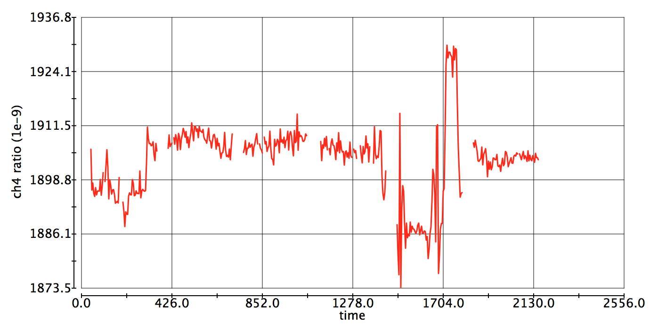
NetCDF4 file of gas concentrations

Slide 5
GeoTIFF of classified landcover information

Slide 6
Please tell us how we did
Complete the survey at:
https://goo.gl/forms/7l4D3sUwfNy6w5u32
Data management information: https://daac.ornl.gov/PI/pi_info.shtml
Workshop presentations will be placed online: https://daac.ornl.gov/workshops/workshops.shtml

