Slide 1
Archiving data with ORNL DAAC
Debjani Deb, Alison Boyer, and Yaxing Wei
ORNL Distributed Active Archive Center (ORNL DAAC)
Environmental Sciences Division
Oak Ridge National Laboratory
Oak Ridge, TN
March 26, 2017

Slide 2
From the Scientist to the Archive
Data Discovery and Distribution
Re-Use
ORNL DAAC
Deposit
Project Planning
Data Collection
Data Analysis
Data Sharing
End of Project Archiving
Re-Purpose

Slide 3
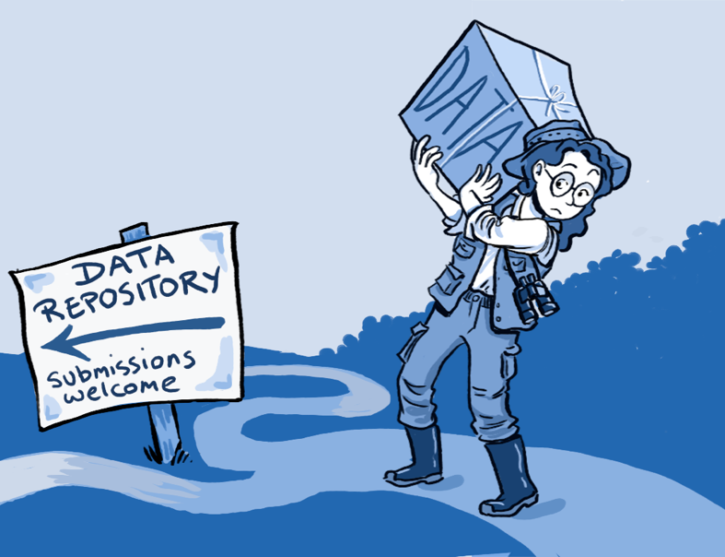
Why Publish?
Get credit for effort
Data citation
Digital Object Identifier (DOI)
Share data for larger synthesis activities
Measure impact of data
Citation statistics
Download statistics
Leverage DAAC curation and data services
Visualize
Subset
Access through Web services
OSTP memo – Increase access to Federally funded scientific research
By Roche DG et al. (2014) Troubleshooting Public Data Archiving: Suggestions to Increase Participation. PLoS Biol 12(1): e1001779. doi:10.1371/journal.pbio.1001779

Slide 4
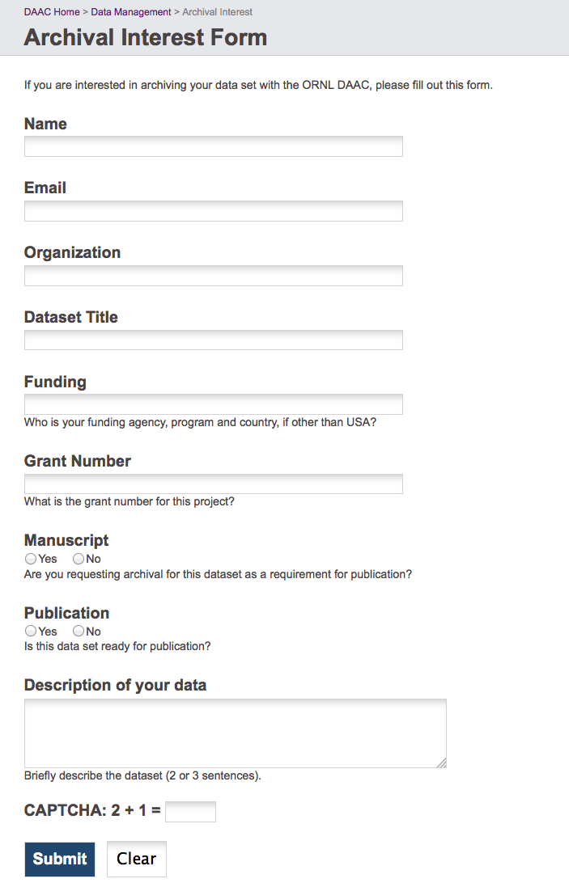
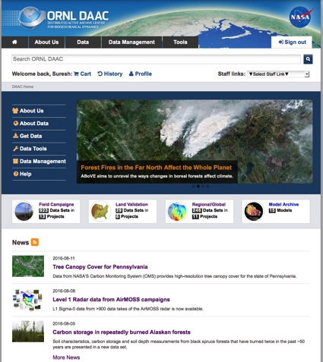
Steps to Archiving Data with ORNL DAAC
Step 1: Initiate Submission
http://daac.ornl.gov/archival_contact_form.html
Step 2: Submit Data
http://daac.ornl.gov/archival_contact_form.html
Step 3: Data Publication
Data Citation
Search Tools
Visualization
Web Services

Slide 5
Submitting Data to ORNL DAAC
Obtain an ORNL DAAC data set submission computer account
Answer the Data Provider Questions
Upload the contents of your data set via FTP client or command line syntax
Confirm that you have completed the upload of the contents of your data set submission
Track progress of your submission

Slide 6
What the ORNL DAAC expects for a data submission
Data files
Document(s) describing data
Supplemental files
Data provider questions

Slide 7
Data Provider Questions

Slide 8
Recommendations for Model Archival
Archiving a Benchmark Model
Model metadata (model name and version)
Source code
Associated documentation describing the application of the model
Example inputs and outputs
Archiving a Manuscript Model
Published manuscript
Source code
Model inputs
Provide all model inputs required to generate the key research results reported in the associated publication.

Slide 9
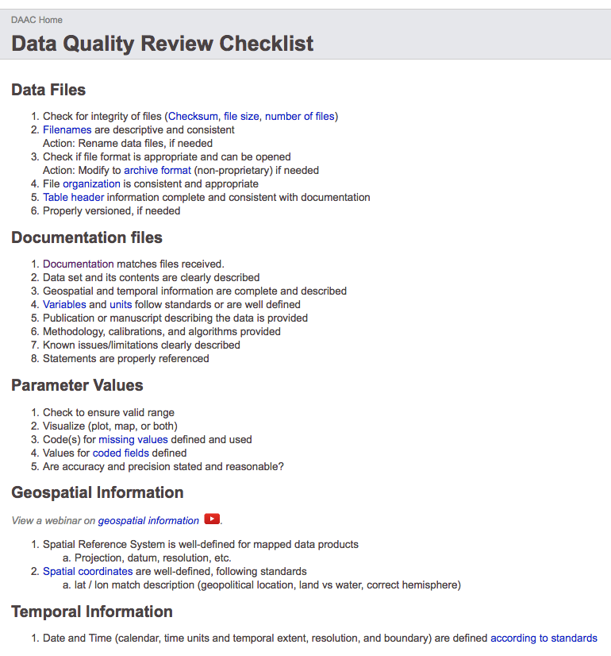
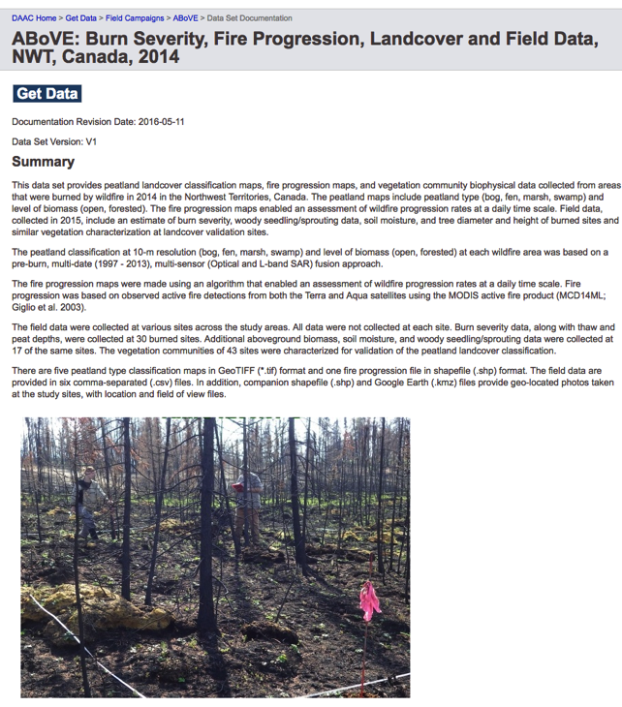
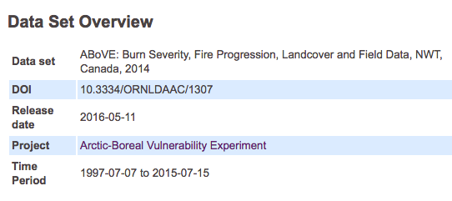
ORNL DAAC Curation Process
Notes:
Might consider telling participants what criterion are examined to determine whether data is accepted to ORNL DAAC or not. Does the data remain property of investigator? Or does the data become ORNL DAAC data?

Slide 10
Progress Tracker

Slide 11
We Support Investigators/Authors with their journal publications
Notes:
Some journals require that data products used and referenced in a manuscript have a DOI. The DOI indicates that a data center is involved in the publication process.
Minimally, a DOI is assigned (reserved) and a proper citation is available for inclusion in the submitted manuscript.
Maximally, the journal wants the DOI – citation to be minted and resolve to data products for use with manuscript review.
With timely communication with the Investigator, we can meet their needs.

Slide 12
Challenges that we face
Better documentation
Tabular data
need columns re-ordered, columns renamed, and dates reformatted
Spatial Data
attributes not defined, projection issues, no-data value problems
proprietary formats and formats that are not friendly for archiving and distribution

Slide 13
Contact us
ORNL DAAC: https://daac.ornl.gov
Debjani Deb: debd@ornl.gov

