Slide 1


Elements of a Data Management Plan
Alison Boyer
Environmental Sciences Division
Oak Ridge National Laboratory
Notes:
20 minutes; look at beginning of ESA workshop talk too
USGS.gov/datamanagement → advice for DMPs.

Slide 2
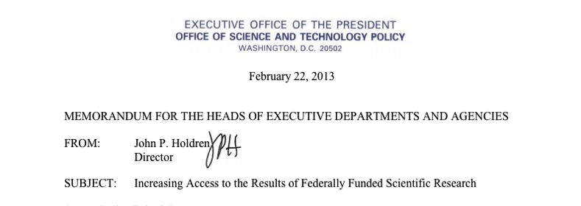
Changes in data management requirements
US Government policy on open data
NASA data policy
  open sharing and no period of exclusive use
Scientific journals (Nature, Science, PLoS, and Ecological Society journals ) have data sharing requirements.
Many funders are requiring that each proposal contain a short Data Management Plan (~2 pages)
2
Notes:
Over the past few years there has been an increasing recogniztion of the importance of research data
US Government has been working toward a policy on open data, culiminating in this February 2013 policy on open data
Agencies have data policies that encourage sharing: NASA has long has a policy of unrestricted access to data and other agencies do as well.
Scientific journals have a requirement to make the data available to readers, often via an data archive
Many funders are requiring that each proposal contain a short Data Management Plan (~2 pages)
Idea is that peer review will help select excellent science with excellent data management activities
What I will do is provide some information about the contents of a data management plan

Slide 3
Benefits of Good Data Management
Short-term (during your project)
Spend less time doing data management and more time doing research
Collaborators can readily understand and use data files
Long-term (after your project)
Scientists outside your project can find, understand, and use your data
You get credit for archived data products and their use in other papers
Sponsors protect their investment

Slide 4
Topics
What is a Data Management Plan?
Components of a Data Management Plan
Example Data Management Plan
Resources
4

Slide 5

“A goal without a plan is just a wish.”
Larry Elder
What is a Data Management Plan?
A document that describes what data you will collect and what you will do with your data during and after your research
5
Notes:
A DMP is a formal document that outlines what you will do with your data during and after your research. This ensures that your data will be safe now and in the future.
This talk describes how to prepare a Data Management Plan

Slide 6


Data Management Plan should contain:
Information about the data
    Description of data to be produced
    How will it be managed in short-term?
Description of Data
    Format, number of files, approx. volume
    Processing and quality
Metadata Content & Format
      Documentation about the data
Policies for Access, Sharing, & Reuse
Long-term Storage & Data Management
  Where will data be archived?
Remember to include data mgmt. costs in Proposal Budget
Detailed Template:
daac.ornl.gov/PI/plan.shtml
6
Notes:
There are many different types of data that may be produced by a research study. Consider this list when describing data that will be produced by the project

Slide 7

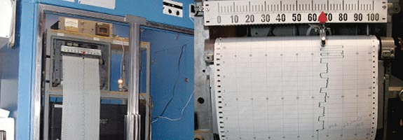
Example Data Management Plan
Mauna Loa CO₂ Record
Example, based on the work of CD Keeling & colleagues
Hypothetical DMP for 2015 - 2018
Study the controls on the concentration of atmospheric CO₂
  high precision and accuracy measurements
Courtesy of NOAA/ESRL,
Photographs by Forrest Mims III
http://daac.ornl.gov/PI/DMP_MaunaLoa_20110523.pdf
7
Notes:
http://www.esrl.noaa.gov/gmd/obop/mlo/pictures/sunsetmaunaloa1.jpg
http://www.esrl.noaa.gov/gmd/obop/mlo/pictures/scripts.jpg

Slide 8
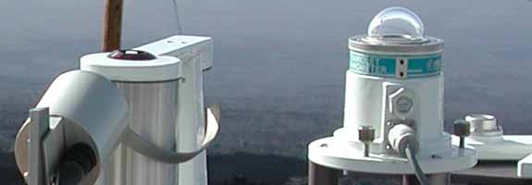
Mauna Loa Example Data Management Plan
1. Information About Data
Collected continuously at five towers
  a central tower and four towers located at compass quadrants.
Raw data files contain continuously measured CO₂ concentrations, calibration standards, references standards, daily check standards, and blanks.
  Site conditions will also be noted and retained.
Final data product will consist of 5-minute, 15-minute, hourly, daily, and monthly average atmospheric concentration of CO₂, in mole fraction in water-vapor-free air
Data managed at Scripps Institute of Oceanography
  Back-up daily
Courtesy of NOAA/ESRL,
Photographs by Forrest Mims III
8
Notes:
Collecting gas samples continutouslyRaw data contains the gas concentrations plus calibration standards, reference standards, daily check standards
Raw data and then averaged at several different time
http://www.esrl.noaa.gov/gmd/obop/mlo/pictures/sunsetmaunaloa1.jpg
http://www.esrl.noaa.gov/gmd/obop/mlo/pictures/scripts.jpg
http://www.esrl.noaa.gov/gmd/obop/mlo/pictures/sunsensor.jpg

Slide 9
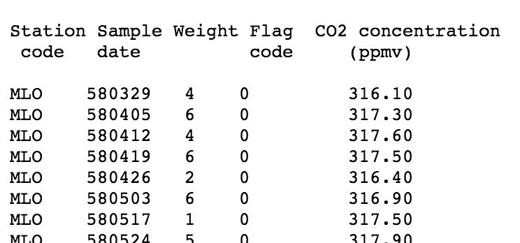
2. Description of Data
Observations in comma-separated-values in ASCII format
Standard gas information
Processing: Samples located at compass quadrants that will be used to correct for non-maritime sources

Slide 10
Mauna Loa Example Data Management Plan
3. Metadata Content & Format
Metadata formats provide a full explanation of the data (text format) and ensure compatibility with international standards (xml format)
Metadata
  contextual information about the data in a text based document
  standard metadata (e.g., FGDC, ISO 19115) in an xml file
10

Slide 11
Mauna Loa Example Data Management Plan
4. Policies for Access, Sharing, & Reuse
Product released when the samples checked against standard gasses and corrections applied (~six months)
No period of exclusive use by the data collectors
Users can access documentation and final aggregated CO₂ data files via the Scripps CO₂ Program website ( http://scrippsco2.ucsd.edu )
Raw data will be maintained and made available on request
11

Slide 12
Mauna Loa Example Data Management Plan
5. Long-term Storage & Data Management
Final data product will be available for use by the research and policy communities in perpetuity.
Raw supporting data and metadata will be available for use by researchers to confirm the quality of the Mauna Loa Record.
Long-term stewardship and curation at the Carbon Dioxide Information and Analysis Center (CDIAC), Oak Ridge National Laboratory.
Data product citation, including DOI:
  Keeling, CD, at al., 2004. Atmospheric CO2 Concentrations - Mauna Loa Observatory, Hawaii, 1958-2003. Numeric Data Package. Available on-line [http://cdiac.ornl.gov] Carbon Dioxide Information Analysis Center (CDIAC), Oak Ridge National Laboratory, Oak Ridge, TN, USA. doi: 10.3334/CDIAC/atg.ndp001
12
Notes:
including DOI, that indicates the version of the Mauna Loa Data Product and how to obtain a copy of that product.
Data available at CDIAC so that interested users can discover the Mauna Loa CO2 record along with other related Earth science data.

Slide 13
Budget for Data Management
Request funds specifically for data management
Costs of preparation and documentation
  Personnel
  Hardware
  Software

Slide 14
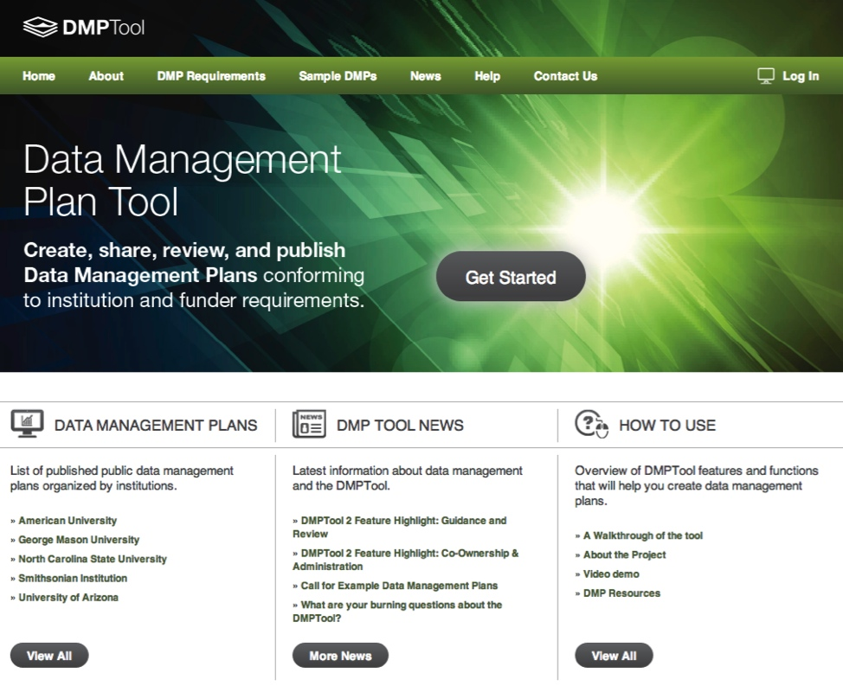









Resources: DMPTool
On-line editor for creating
DMPs
22 funder templates
Institutional resources and advice
7,200 registered users from 1,000 institutions
http://dmptool.org
Step-by-Step
Create, edit, share,

Slide 15
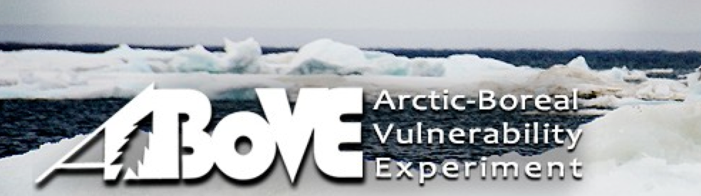

Resources
http://above.nasa.gov/2014_NRA/data_management_plan.html
http://www.usgs.gov/datamanagement/

Slide 16
References and Resources
daac.ornl.gov/PI/plan.shtml
Elements of a Data Management Plan
Annotated Template
Example Data Management Plans from successful NASA proposals
Links to other Data Management Plan resources
Best Practices for Managing Data

