Slide 1

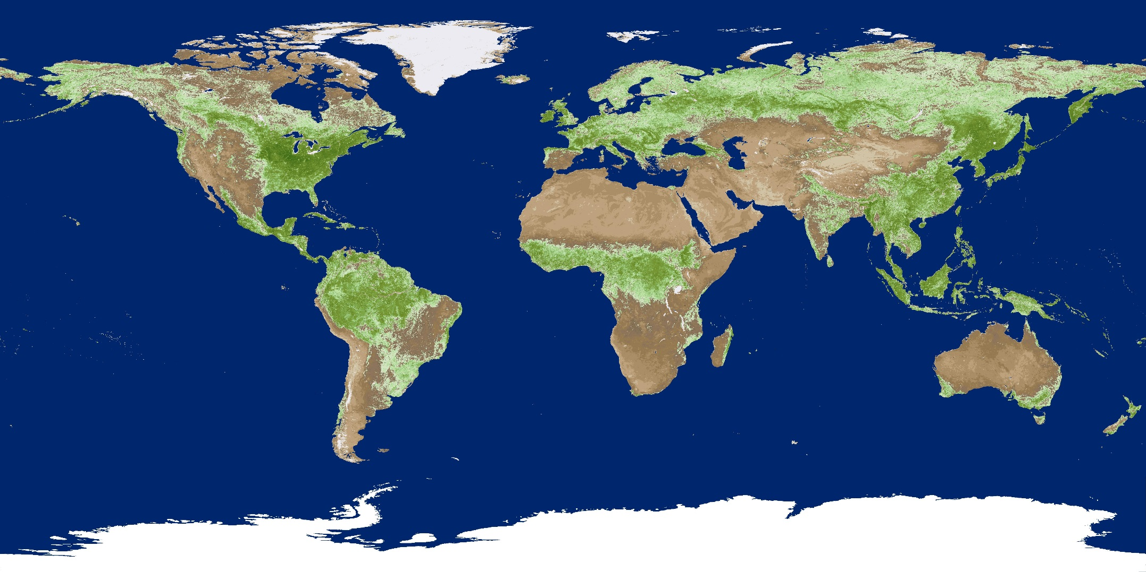
LP DAAC Data, Tools, and Services
ESA 2017 Workshop 55:
Ecology from Space: How Can NASA Remote-Sensing Data Inform Your Research?
Thursday, August 10th
Cole Krehbiel
LP DAAC Remote Sensing Scientist
Cole.Krehbiel.ctr@usgs.gov
Innovate!, Inc., contractor to USGS EROS
Sioux Falls, South Dakota
*Work performed under USGS contract G15PD00766
U.S. Department of the Interior
U.S. Geological Survey
Notes:
Good Morning, my name is Cole Krehbiel and I am a Remote Sensing Scientist working as a contractor to NASA’s Land Processes Distributed Active Archive Center, or LP DAAC.

Slide 2
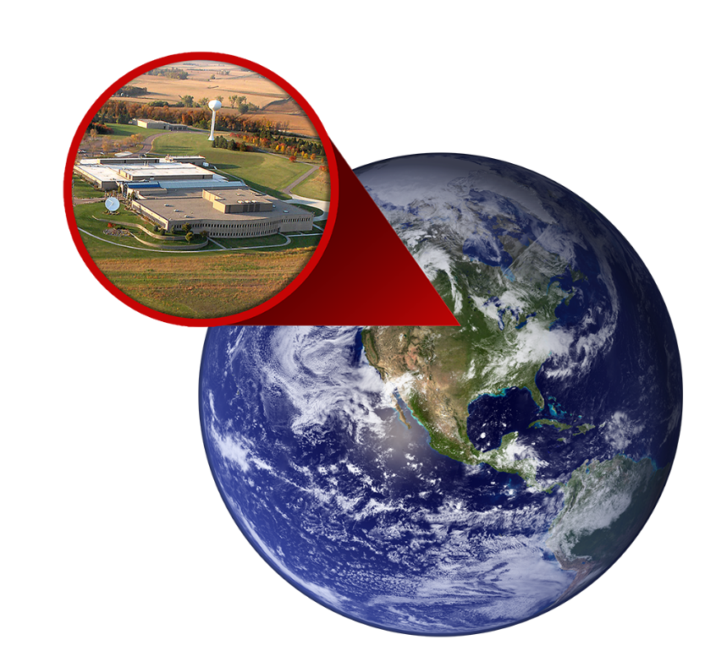
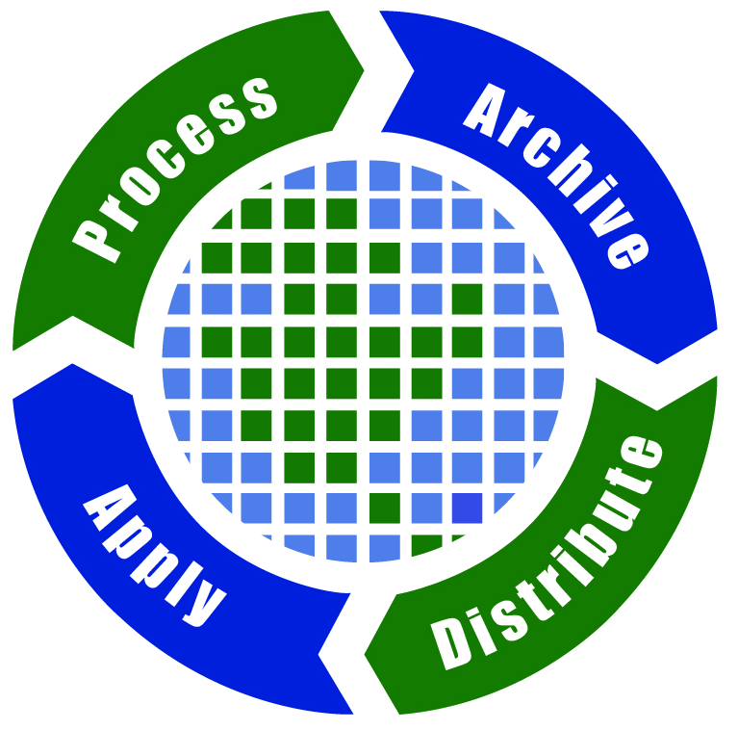

NASA’s LP DAAC
Land Processes (LP) Distributed Active Archive Center (DAAC)
  https://lpdaac.usgs.gov
Located in Sioux Falls, SD at the U.S. Geological Survey (USGS) Earth Resources Observation and Science (EROS) Center
1 of 12 NASA Earth Observing System Data and Information System (EOSDIS) DAACs
Part of NASA’s Earth Science Data Systems Program
Notes:
So, NASAs Land Processes Distributed Active Archive Center or LP DAAC is located in Sioux Falls, SD at the USGS Earth Resources Observation Science Center or EROS. It is one of 12 NASA DAACs, part of NASA’s Earth Science Data Systems Program. Our four main objectives are to process, archive, distribute and apply NASA land data products.

Slide 3
Overview of LP DAAC Resources:
Vegetation Indices and Phenology (VIP) Product
E-Learning (R and Python Tutorials)
  https://lpdaac.usgs.gov/user_resources/e_learning
Hands-on AppEEARS Demo
  https://lpdaacsvc.cr.usgs.gov/appeears
Notes:
Today I want to provide an overview of three LP DAAC resources. First I will go over a newly available data product that I think will be of interest to ecologists. Next, I will demonstrate where to find E-learning materials such as R and Python tutorials for working with LP DAAC data on our website. Lastly, I will walk everyone through the Application for Extracting and Exploring Analysis Ready Samples, or AppEEARS. I encourage everyone to follow along on their own computers for the LP DAAC website and the AppEEARS web application demos.

Slide 4
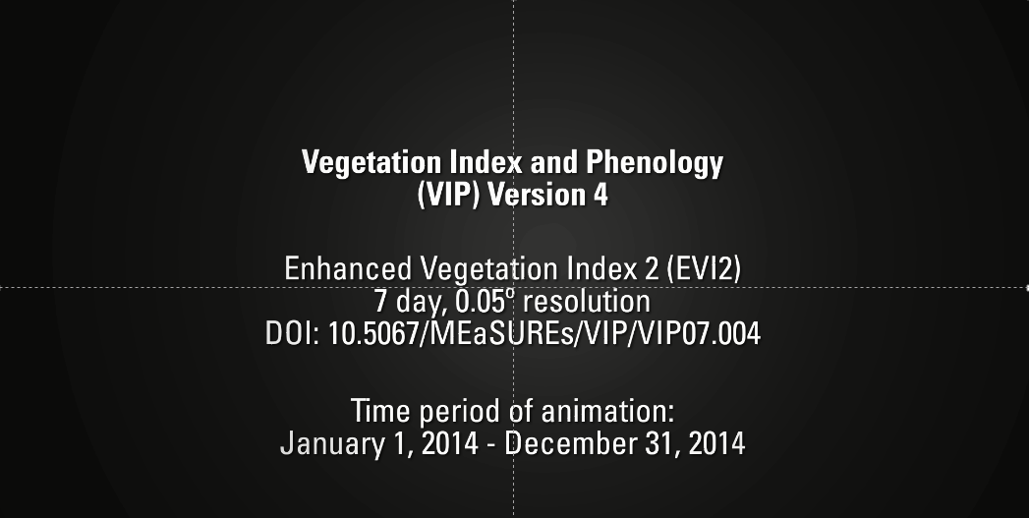

Notes:
We will cover many LP DAAC datasets when we look at AppEEARS in a little bit, but first I wanted to introduce you to a product that is not currently available in AppEEARS, but may be of interest to the ecology community.
On September 20th 2016 the LP DAAC released the NASA Making Earth System Data Records for Use in Research Environments or MEaSUREs) Vegetation Index and Phenology Collection. [TAB]
The VIP collections comprise 34 years of a consistent global record with sensor-independent Earth System Data Records (ESDR) for vegetation indices and landscape phenology.
Here we are looking at a global Animation of the weekly Enhanced Vegetation Index 2 product for 2014, showing global seasonality.
The VIP collections are based on MODIS, Advanced Very High Resolution Radiometer or AVHRR, and SPOT data inputs.
The Collection includes CMGs at daily, weekly, bi-weekly, monthly, and yearly temporal resolutions.
The data are available through Data Pool, Reverb, and Earthdata Search client.
VIP Data are available from 1981 to 2014.

Slide 5
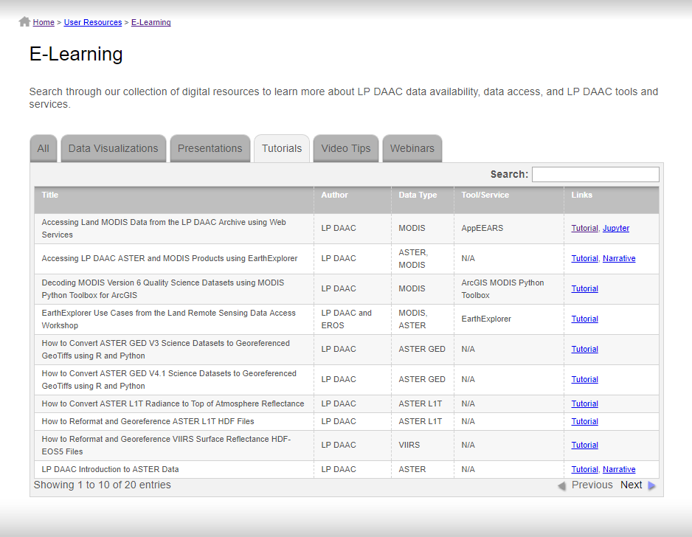
Notes:
NOTE: I Plan to just talk on the E-Learning pages on the actual website, but as a draft I wanted to give a little context of what I will say using some screenshots.
Next I wanted to show you the E-learning section of the LP DAAC website, where you can find available resources for accessing and processing LP DAAC data. So if we go to the LP DAAC website and hover over user resources, we can see our E-learning section. Our E-learning materials include Data Visualizations, past presentations, tutorials, Video Tips, and Webinars. [TAB] So if I click on the Tutorials tab, you can see here we have tutorials available for working with LP DAAC data. Most of these are written in both R and Python. R and Python tutorials are available for working with ASTER GED and ASTER L1T data, as well as the newly released VIIRS Surface Reflectance products. I also want to point out our MODIS Quality decoder tool, which is an ArcGIS toolbox that decodes MODIS quality information. For a more thorough explanation of these tutorials, we can click over to the webinars tab [TAB], and use the search functionality to search for a NASA Earthdata Webinar that my colleague Aaron Friesz and I recently gave that provides more in-depth demonstrations of our available R and Python tutorials for working with land remote sensing data products.
(Click on new ASTER tutorial) Here is an example of our newest tutorial that demonstrates how to work with ASTER L1T data in R.
(Go to ASTER L1T Page). If you are interested in E-learning materials for a specific product, you can find which of our materials relates to your product of interest by finding the E-learning table at the bottom of the product page for your given product of interest.

Slide 6
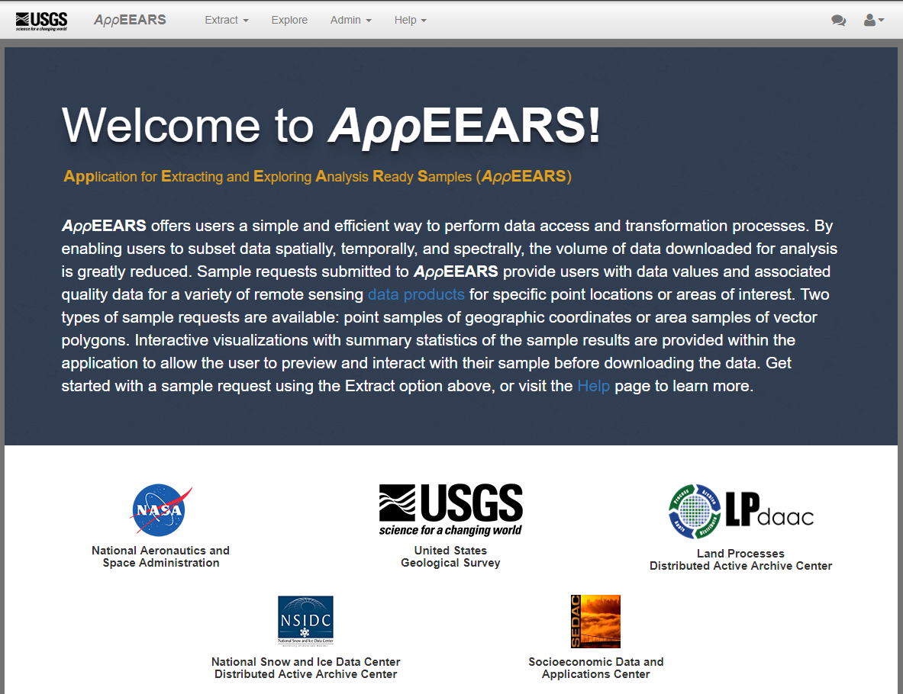
Notes:
NOTE: I Plan to just talk on the AppEEARS landing page on the actual website.
So lastly I will be discussing the Application for Extracting and Exploring Analysis Ready Samples, or AppEEARS. AppEEARS is a web application interface for accessing, extracting, and exploring NASA datasets. One of the goals of AppEEARS is to improve interoperability and usability of Big Earth Data. AppEEARS makes it easier for ecologists, or anyone for that matter, to access and synthesize remote sensing data into their research.
AppEEARS allows users to subset data by selecting their time period of interest, either point locations or a spatial region or interest, and products and layers of interest. So, by now I am sure you are all wondering what data are in AppEEARS? We can click on this link here to view our available products. Currently we provide MODIS Terra, Aqua, and Combined land products for version 5 and version 6. These include datasets such as MODIS surface reflectance, land surface temperature, vegetation indices, land cover type, leaf area index, fpar, and gross and net primary productivity, among others. We also have snow cover products from the National Snow and Ice Data Center. In addition to MODIS land products, we have the Shuttle Radar Topography Mission or SRTM version 3 Digital elevation models, available at 30 and 90 m resolution. We also have Web-Enabled landsat Data and recently added Gridded Population of the World or GPW version 4 data from the Socioeconomic Data Archive Center. If you want to learn more about a specific product, you can click on the link attached to the product name and it will take you to the product page which will provide a more in-depth explanation of what that product is.
From here: dive into demo of Area and then when I wrap things up in conclusion I will point out “also be sure to check out our documentation under the help page, which provides step-by-step guidance of working with AppEEARS as well”.
I found an interesting study on bird ecology for NPS units in Oregon/NoCal that should fit in perfectly with the crowd/location, and the study used LAI/FPAR from LP.

Slide 7
Use Case #1: Bird Communities and Environmental Correlates in S. Oregon and N. California
Based on: Stephens, J. L., Dinger, E. C., Alexander, J. D., Mohren, S. R., Ralph, C. J., & Sarr, D. A. (2016). Bird communities and environmental correlates in southern Oregon and northern California, USA. PloS one, 11(10), e0163906.
Studied avian community ecology & how it relates to climate, geography, & vegetation metrics in 6 National Park Service Units in Oregon/California
AppEEARS Request Parameters:
Input: Shapefile containing 6 NPS Units defined in study
Temporal Range: 2011-2013
Datasets:
  Combined MODIS Land Cover Type (MCD12Q1 v51)
    Layer: Land_Cover_Type_1
  SRTM Digital Elevation Model (SRTMGL1 v3)
  Terra MODIS 8-day Land Surface Temperature and Emissivity (MOD11A2 v6)
    Layer: LST_Day_1km
  MODIS Combined 4-day Leaf Area Index/FPAR (MCD15A3H v6)
    Layers: Fpar_500m, Lai_500m
  Terra MODIS 8-day Thermal Anomalies & Fire (MOD14A2 v6)
    Layer: FireMask
Projection: Geographic Format: Net-CDF4
Notes:
So, for our demo, I thought it would be cool to use a relevant ‘real world’ use case. This is a recently published study that I found that was looking at avian community ecology and how it relates to climate, geography, and vegetation metrics for 6 national park service units in southern Oregon and northern California. So I went online and downloaded a shapefile of NPS Units boundaries, clipped out the 6 units used in the study, and drag and dropped them into AppEEARS. The study covered a wider range but here I decided to look at three years of data and set that as my temporal range. The study looked at the correlations between bird populations and metrics such as land cover type, elevation, temperature, Leaf area index and FPAR, and disturbances, so I chose datasets related to those climate, geography, and vegetation metrics as we can see here. I set my output reprojection to Geographic and then since there will be many files generated for this request I chose the NetCDF output format.

Slide 8
Questions?
User Services
  Voice: 605-594-6116
  Toll Free: 866-573-3222
  E-mail: lpdaac@usgs.gov
  Web: https://lpdaac.usgs.gov/
  Subscribe to our Listserv: https://lists.nasa.gov/mailman/listinfo/lpdaac
Thanks!
Notes:
Thank you all for your time. I am sorry that we had to rush through everything but I encourage everyone to check out our e-learning materials and start using AppEEARS. Thanks!

