Slide 1



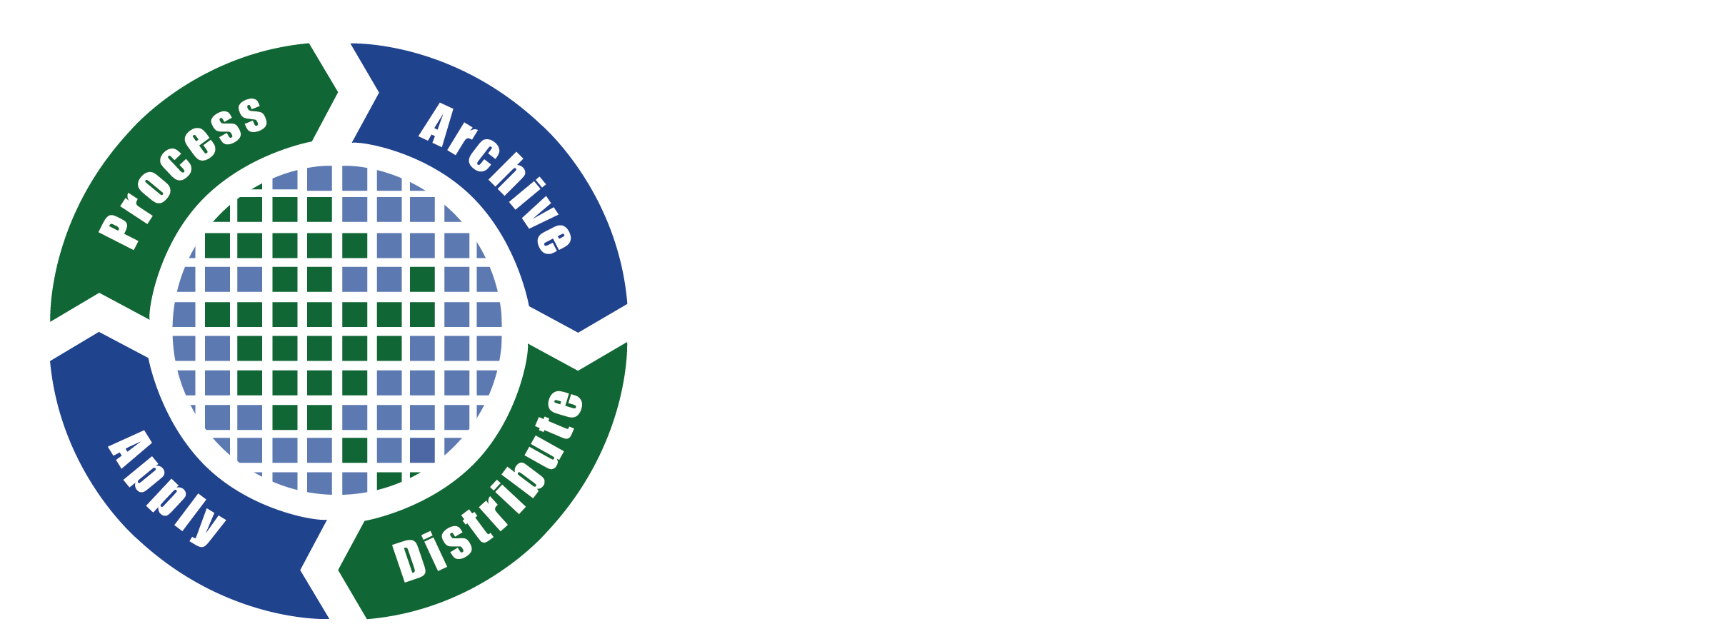
Workshop 55
Ecology from Space:
How Can NASA Remote-Sensing Data Inform Your Research?
Alison Boyer, Oak Ridge National Lab DAAC
Jennifer Brennan, NASA EOSDIS
Cole Krehbiel, Land Processes DAAC
Michele Thornton, ORNL DAAC
Pinki Mondal, SEDAC
Ecological Society of America Meeting, Portland, OR
August 10, 2017

Slide 2
Workshop Goals
provide a beginner’s level introduction to NASA’s remote-sensing and ground-based ecological data
demonstrate user-friendly tools to access, subset, and visualize this data

Slide 3
Workshop Agenda
11:30 am | Introduction and Goals | Alison Boyer (ORNL DAAC)
11:35 am | NASA Earthdata Overview | Jennifer Brennan (NASA EOSDIS)
11:55 am | Land Processes DAAC Data, Tools, and Services | Cole Krehbiel (LP DAAC)
12:15 pm | Ecological and Climate Data from ORNL DAAC | Michele M. Thornton & Alison Boyer (ORNL DAAC)
12:40 pm | Socioeconomic Data and Applications | Pinki Mondal (SEDAC)
1 pm | Q&A session
1:15 pm | Adjourn
Follow along at the workshop website: http://www.goo.gl/J1Hm7X

Slide 4
NASA data informs Ecology
Acta Oecologica
Biogeosciences
Canadian Journal of Forest Research
Change and Adaptation in Socio-Ecological Systems
Conservation Letters
Ecography
Ecological Applications
Ecological Monographs
Ecology
Ecology and Evolution
Ecosphere
Environmental Conservation
Fire Ecology
Forest Ecology and Management
Forest Science
Forests
Freshwater Biology
Global Change Biology
Global Ecology and Biogeography
Journal of Applied Ecology
Journal of Ecology
Journal of Plant Ecology
Movement Ecology
Nature
Philosophical Transactions of the Royal Society B: Biological Sciences
PLOS ONE
Proceedings of the National Academy of Sciences
In 2016, NASA Earthdata was used (and cited) in
> 750 papers
in more than 200 journals,
including …

Slide 5
NASA provides data on:
Climate
Carbon cycling and other nutrients
Fires
Agriculture
Land Use/Land Cover
Vegetation, Phenology, & Photosynthesis
Snow and Ice
Hazards and Disasters
Land Surface Elevation
Soil conditions and soil moisture
Even species distributions and vegetation inventories

Slide 6
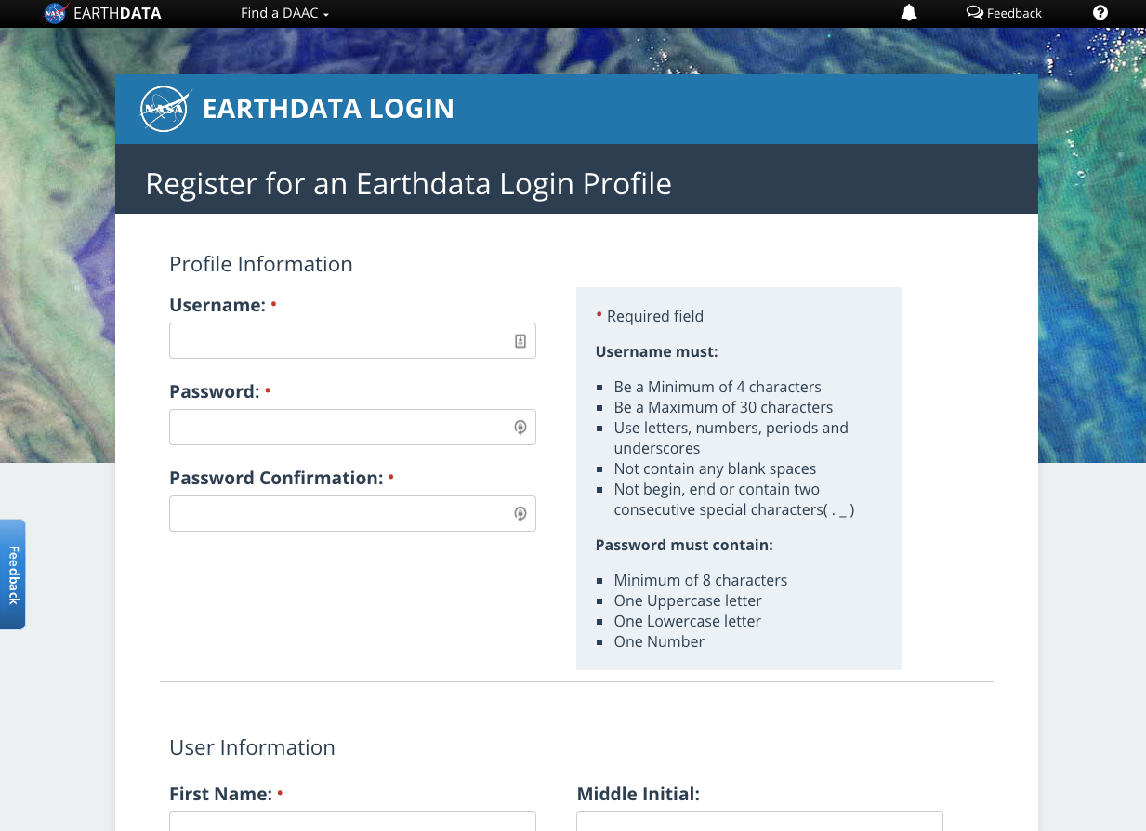
Accessing NASA Earthdata
Sign up for a (free) NASA Earthdata account
https://urs.earthdata.nasa.gov/users/new

