Slide 1
Preparing Spatial Data to Archive
Yaxing Wei
ORNL Distributed Active Archive Center
Environmental Sciences Division
Oak Ridge National Laboratory
Oak Ridge, TN
weiy@ornl.gov
CC&E Joint Science Workshop
College Park, MD
April 19, 2015

Slide 2

Presenter: Yaxing Wei
Geospatial Information Scientist at Oak Ridge National Laboratory Distributed Active Archive Center (ORNL DAAC)
Data Management for NACP
Spatial data management, Web-based spatial data distribution and visualization, data quality assurance and quality check (QAWC), …

Slide 3
Outline
Introduction to spatial data
Fundamental things for spatial data
  Where, when, what, how
Make better spatial data
  Choose appropriate format
  NetCDF and Climate & Forecast Convention
Tools for spatial data

Slide 4
Spatial Data
Data with “location” information
Majority of environmental data are spatial!

Slide 5
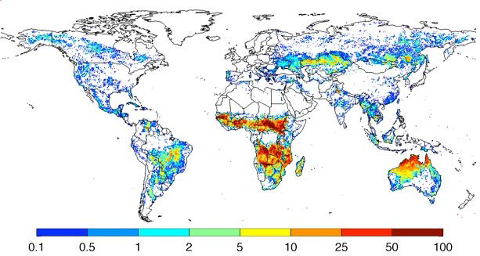
Environmental Data are Spatial
Annual burned area (as percentage of the area of the grid cell), averaged over 1997-2009

Slide 6
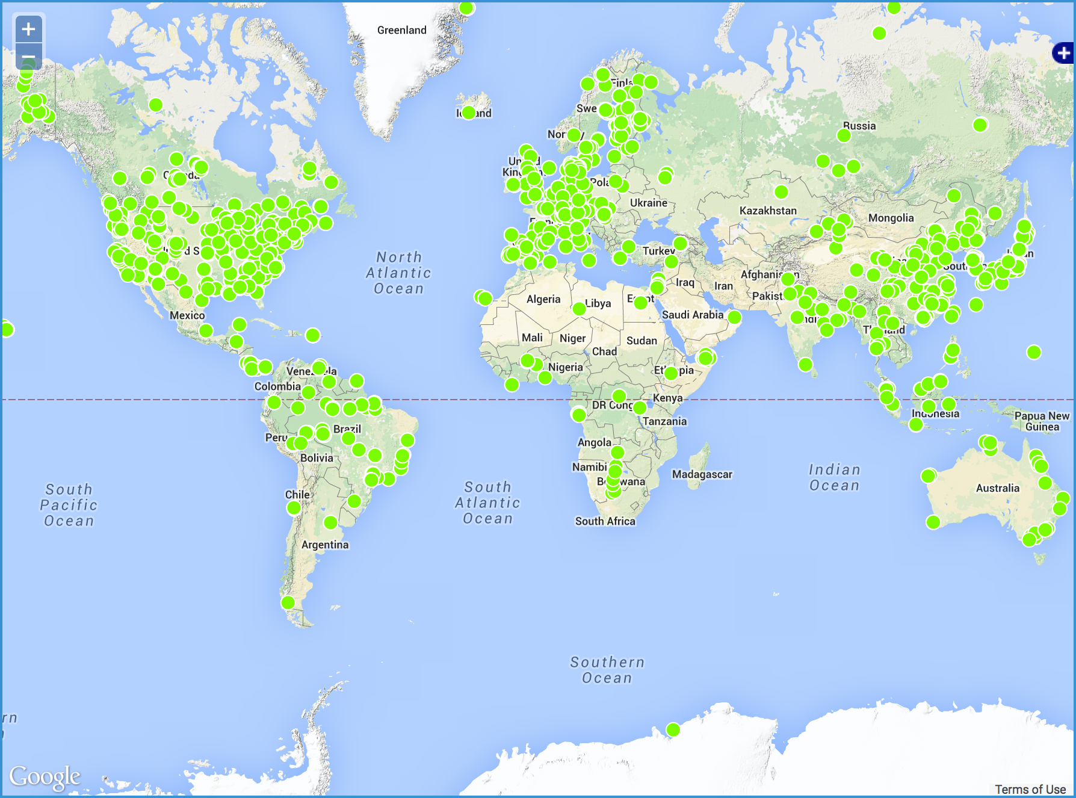
Environmental Data are Spatial
Locations of 5,173 soil respiration observations across the world

Slide 7
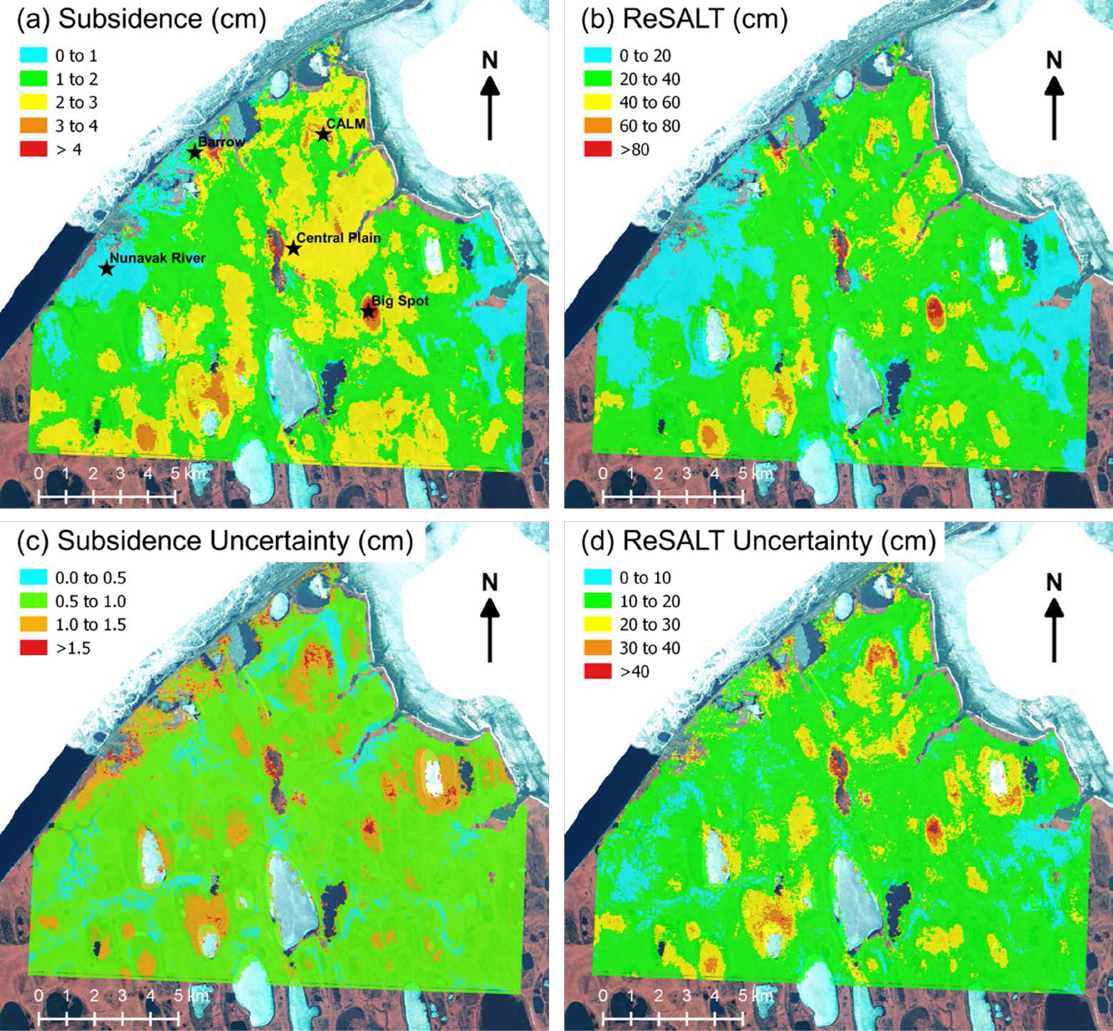
Environmental Data are Spatial
The remotely sensed seasonal subsidence, estimates of active layer thickness, and their associated uncertainties in Barrow, Alaska, 2006-2011.

Slide 8
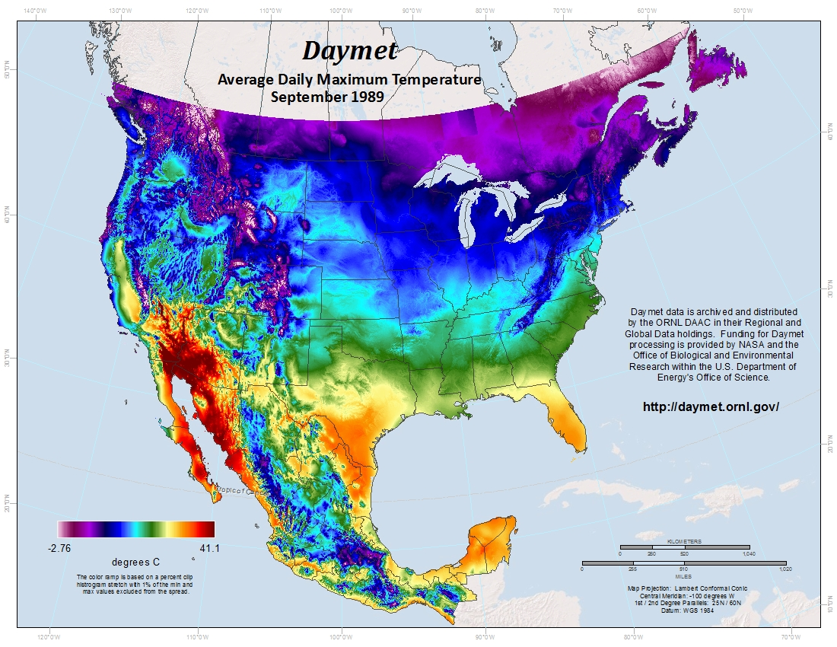
Environmental Data are Spatial
Daily Surface Weather Data on a 1-km Grid for North America

Slide 9

Issues with Spatial Data
Spatial data received from investigators are often not usable
Poorly documented
QA not finalized
Basic information about spatial data lacking or incorrect (projection, resolution, datum, & geo-rectification)
Data in proprietary format

Slide 10
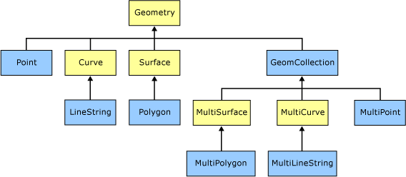
Types of Spatial Data
Feature (vector) data
  Geometry “object” with location and other properties
  AmeriFlux sites/instruments, river lines, ecoregion boundaries, etc.
  Coverage (raster) data
  “phenomenon” spanning spatial extent / temporal period
  AmeriFlux site GPP time series (1-D)
  one scene of MODIS LAI (2-D)
  global 1°monthly model output NEE (3-D)
Source: Microsoft

Slide 11
Fundamental Things for Spatial Data
Where: spatial information
  Spatial Reference System
  Spatial extent/boundary/resolution/scale
When: temporal information
  Calendar
  Time units & extent/resolution/boundary
What: data content
  Data format: structure & organization
  Variables, units, scale, missing value, valid range, …
How: data provenance
  History of data creation

Slide 12
Specify Spatial Information
Allow environmental data to be precisely positioned on the Earth and overlaid with each other
Two components
  Spatial coordinates
  Spatial Reference System (SRS)

Slide 13
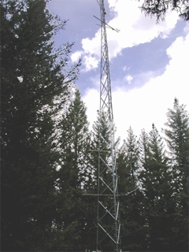
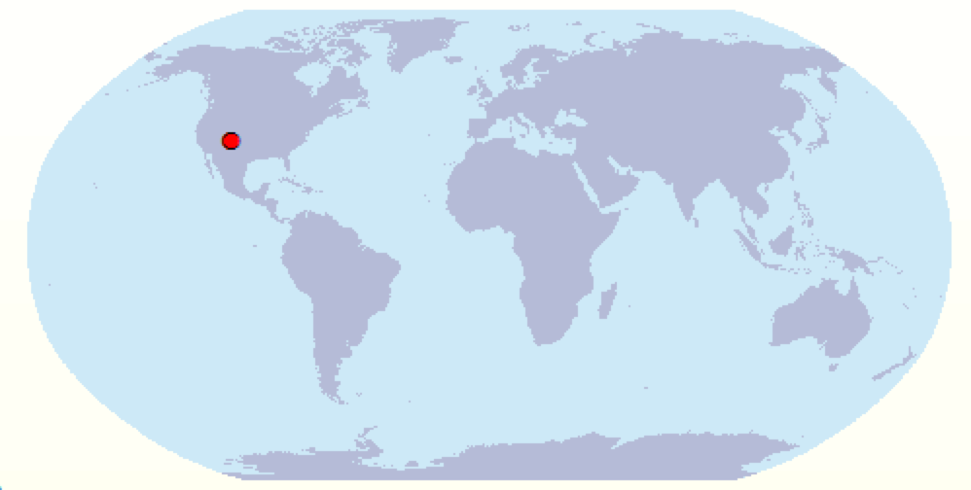
Spatial Coordinates (1)
Where is an AmeriFlux tower located?
  Valles Caldera Mixed Conifer / US-Vcm
    Latitude: 35.8884
    Longitude: -106.5321
    Elevation: 3003m
35.8884
100km
10km
1km
100m
10m

Slide 14
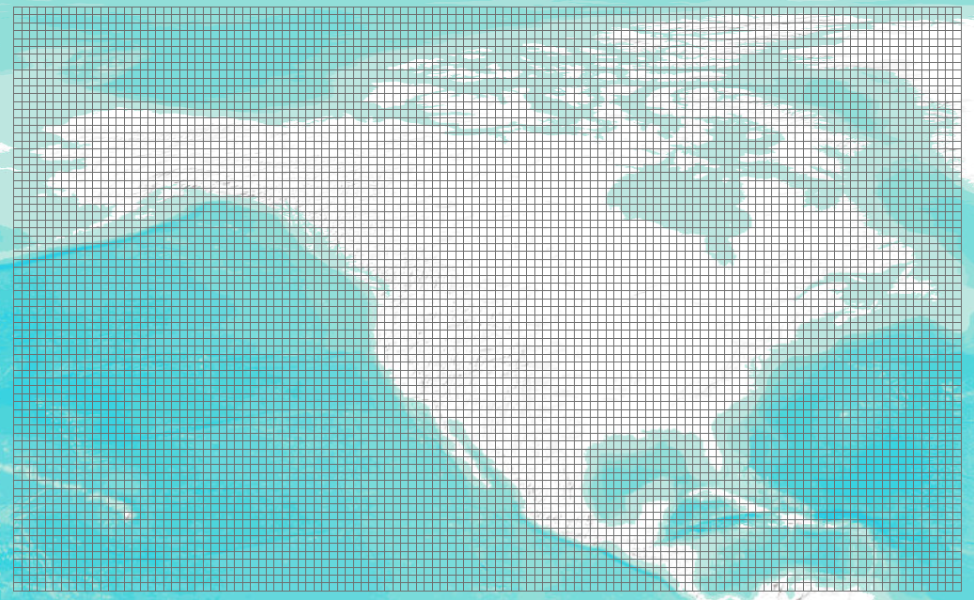
Spatial Coordinates (2)
Where do my data represent?
  NACP regional TBM output
    West: -170.0
    South: 10.0
    East: -50.0
    North: 84.0
    X-resolution: 1-degree
    Y-resolution: 1-degree

Slide 15
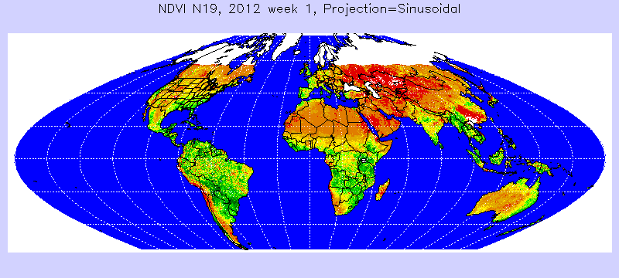

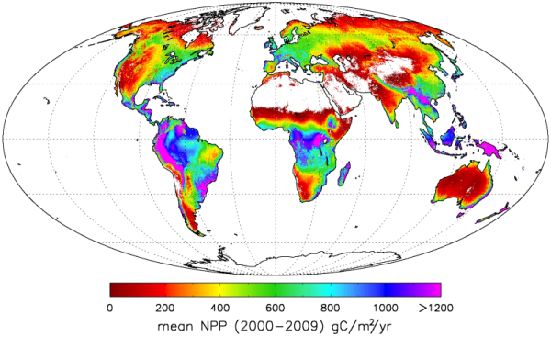
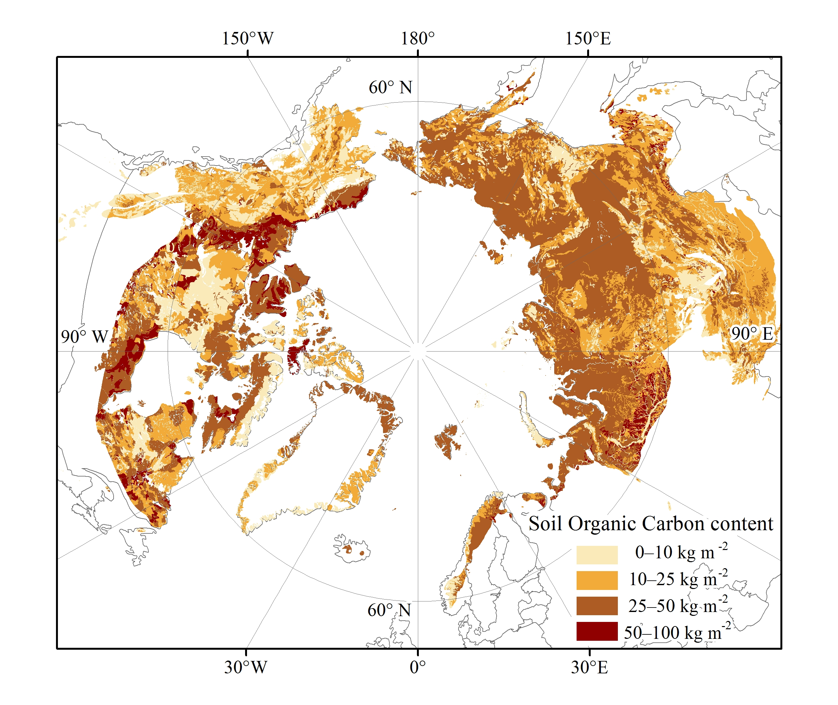
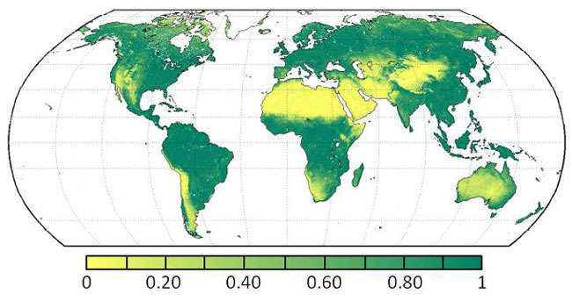
Spatial Reference System (1)

Slide 16
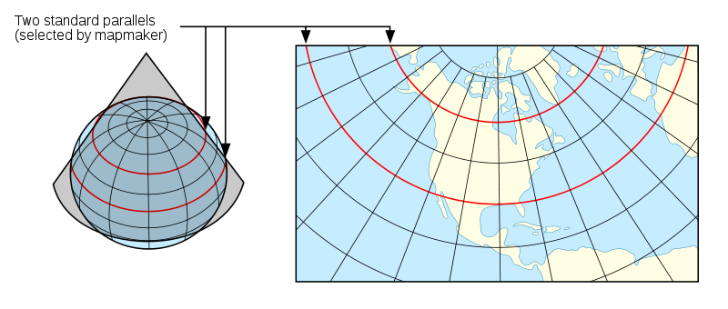
Spatial Reference System (2)
Framework to define positions on the Earth’s surface.
Projection: 3D Earth surface → 2D map
Many different projections
  Conformal: preserve angles locally
  Equal area: preserve area measure
  Equal distant: preserve distance from point/line
  Compromise: make things "look right"

Slide 17
Specify Temporal Information
Need to correctly and precisely specify:
Calendar
Overall start and end temporal representation of a data variable
Time point/period that each data value represents
Temporal frequency of a data variable

Slide 18
Calendar
  julian: one leap year in every 4 years
  gregorian: leap year if either (i) it is divisible by 4 but not by 100 or (ii) it is divisible by 400
  proleptic_gregorian: gregorian calendar extended to dates before 1582-10-15
  365_day: no leap year, Feb. always has 28 days
  360_day: 30 days for each month
  366_day: all leap years
  gregorian is the internationally used civil calendar

Slide 19
Time Point and Period
Specify the time a measurement was made
  “the measurement was made at 6 in the afternoon on March 22, 2010 and it took 1 hour 20 minutes and 30 seconds” - BAD
ISO 8601: representation of dates and times
  Time point: YYYY-MM-DDThh:mm:ss.sTZD
  (2010-03-22T18:00:00.00-06:00)
  Duration: P[n]Y[n]M[n]DT[n]H[n]M[n]S (PT1H20M30S)

Slide 20
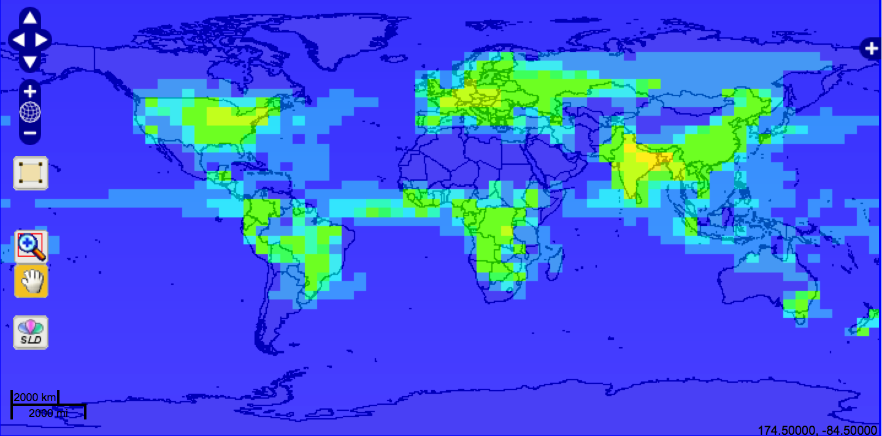
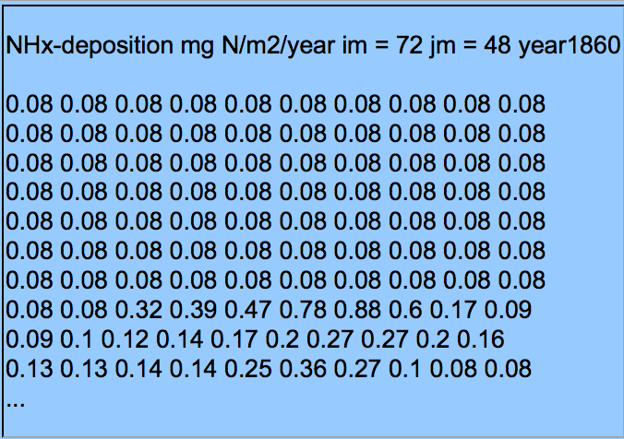
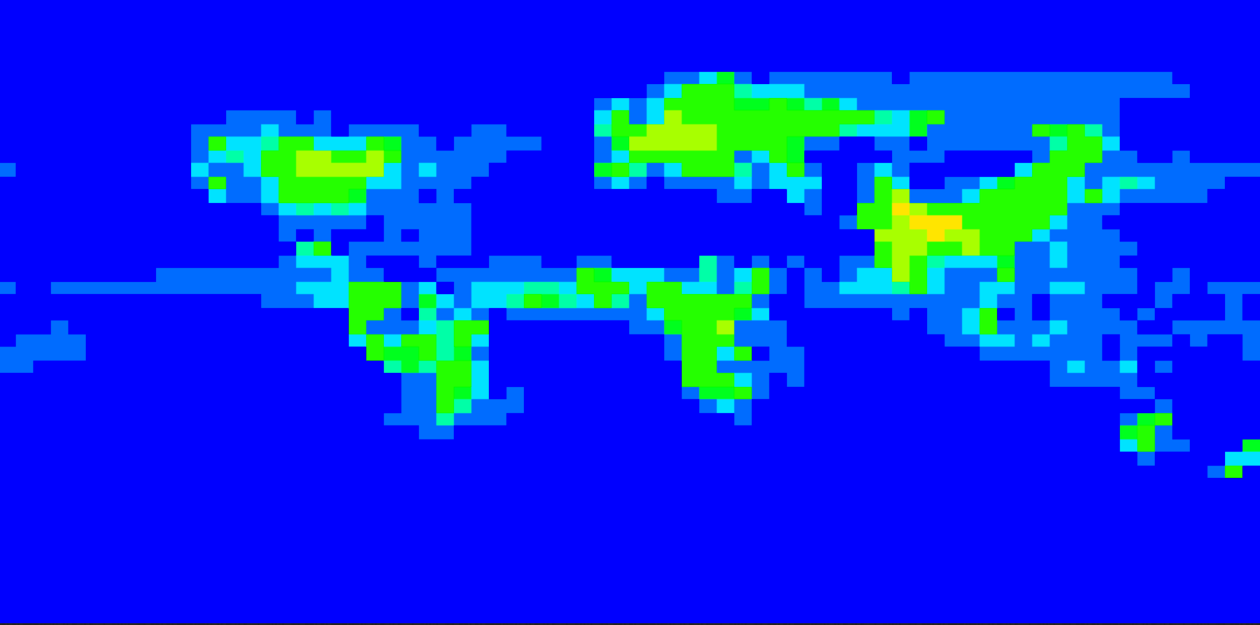
Perform Quality Assurance (1)
Mapping – overlay with common layers
Global Maps Of Atmospheric Nitrogen Deposition, 1860, 1993, and 2050

Slide 21
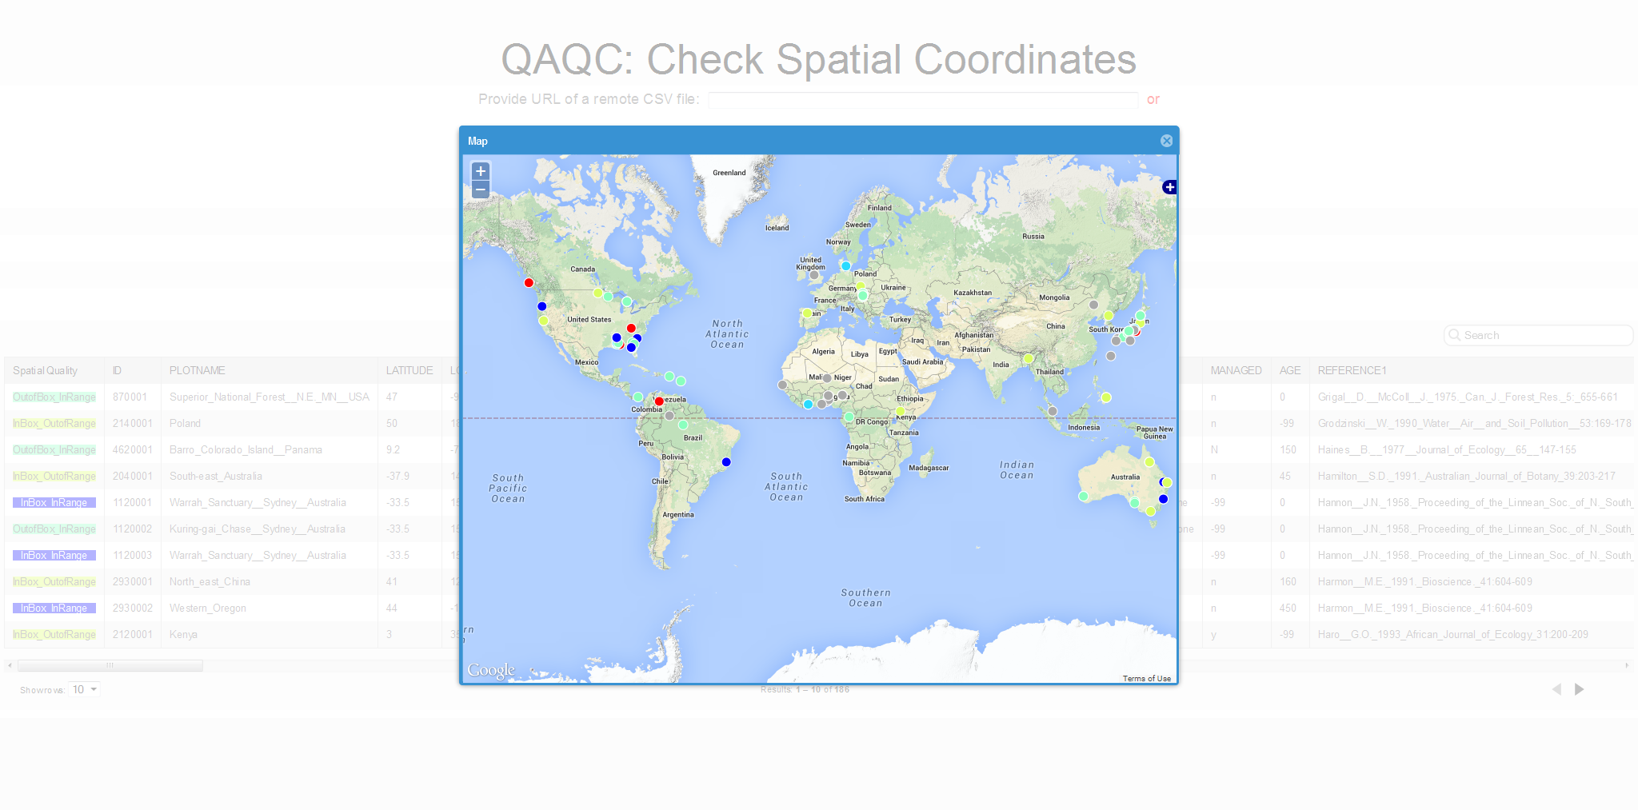
Perform Quality Assurance (2)
Geocoding – relate locations with place names

Slide 22
Perform Quality Assurance (3)
Time in Daymet
  Time information was messed up in the alpha release of Daymet data
  Daymet has data for 365 days in every year, so we thought it used the “365_day” calendar
  No! It has leap years. It removed December 31st instead of Feb 29th in leap years. We reset its calendar to “gregorian”

Slide 23
Make Better Spatial Data
Fundamental things have to be PROVIDED and CORRECT!
One step forward: choose “GOOD” formats.
Good spatial data shall be easy to understand and use by yourself, other researchers, and computer.

Slide 24
“Good” Data Formats
Open and non-proprietary
Easy to use, simple, and widely-supported
More importantly, self-descriptive
  Interpretive metadata is included inside data
Vector Data Formats
  ASCII/CSV
  Shapefile
  KML/GML
  ESRI Geodatabase
Raster Data Formats
  GeoTIFF
  CF-netCDF
  HDF/HDF-EOS

Slide 25
Choose File Format
Choose the most suitable format
  ASCII/CSV: suitable for representing tabular data such as field observations and site characteristics.
  Shapefile: most widely used open format for representing vector data.
  GeoTIFF: open and popular format for storing geospatial raster imageries.
  netCDF: open, self-describing, and ideal for storing multi-dimensional data and multi-variables.
  KML: open, standard, and rich visualization features

Slide 26
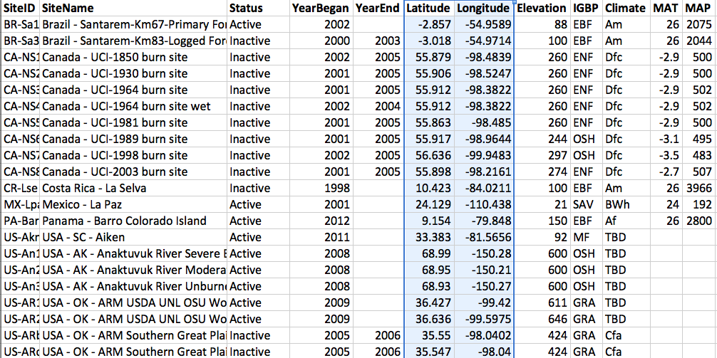
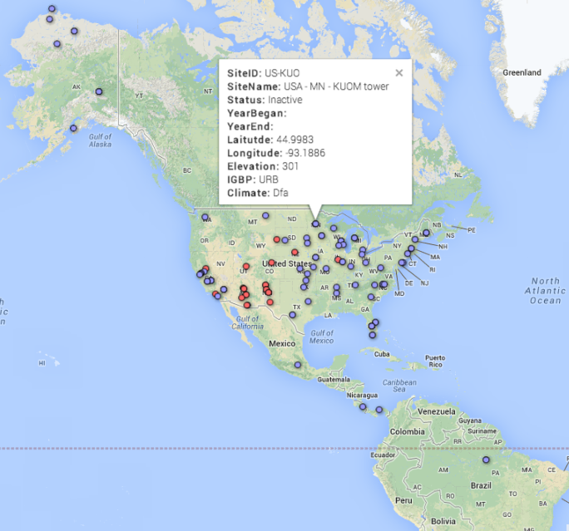

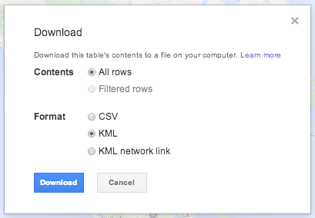

ASCII/CSV
Tabular data can be “spatial”
Good tabular spatial data can be easily understood, analyzed, and visualized
  Fusion Table

Slide 27
Climate and Forecast (CF) Convention
http://cfconventions.org
CF Standard Names (what)
CF metadata conventions
  Spatial/temporal coordinates (where, when)
  Cell boundaries/shape/methods (where, how)
  Missing data/valid range (what)
  Data units (what)
  History (how)
  Other attributes (what)

Slide 28
CF-NetCDF
NetCDF following CF conventions: perfect for climate change and earth system model data
  The NetCDF classic data model provides a clean way to organize multi-dimensional data
  NetCDF v4 supports internal compression and advanced data model
  NetCDF is supported by many tools: Matlab, IDL, Ferret, Python, NCO, Panoply, …
  CF makes data self-descriptive and analysis can be automated

Slide 29
Define Variable Names
CF Standard Name Table (v28)
  Contain 2362 of (name, description, units) in 9 categories: Atmospheric Chemistry, Atmosphere Dynamics, Carbon Cycle, Cloud, Hydrology, Ocean Dynamics, Radiation, Sea Ice, and Surface.
What if there is no CF standard name that describes your variable?
  Make your own: leaf_carbon_content -> leaf_nitrogen_content
  Make it a CF standard name

Slide 30
Structure of a common netCDF file
dimensions:
lat = 360 ;
lon = 720;
time = UNLIMITED ; // (365 currently)
variables:
double lat(lat) ……;
double lon(lon) ……;
double time(time) ……;
double var1(time, lat, lon) ;
var1:standard_name = “some_variable_standard_name”;
double var2(time, lat, lon) ;
var2:standard_name = “some_variable_standard_name”;
// global attributes:
….
data:
lat = -89.75, -89.25, -88.75, -88.25, -87.75, ……
lon = -179.75, -179.25, -178.75, -178.25, -177.75, ……
time = ……
var1 = ……
var2 = ……

Slide 31
Specify Spatial Info in NetCDF (1)
Provide cell center coordinates in Geographic Lat/Lon SRS and native SRS (if different)
variables:
double lat(lat) ;
lat:standard_name = "latitude" ;
lat:long_name = "latitude coordinate" ;
lat:units = "degrees_north" ;
double lon(lon) ;
lon:standard_name = "longitude" ;
lon:long_name = "longitude coordinate" ;
lon:units = "degrees_east" ;
data:
lat = -89.75, -89.25, -88.75, -88.25, -87.75, …
lon = -179.75, -179.25, -178.75, -178.25, -177.75, …

Slide 32
Specify Spatial Info in NetCDF (2)
Specify cell boundaries
  Left-right boundary
  Bottom-top boundary
double lat_bnds(lat=360, nv=2);
:units = "degrees_north";
double lon_bnds(lon=720, nv=2);
:units = "degrees_east";
double lat(lat=360);
:bounds = "lat_bnds";
:units = "degrees_north";
double lon(lon=720);
:bounds = "lon_bnds";
:units = "degrees_east";

Slide 33
Specify Temporal Info in NetCDF (1)
Specify calendar and time coordinates
dimensions:
time = UNLIMITED ; // (365 currently)
variables:
float time(time) ;
time:standard_name = "time" ;
time:calendar = "standard" ;
time:units = "days since 1980-01-01 00:00:00 UTC" ;
time:bounds = "time_bnds" ;
data:
time = 7305.5, 7306.5, 7307.5, …, 7668.5, 7669.5 ;
// time = "2000-01-01 12", "2000-01-02 12", "2000-01-03 12”, …, "2000-12-29 12”, "2000-12-30 12” ;
Calendar and time coordinates for Daymet data in 2000

Slide 34
Specify Temporal Info in NetCDF (2)
Specify time boundaries
1980
2010
start
middle
end

Slide 35
Specify Temporal Info in NetCDF (2)
Specify time boundaries
dimensions:
time = UNLIMITED ; // (365 currently)
nv = 2 ;
variables:
float time_bnds(time, nv) ;
time:long_name = "time boundaries" ;
time:calendar = "standard" ;
time:units = "days since 1980-01-01 00:00:00 UTC" ;
data:
time_bnds = {7305, 7306; 7306, 7307; …; 7669, 7670; }
// time_bnds = {"2000-01-01", "2000-01-02”; "2000-01-02", "2000-01-03”; …; "2000-12-30", "2000-12-31”; }
Time boundaries for Daymet data in 2000

Slide 36
Cell Methods
To describe the characteristic of a variable that is represented by grid cell values
  NARR dswrf: 3-hourly average, average across a 32km by 32km region
  NARR precip: 3-hourly accumulated, average across a 32km by 32km region
cell_methods
  “time: mean area: mean”
  “time: sum area: mean”
point
sum
maximum
median
mid_range
minimum
mean
mode
standard_deviation
variance

Slide 37
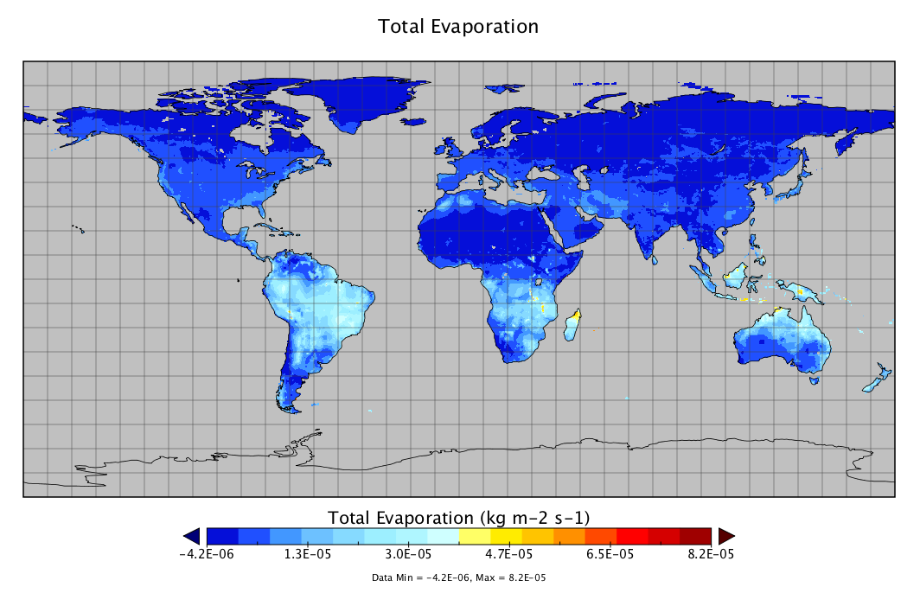
Missing Data
Use _FillValue, missing_value, valid_min, valid_max, and valid_range to indicate what values in a variable are considered to be valid or what values shall be ignored.
  float nbp(time=20, lat=74, lon=120);
  :_FillValue = -9999.0f; // float

Slide 38
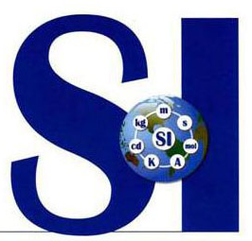
Data Units
UDUNITS
  Based on International System of Units
  Support conversion of unit specifications
  Support arithmetic manipulation of units
  conversion of values between compatible scales of measurement
Follow the rules and computers can then do a lot of work for you and others.
kg m-2 s-1
Kg/m2/month
kgC m-2 s-1
Units for Gross Primary Productivity (GPP)

Slide 39
General Attributes
title: description of what is in the dataset
institution: specifies where the data was produced
references: references that describe the data
source: the method of production of the original data
history: provenance of the data
comment: miscellaneous information
// global attributes:
:title = "CLM4 monthly GPP for MsTMIP RG1 global simulation" ;
:source = "CLM-CN v4.0" ;
:institution = "Oak Ridge National Laboratory" ;
:references = "Oleson K. W. et al., 2010, Technical description of version 4.0 of the Community Land Model (CLM) NCAR Tech. Note NCAR/TN-478+STR (Boulder, CO: National Center for Atmospheric Research)" ;
Attributes for Global Monthly GPP Output from CLM4 Model

Slide 40
Tools for Spatial Data
GDAL/OGR
  Allows you to convert data between over a hundred of raster/vector formats
  Allows you to reproject/subset/modify data
ncdump/ncgen
  Create/modify simple netCDF files via CDL
NCO
  Manipulate netCDF files easily
Panoply
  Nice viewer for netCDF, HDF and GRIB data files
Google Fusion Table

Slide 41
Summary
Provide spatial and temporal information completely and accurately
Choose good formats to organize the data content and make them self-descriptive
Provide interpretative metadata in standard ways
You will be returned a lot by doing this
  Your data will be easily understood by not only users but also computers
  A lot of data visualization and analysis can be automated
  Your data can be ingested into many existing Web services to provide on-demand data distribution to users
  Value of your data can be preserved longer into the future

