Slide 1



Fundamental Practices for Preparing Data Sets
Bob Cook
Environmental Sciences Division
Oak Ridge National Laboratory
5th NACP Principal Investigator’s Meeting
Washington, DC
January 25, 2015

Slide 2
Data centers use the 20-year rule
The data set and accompanying documentation should be prepared for a user 20 years into the future--what does that investigator need to know to use the data?
Prepare the data and documentation for a user who is unfamiliar with your project, methods, and observations
NRC (1991)

Slide 3
Fundamental Data Practices
Define the contents of your data files
Define the variables
Use consistent data organization
Use stable file formats
Assign descriptive file names
Preserve processing information
Perform basic quality assurance
Provide documentation
Protect your data
Preserve your data
Notes:
Main part of my talk will be to describe these 10 fundamental data practices. These are basic habits that will help improve the information content of your data and make it easier to share with others

Slide 4
1. Define the contents of your data files
Content flows from science plan (hypotheses) and is informed from requirements of final archive.
Keep a set of similar measurements together in one file
    same investigator,
    methods,
    time basis, and
    instrument
  No hard and fast rules about contents of each files.
Notes:
Researchers who later use your relatively large data file won't have to process many small files individually.

Slide 5

2. Define the variables
Choose the units and format for each variable,
Explain the format in the metadata, and
Use that format consistently throughout the file
Date / Time Example
  e.g., use yyyymmdd; January 2, 1999 is 19990102
  Report in both local time and Coordinated Universal Time (UTC) and 24-hour notation (13:30 hrs instead of 1:30 p.m.)
  Use a code (e.g., -9999) for missing values
Representation of dates and times

Slide 6
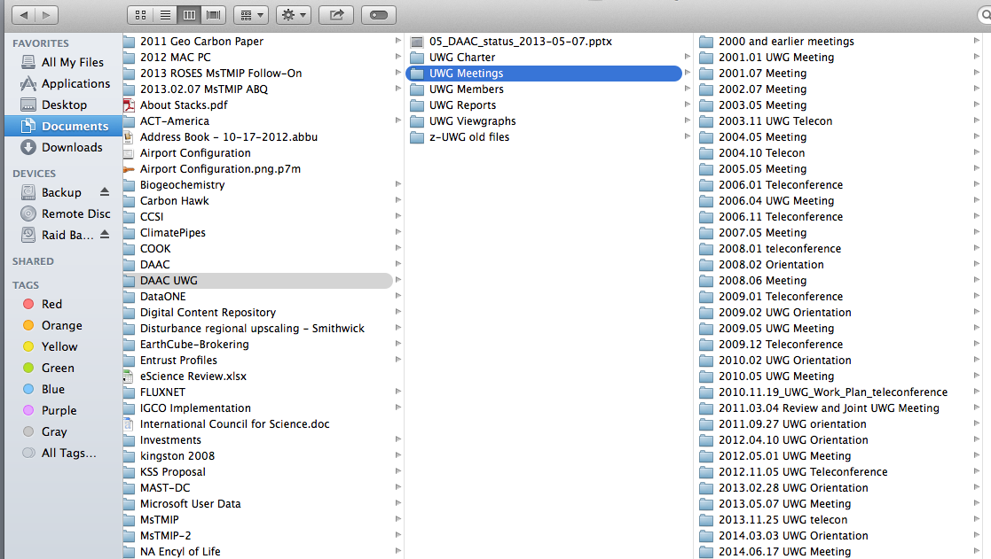
ISO Formatted Dates Sort Chronologically

Slide 7
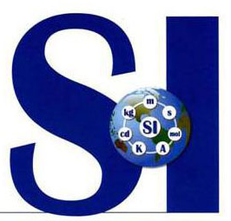

2. Define the variables (cont)
Use commonly accepted variable names and units
ORNL DAAC Best Practices (Hook et al., 2010)
  Additional examples of variable names, units, and their formats
Next Generation Ecosystem Experiment – Arctic
  Guidance for variable names and units
FLUXNET
  Guidance for flux tower variable names and units
International System of Units
UDUNITS
CF Standard Name
Climate Forecast (CF)
standards promote sharing
Unit database and conversion between units

Slide 8
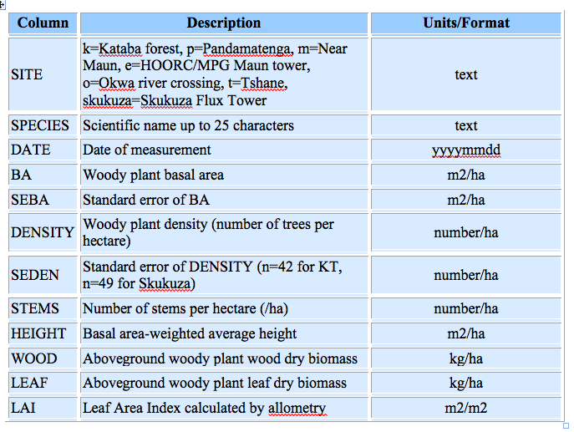
2. Define the variables (cont)
Variable Table
Be consistent
Explicitly state units
Use ISO formats
Scholes (2005)

Slide 9
2. Define the variables
Site Table
Site Name | Site Code | Latitude (deg ) | Longitude (deg) | Elevation (m) | Date
Kataba (Mongu) | k | -15.43892 | 23.25298 | 1195 | 2000.02.21
Pandamatenga | p | -18.65651 | 25.49955 | 1138 | 2000.03.07
Skukuza Flux Tower | skukuza | -31.49688 | 25.01973 | 365 | 2000.06.15
……
Scholes, R. J. 2005. SAFARI 2000 Woody Vegetation Characteristics of Kalahari and Skukuza Sites. Data set. Available on-line [http://daac.ornl.gov/] from Oak Ridge National Laboratory Distributed Active Archive Center, Oak Ridge, Tennessee, U.S.A. doi:10.3334/ORNLDAAC/777

Slide 10
3. Use consistent data organization (one good approach)
Each row in a file represents a complete record, and the columns represent all the variables that make up the record.
Station | Date | Temp | Precip
Units | YYYYMMDD | C | mm
HOGI | 19961001 | 12 | 0
HOGI | 19961002 | 14 | 3
HOGI | 19961003 | 19 | -9999
Note: -9999 is a missing value code for the data set
Notes:
Choose one way to organize your data and stick to that way throughout the file
Make month or site a variable and have all the data in one large file.
There is an upper limit to the size of files, though.

Slide 11
3. Use consistent data organization (a 2nd good approach)
Variable name, value, and units are placed in individual rows.
This approach is used in relational databases.
Station | Date | Variable | Value | Unit
HOGI | 19961001 | Temp | 12 | C
HOGI | 19961002 | Temp | 14 | C
HOGI | 19961001 | Precip | 0 | mm
HOGI | 19961002 | Precip | 3 | mm
Notes:
For data that is sparse (a sparsely populated matrix)

Slide 12
3. Use consistent data organization (cont)
Be consistent in file organization and formatting
  don’t change or re-arrange columns
  Include header rows (first row should contain file name, data set title, author, date, and companion file names)
  column headings should describe content of each column, including one row for variable names and one for variable units

Slide 13
Example of Poor Data Practices for Collaboration and Data Sharing
Problems with spreadsheets
Multiple tables
Embedded figures
No headings / units
Poor file names
Courtesy of Stefanie Hampton, NCEAS
Notes:
Problems with spreadsheets
Many tables (not a consistent format)
Embedded figures
No headings
Poor filenames

Slide 14
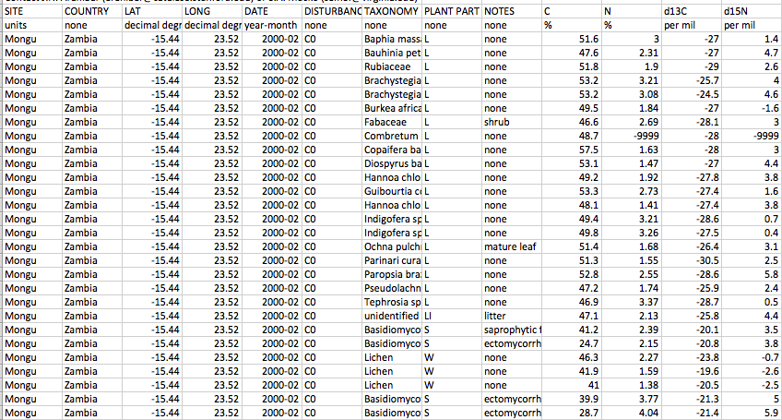
Stable Isotope Data at ORNL: tabular csv format
Aranabar and Macko. 2005. doi:10.3334/ORNLDAAC/783

Slide 15
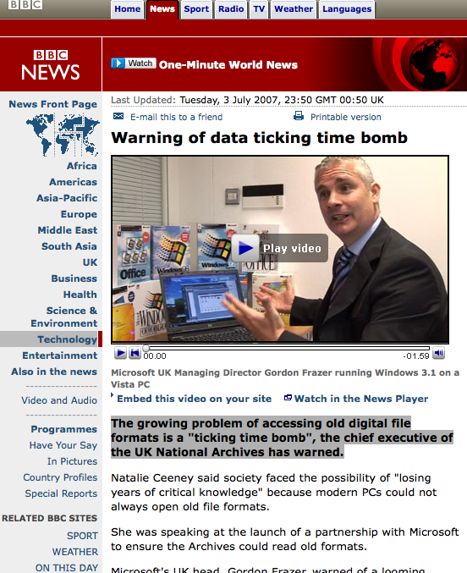
4. Use stable file formats
Los[e] years of critical
knowledge because
modern PCs could not
always open old
file formats.
Lesson: Avoid proprietary formats
They may not be readable in the future
http://news.bbc.co.uk/2/hi/6265976.stm
15

Slide 16
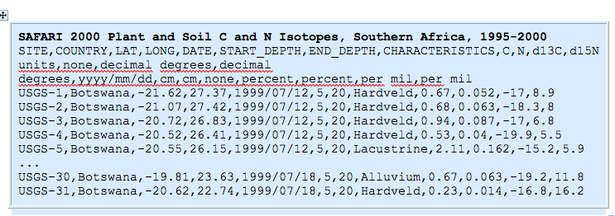
4. Use stable file formats (cont)
Use text (ASCII) file formats for tabular data
      (e.g., .txt or .csv (comma-separated values)
Aranibar, J. N. and S. A. Macko. 2005. SAFARI 2000 Plant and Soil C and N Isotopes, Southern Africa, 1995-2000. Data set. Available on-line [http://daac.ornl.gov/] from Oak Ridge National Laboratory Distributed Active Archive Center, Oak Ridge, Tennessee, U.S.A. doi:10.3334/ORNLDAAC/783
Notes:
Use text (ASCII) file formats for tabular data
(e.g., .txt or .csv (comma-separated values)
within the ASCII file, delimit fields using commas, pipes (|), tabs, or semicolons (in order of preference)

Slide 17
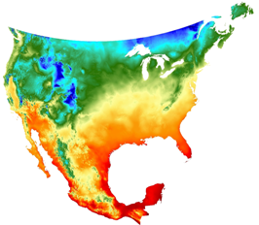
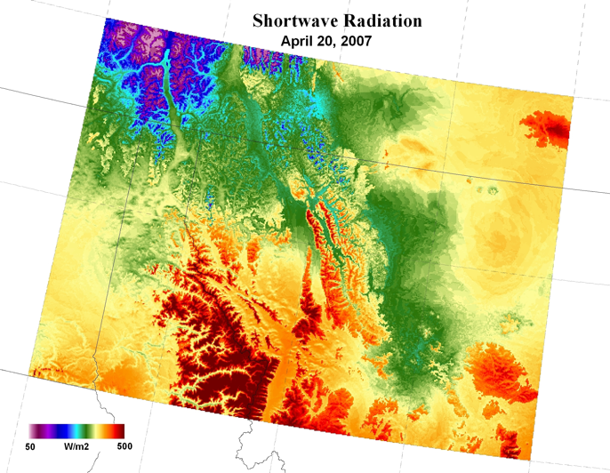
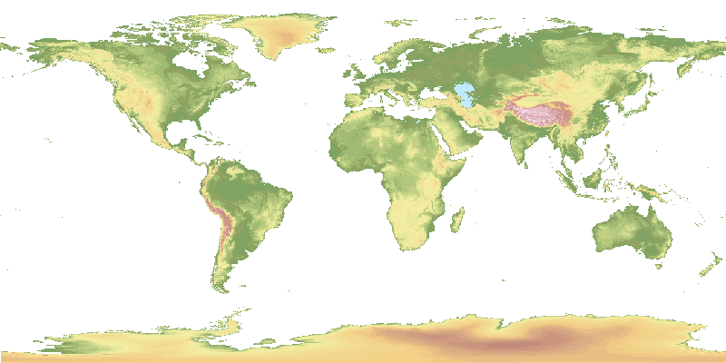
4. Use stable file formats (cont)
Suggested Geospatial File Formats
Raster formats
Geotiff
netCDF
  with CF convention preferred
HDF
ASCII
  plain text file gridded format with external projection information
Vector
Shapefile
ASCII
Minimum Temperature
GTOPO30 Elevation
17

Slide 18
5. Assign descriptive file names
Use descriptive file names
Unique
Reflect contents
ASCII characters only
Avoid spaces
Bad: Mydata.xls
2001_data.csv
best version.txt
Better: bigfoot_agro_2000_gpp.tiff
Project Name
File Format
Year
Site name
What was measured
18

Slide 19
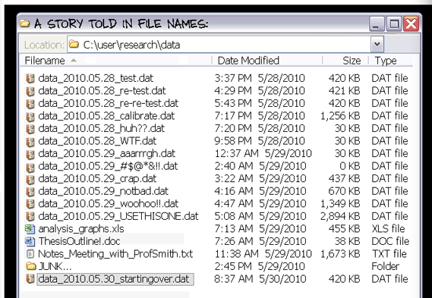
Courtesy of PhD Comics

Slide 20

5. Assign descriptive file names (cont) Organize files logically
Make sure your file system is logical and efficient
Biodiversity
Lake
Biodiv_H20_heatExp_2005_2008.csv
Experiments
Biodiv_H20_predatorExp_2001_2003.csv
…
Biodiv_H20_planktonCount_start2001_active.csv
Field work
Biodiv_H20_chla_profiles_2003.csv
…
Grassland
From S. Hampton
Notes:
As a corollary, need to make sure that your well-named files are organized in a logical directory structure

Slide 21
6. Preserve processing information
Raw Data File
### Giles_zoop_temp_regress_4jun08.r
### Load data
Giles<-read.csv("Giles_zoopCount_Diel_2001_2003.csv")
### Look at the data
Giles
plot(COUNT~ TEMPC, data=Giles)
### Log Transform the independent variable (x+1)
Giles$Lcount<-log(Giles$COUNT+1)
### Plot the log-transformed y against x
plot(Lcount ~ TEMPC, data=Giles)
Giles_zoopCount_Diel_2001_2003.csv
TAX COUNT TEMPC
C 3.97887358 12.3
F 0.97261354 12.7
M 0.53051648 12.1
F 0 11.9
C 10.8823893 12.8
F 43.5295571 13.1
M 21.7647785 14.2
N 61.6668725 12.9
…
Keep raw data raw:
Do not Include transformations, interpolations, etc in raw file
Make your raw data “read only” to ensure no changes
When processing data:
Use a programming language (e.g., R, SAS, MATLAB)
  Code is a record of the processing done
  Codes can be revised, rerun
Notes:
To preserve your data and its integrity, save a "read-only" copy of your raw data files with no transformations, interpolation, or analyses. Use a scripted language such as “R”, “SAS” or “MATLAB” to process data in a separate file, located in a separate directory. The scripts you have written are an excellent record of data processing, they can also easily and quickly be revised and rerun in the event of data loss or requests for edits, and have the added benefit of allowing a future worker to follow-up or reproduce your processing. Keep in mind that while GUI-based programs are easy on the front end, they do not keep a record of changes to your data and make reproducing results difficult.
In this example, an “R” to call is made on the data set to plots the data and perform a log transform – this way, changes are not retained in the original, raw data file.

Slide 22
7. Perform basic quality assurance
Assure that data are delimited and line up in proper columns
Check that there no missing values (blank cells) for key variables
Scan for impossible and anomalous values
Perform and review statistical summaries
Map location data (lat/long) and assess errors
No better QA than to analyze data

Slide 23
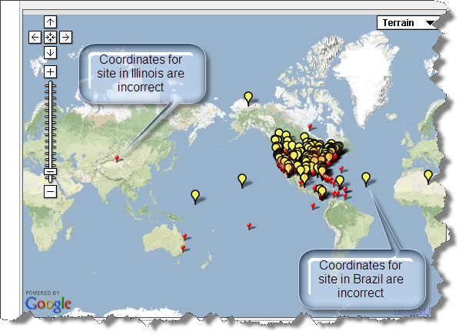
7. Perform basic quality assurance (cont)
Place geographic data on a map to ensure that geographic coordinates are correct.
Notes:
Place geographic data on a map to ensure that geographic coordinates are correct. Example is from OBFS Web site.
Illinois site (longitude has the wrong sign, should be negative)
Brazil Site (latitude is positive, but should be negative (should be south of the equator).

Slide 24
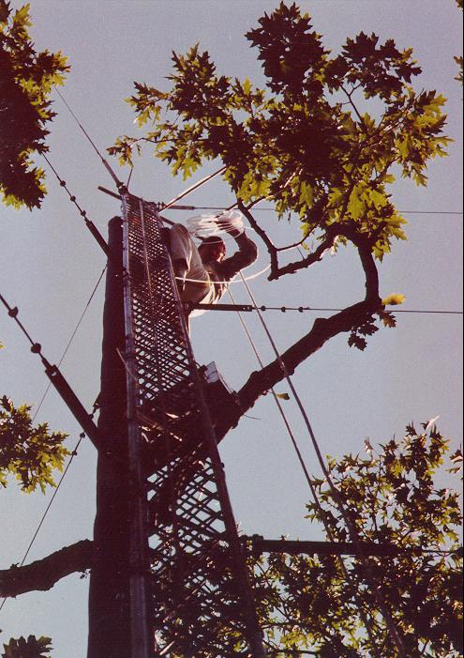
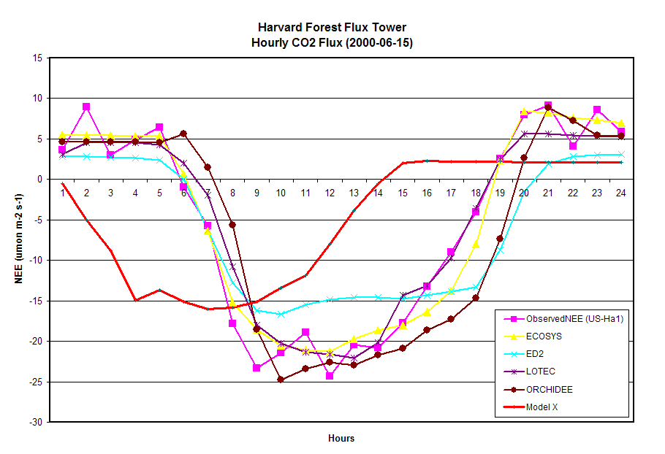
7. Perform basic quality assurance (con’t)
Plot information to examine outliers
Model-Observation Intercomparison
Model X uses UTC time, all others use Eastern Time
Data from the North American Carbon Program Interim Synthesis
(Courtesy of Dan Ricciuto and Yaxing Wei, ORNL)

Slide 25
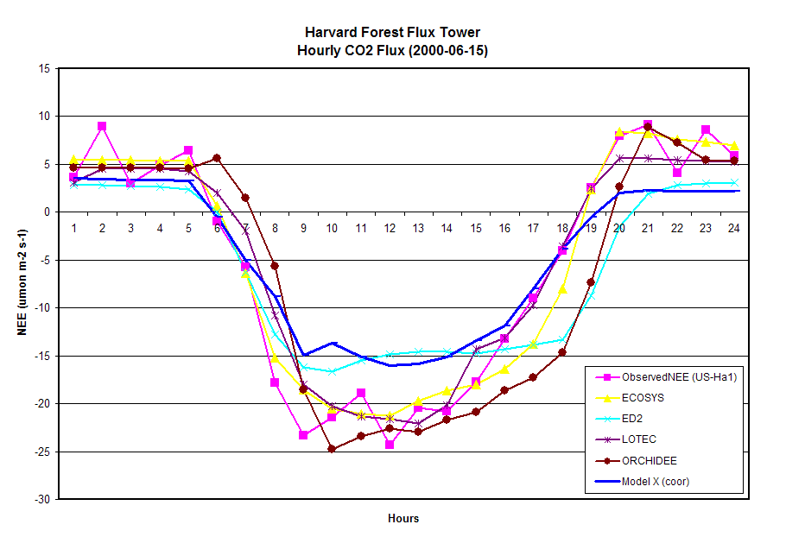
7. Perform basic quality assurance (con’t)
Plot information to examine outliers
Model-Observation Intercomparison
Data from the North American Carbon Program Interim Synthesis
(Courtesy of Dan Ricciuto and Yaxing Wei, ORNL)

Slide 26
8. Provide Documentation / Metadata
What does the data set describe?
Why was the data set created?
Who produced the data set and Who prepared the metadata?
When and how frequently were the data collected?
Where were the data collected and with what spatial resolution? (include coordinate reference system)
How was each variable measured?
How reliable are the data?; what is the uncertainty, measurement accuracy?; what problems remain in the data set?
What assumptions were used to create the data set?
What is the use and distribution policy of the data set? How can someone get a copy of the data set?
Provide any references to use of data in publication(s)

Slide 27
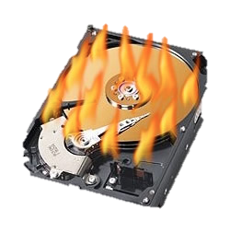
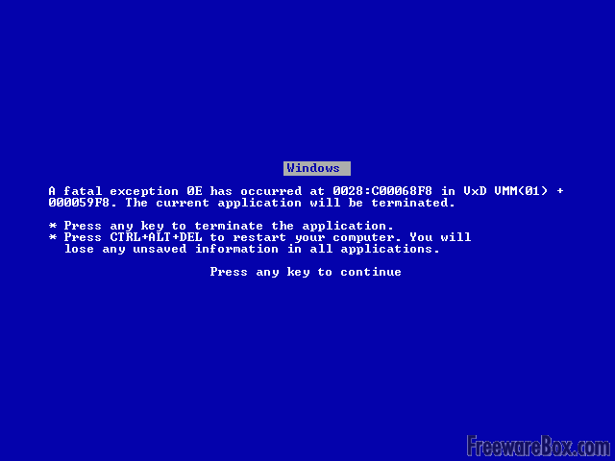
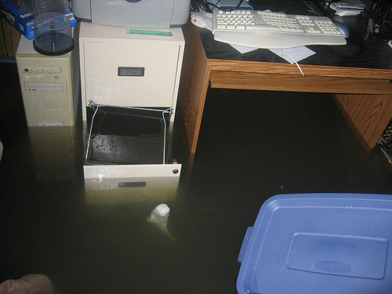
9. Protect data
Create back-up copies often
  Ideally three copies
      original, one on-site (external), and one off-site
  Frequency based on need / risk
Know that you can recover from a data loss
  Periodically test your ability to restore information
Notes:
Remember that disaster may strike not just your computer, but also your building or city. Public repositories provide mirroring of your data at multiple, managed sites.

Slide 28
9. Protect data (cont)
Ensure that file transfers are done without error
  Compare checksums before and after transfers
    Example tools to generate checksums
    http://www.pc-tools.net/win32/md5sums/
    http://corz.org/windows/software/checksum/
Notes:
Checksums to verify that files received are the same as those sent

Slide 29
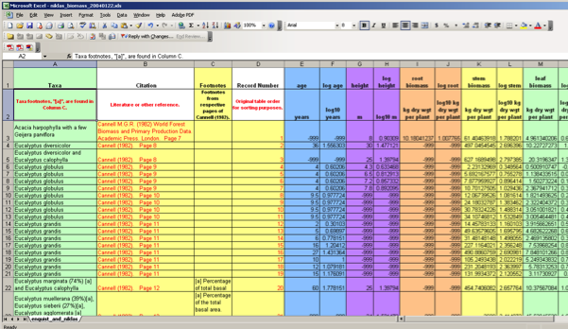
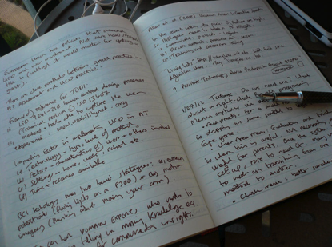
10. Preserve Your Data
What to preserve from the research project?
Well-structured data files, with variables, units, and values defined
Documentation and metadata record describing the data
Additional information (provides context)
  Materials from project wiki/websites
  Files describing the project, protocols, or field sites (including photos)
  Publication(s)
Notes:
You may wonder what should you be preserving from your research project. Generally you should preserve your well-structured data files, with variables, units, and values well-defined. Additionally, preserve your standardized metadata record that describes the data, and, finally, any additional information that provides context such as materials from project wikis or websites, files describing the project, protocols, or field sites, including photos, and any publications using the data.

Slide 30
10. Preserve Your Data (cont)
Where should the data be archived?
Part of project planning
Contact archive / data center early to find out their requirements
  What additional data management steps would they like you to do?
Suggested data centers / archives:
CDIAC
Dryad
NASA DAACs
  (ORNL DAAC)
BCO-DMO
Ecological Archives

Slide 31
Fundamental Data Practices
Define the contents of your data files
Define the variables
Use consistent data organization
Use stable file formats
Assign descriptive file names
Preserve processing information
Perform basic quality assurance
Provide documentation
Protect your data
Preserve your data
Notes:
Main part of my talk will be to describe these 10 fundamental data practices. Basic habits that will help improve the information content of your data and make it easier to share with others

Slide 32
Best Practices: Conclusion
Data management is important in today’s science
Well organized data:
  enables researchers to work more efficiently
  can be shared easily by collaborators
  can potentially be re-used in ways not imagined when originally collected
Include data management in your research workflow and budget
Data Management Practices should be a habit

Slide 33
Web Resources
Web Site
  Data Management for Data Providers
Workshops
  Workshops on Data Management 101 at NASA Terrestrial Ecology meeting in 2013
  Workshop at American Meteorological Society
    2012 with ESIP and DataONE
Training Materials (ORNL DAAC contributed)
  ESIP training modules
  DataONE training modules

