Slide 1
Introduction to Metadata
Suresh Vannan
ORNL Distributed Active Archive Center
Oak Ridge National Laboratory, Oak Ridge, TN
santhanavans@ornl.gov
CC&E Joint Science Workshop
College Park, MD
April 19, 2015

Slide 2
Presenter: Suresh Vannan
Manager, ORNL DAAC http://daac.ornl.gov
Data Theme Lead, Climate Change Science Institute (CCSI) - http://climatechangescience.ornl.gov/
Principal Investigator for data/data analysis type projects
Engineer, scientist, and manager by professional and educational experience

Slide 3
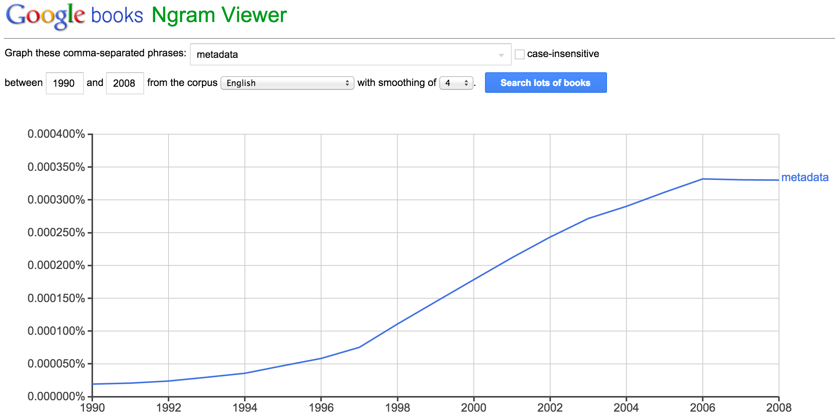
Metadata
A set of data that describes and gives information about other data.
describes
data.
Notes:
GCMD DIF – 1988
FGDC – 1994

Slide 4
Metadata in the Real World
Metadata is all everywhere…
Author(s) Burley, T.E.
Title(s) Data Management: A Critical Link Between Scientists and Managers
Date 2008
Place Chattanooga, TN
Physical Desc proceedings; 120p; 22 cm.
Subject(s) Science Data Management
Notes:
Try to think of some examples in everyday life that have metadata associated with them.
A few examples might include library card catalogues and food labels.
Card catalogues tell us more information than just the title of the book, they also tells the user:
Who is the author?
Who published the book?
What subject area does the book fall in?
And finally, where is it located in the library?
Another example of metadata that we see in our daily lives is the nutrition and ingredient information on food labels.
Nutrition labels answer questions such as:
What is the soup made of?
Who made the soup?
How many calories per serving?
How many servings in the can?
What percentage of daily vitamins are in each serving?

Slide 5
Metadata
QUALITY
Accuracy
Completeness
Consistency
Timeliness
Provenance
Accessibility
Conformance
Metadata in Practice
By Diane Ileana Hillmann, Elaine L. Westbrooks

Slide 6
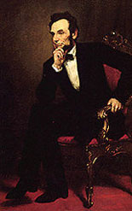
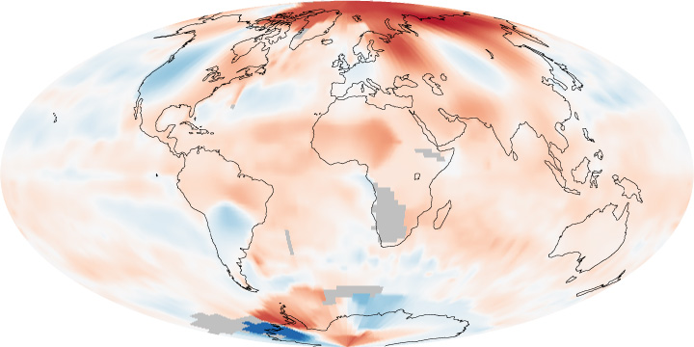
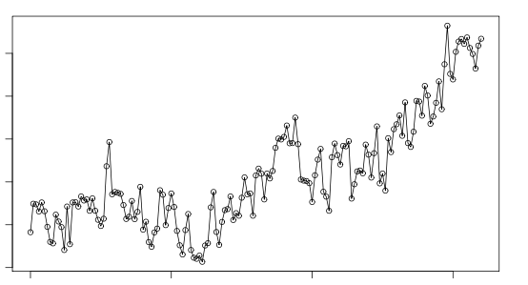
Metadata
Name contains Seven Letters
Successor was named Johnson
Elected to Congress in XX46
Elected President in XX60

Slide 7
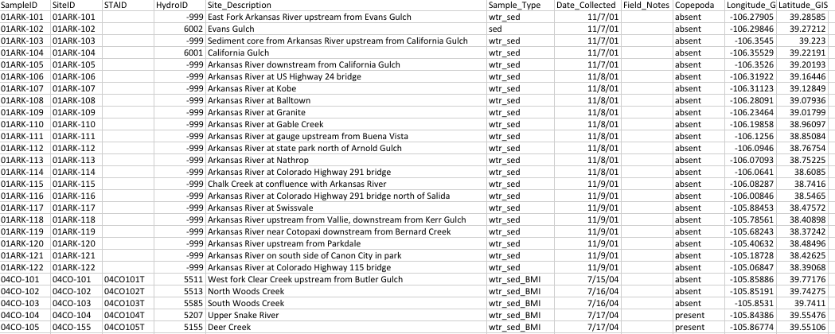
Scenario: You just inherited this dataset. Can you explain it?
What do the column headers mean? What is STAID? What is the HydroID? What does the sample type wtr_sed mean? What values should I expect to see in each column? How was the data collected?

Slide 8
From the published paper we gather some of the answers about the data….
Data collected and developed for CCAP are compiled in a geospatial database that is suitable for visualization and analysis. Water, sediment, and invertebrate samples collected in the field are represented as point layers with attribute tables that contain the results of chemical analyses and (or) information pertaining to the characteristics of the sampled fauna or catchment environment. The project area boundary, a simplified lithogeochemical map, and model-generated catchment boundaries are represented as polygon layers. One table is formatted specifically for the Invertebrate Data Analysis System (IDAS) program and thus lacks coordinate information and point features. The coordinate system for all feature layers (that is, point or polygon) is Universal Transverse Mercator, Zone 13, North American Datum (NAD) 1927. Latitude and longitude coordinates reported in attribute tables also reference NAD 1927.A metadata document for each GIS layer summarizes details pertaining to attributes, accuracy, and limitations of the information, and methods used to derive the information. A summary of the database layers and information compiled in them is presented in table 15. Sample coordinates, used to create the point feature layers, were determined from hand-held global positioning system (GPS) devices. In general, the GPS units used by field scientists recorded sample locations to within 100 ft (30 m) of the true location. When more than one scientist collected field samples at a site on different dates, the reported location is a composite of the GPS measurements and the location is verified using a geographic information system (GIS) and digital topographic maps. Water samples were typically collected at the recorded GPS location; sediment and aquatic fauna samples may have been collected within 75 ft (22 m) of the indicated location if conditions were more suitable. Collected samples were assigned identification codes, as appropriate, to uniquely identify the sample, the sample location, the catchment of the sample, laboratory analyses associated with the sample, or samples used as input in the IDAS program. All samples have a unique field identification assigned at the time of collection, and a site identification that uniquely identifies the stream location where samples were collected. Select samples have a catchment and (or) an IDAS identification. Samples submitted to USGS laboratories are assigned a laboratory ID number. The laboratory identification is the same one maintained by the USGS National Geochemical Database (NGDB) and is provided for cross-referencing with that system. The exceptions are total iron and dissolved organic carbon analyses of water, which are not archived in the NGDB (URL: http://minerals.cr.usgs.gov/projects/geochem_database/ index.html, accessed Aug. 9, 2010). As described above, catchments underlain by a predominant lithogeochemical unit were targeted for sampling and study. In some areas, like the Rocky Mountain National Park region, streams and tributaries were sampled progressively upstream towards the headwater area. The subsequent catchment polygons generated through GIS methods are often “nested” and overlay one another in the digital layer. Displaying the catchment boundaries as outlines (versus solid fills) and using the catchment identification field (HYDOR_ID) allows the user to accurately discern the nested relationship and extent of each catchment. Catchment characteristics, such as the presence or absence of mining, hydrothermal alteration type, and the area of lithogeochemical units in a catchment are summarized by catchment. These areal catchment characteristics are also provided in sample point layers so that relationships between the physical environment and sample chemistries can be evaluated. The geospatial database is provided in the following formats to accommodate common proprietary software as well as non-proprietary software: ESRI ArcGIS file geodatabase version 9.3 (all layers), ArcGIS shapefile (polygon layers; ESRI, 2009), Microsoft Access (point information only; Microsoft, 2010), and as comma-separated value (CSV) ASCII files (point information only).
Notes:
Answers to questions about the data can be found in the published paper, but that’s not always the entire story. The data is not always printed in its entirety in the paper, and generally not in a re-usable format. Details about how to understand the dataset are not necessarily explained in full….so in order to re-use the data, and metadata record is necessary.

Slide 9
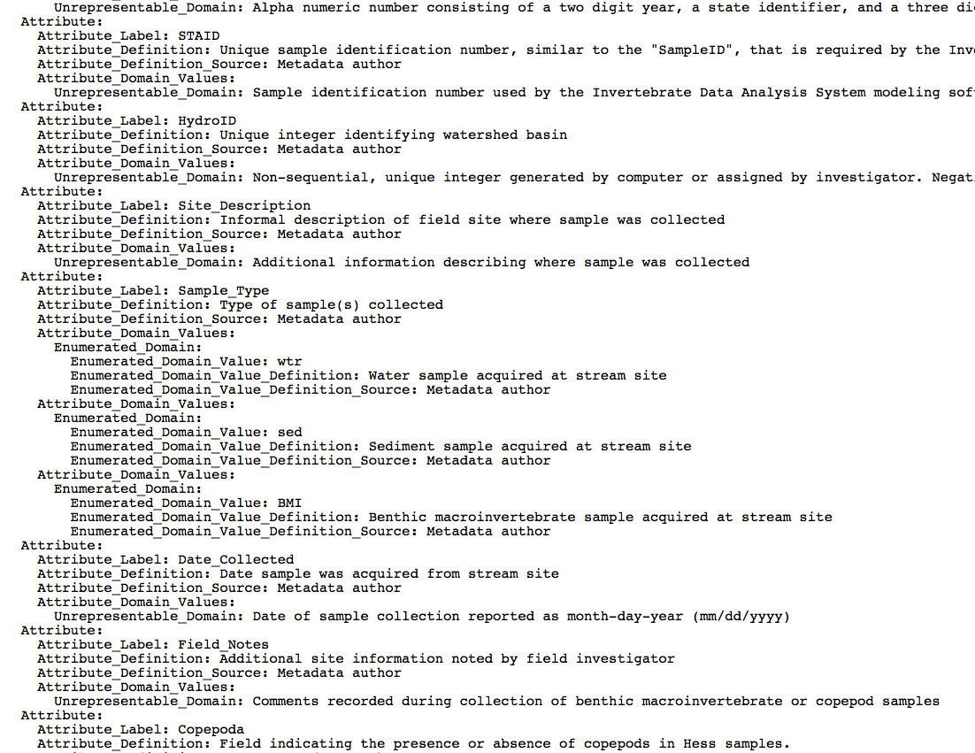
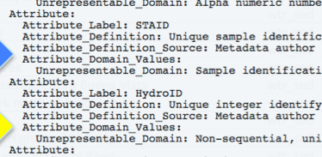
…but from the metadata record we get all of our answers…
Lineage:
Process_Step:
Process_Description: Stream sediment, water, benthic macroinvertebrate, and (or) copepod samples were collected from suitable sites from July 2004 to September 2007. Sample locations, digitally recorded with hand-held GPS devices, were imported into ArcGIS to produce the point features in this data set. Field blanks, collected and processed for quality assurance purposes, were assigned an arbitrary location outside the project area of N 40 degrees, W 105 degrees. Attributes identifying the sample(s), the field site, and the watershed were added by the authors. Other attributes include a description and observations at the field site and date of sample collection. Chemical information, watershed boundaries, and geology related to the sample locations are presented as separate layers in the geodatabase.
Process_Date: 2004-2009
…about the data itself
Notes:
Metadata record on the right and in lower left corner.

Slide 10
Metadata Components
Metadata
Structural
Administrative
Linkage
Descriptive
Notes:
What is Metadata?
Metadata is analogous to journalistic reporting.
Metadata is data about data. Metadata describes the content, quality, condition, and other characteristics of data.
Metadata allows a user of a data set to locate and understand another organization’s data.
Metadata records will answer questions such as:
What is the history of the dataset?
Why was it created?
How was the data created?
What projection is the data in?
What datum is it in?
When was the data last updated?
Who created the data?
What scale are the data described in?
What scale are the data intended to be used?
What fields are in the table?
What do the values in those fields mean?
Who do I contact about getting more information about the data?
How do I obtain a copy of the data?
Do the data cost anything?
Are there any limitations to the data?
Metadata is a valuable tool. Metadata records preserve the usefulness of data over time by detailing methods for data collection and data set creation. Metadata greatly minimize duplication of effort in the collection of expensive digital data and foster the sharing of digital data resources. Metadata support local data asset management such as local inventory and data catalogs, and external user communities such as Clearinghouses and websites. Records provide adequate guidance for end-use application of data such as detailed lineage and context. As an example, metadata make it possible for data users to search, retrieve, and evaluate data set information from the NBII's vast network of biological databases by providing standardized descriptions of geospatial and biological data in a searchable catalog.

Slide 11
What Is Metadata?
WHO created the data?
WHO owns the data?
WHEN was it collected?
WHEN was it created?
WHERE is it geographically?
HOW was the data developed?
WHY was the data developed?
WHAT are the data issues?
………
Notes:
What is Metadata?
Metadata is analogous to journalistic reporting.
Metadata is data about data. Metadata describes the content, quality, condition, and other characteristics of data.
Metadata allows a user of a data set to locate and understand another organization’s data.
Metadata records will answer questions such as:
What is the history of the dataset?
Why was it created?
How was the data created?
What projection is the data in?
What datum is it in?
When was the data last updated?
Who created the data?
What scale are the data described in?
What scale are the data intended to be used?
What fields are in the table?
What do the values in those fields mean?
Who do I contact about getting more information about the data?
How do I obtain a copy of the data?
Do the data cost anything?
Are there any limitations to the data?
Metadata is a valuable tool. Metadata records preserve the usefulness of data over time by detailing methods for data collection and data set creation. Metadata greatly minimize duplication of effort in the collection of expensive digital data and foster the sharing of digital data resources. Metadata support local data asset management such as local inventory and data catalogs, and external user communities such as Clearinghouses and websites. Records provide adequate guidance for end-use application of data such as detailed lineage and context. As an example, metadata make it possible for data users to search, retrieve, and evaluate data set information from the NBII's vast network of biological databases by providing standardized descriptions of geospatial and biological data in a searchable catalog.

Slide 12
Questions metadata can help solve
Does any of this data have configuration problems?
Which data products measure the quantities I need?
This data is valuable - will I be able to find it again?
Can I trust these measurements? How were they taken?
Where was this data collected?

Slide 13
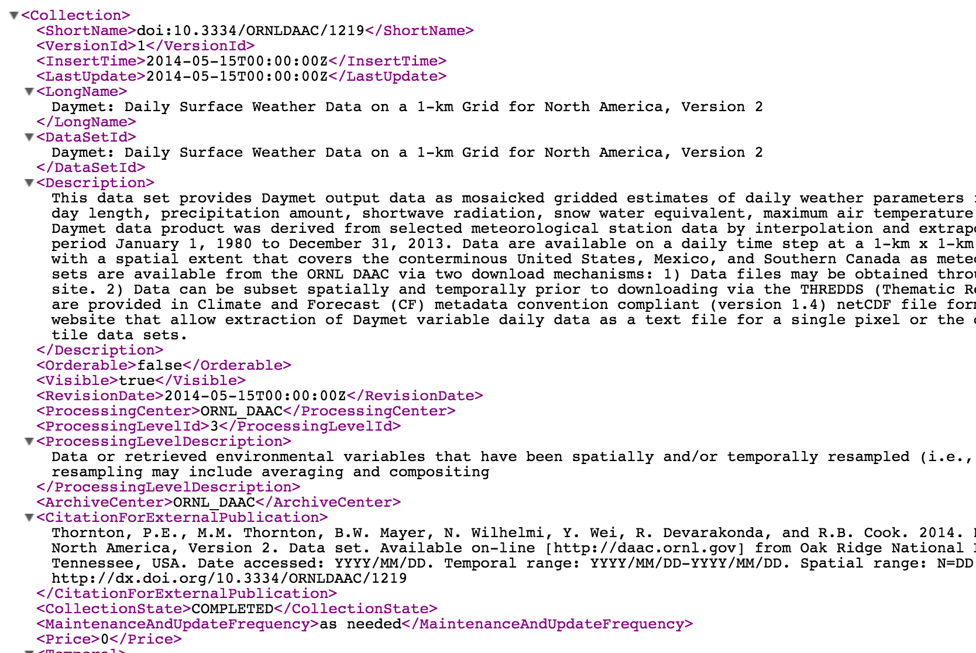
What does a metadata record look like?
Notes:
This is an example of the FGDC Standard output with elements of the Biological Data Profile present.

Slide 14
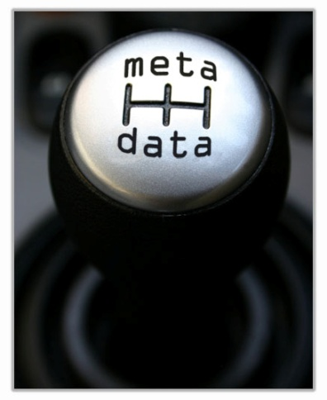
What is a metadata standard?
A Standard provides a structure to describe data with:
Common terms to allow consistency between records
Common definitions for easier interpretation
Common language for ease of communication
Common structure to quickly locate information
In search and retrieval, standards provide:
documentation structure in a reliable and predictable format for computer interpretation
a uniform summary description of the data set
Notes:
An established standard provides common terms that are used universally, thereby allowing communication of information to become consistent.
A standard also provides the opportunity to create consistent definitions. When a user reads metadata they will become familiar with the standard and will know which sections provide certain information, regardless of who wrote the metadata.
A standard will also encourage a common language for metadata. This language will allow all metadata creators to use the same vocabulary, resulting in easier communication.
Finally a standard allows all creators to use a common structure. Structure is important for knowing where to find the required information that you need quickly and for cataloguing information online. All metadata structured in the same format allows the catalogues to be searchable.
Content Standard for Digital Geospatial Metadata (CSDGM)
The objective of the CSDGM standard is to provide a common set of terminology and definitions for the documentation of digital geospatial data.
Common terms and common definitions ensure that all users “speak the same language.” Creating this commonality helps increase communication and avoid errors.
The CSDGM standard establishes:
the names of data elements and compound elements (groups of data elements) to be used for these purposes,
the definitions of these data elements and compound elements, and
information about the values that are to be provided for the data elements.

Slide 15
Multiple metadata standards exist
Content Standard for Digital Geospatial Metadata (CSDGM)
Federal Geographic Data Committee (FGDC)
Emphasis on geospatial data; environmental sciences
Includes: Biological Data Profile (BDP)
Darwin Core
Emphasis on taxa - observations, specimens, and samples
Dublin Core Element Set
Emphasis on describing resources for discovery (video, images, web pages, and physical resources books, objects)
Ecological Metadata Language (EML)
Emphasis on documentation of ecological data
ISO 19115 Geographic information: Metadata
Emphasis on geospatial data and services

Slide 16
Summary
Data is incomplete without metadata.
Robust metadata is required for data management, data reuse, and
data integration to be successful.

