Slide 1
Preparing Spatial Data to Archive
Yaxing Wei &
Suresh K.S. Vannan
Environmental Sciences Division
Oak Ridge National Laboratory

Slide 2
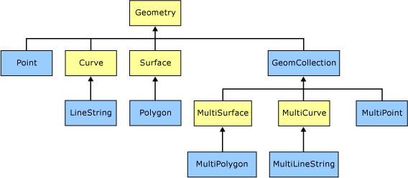
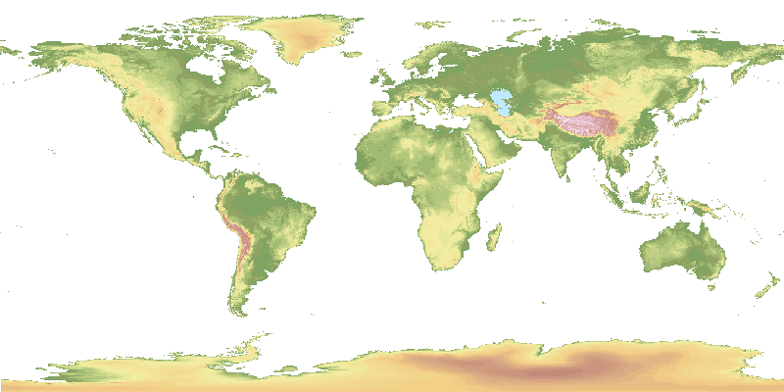
Spatial Data
Any data with location information
  Feature data: “object” with location and other properties
    AmeriFlux sites/instruments, rivers, ecoregion boundaries
  Coverage data: “phenomenon” spanning spatial extent / temporal period
    AmeriFlux site GPP time series (1-D)
    one scene of MODIS LAI (2-D)
    global 1°monthly model output NEE (3-D)
    ….
From Microsoft
GTOPO30 Elevation

Slide 3
Critical Things for Spatial Data
Where: spatial information
  Spatial Reference System: datum and projection
  Spatial extent/resolution/boundary
When: temporal information
  Calendar
  Time units & extent/resolution/boundary
What: data content
  Data format: structure & organization
  Units, scale, missing value, …

Slide 4
Bottom Line
These critical things have to be PROVIDED and CORRECT, even if they are provided in human-understandable ways!

Slide 5
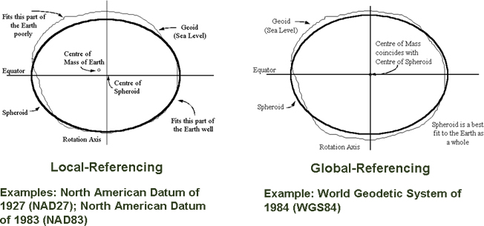
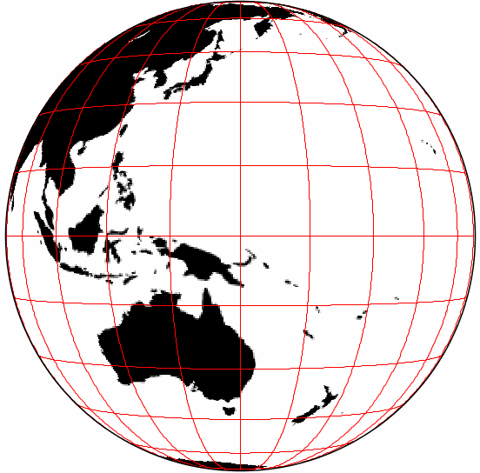
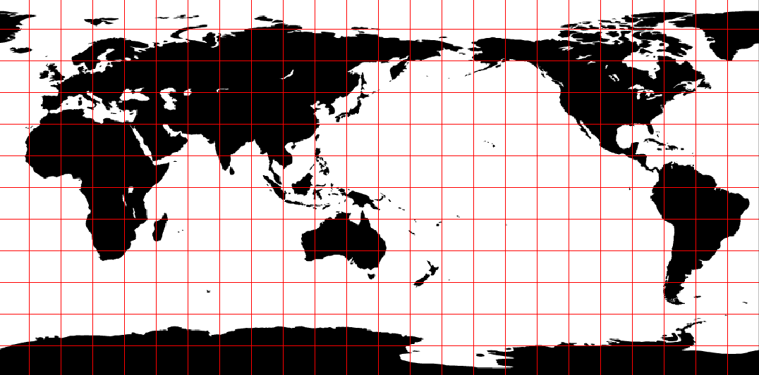
Spatial Reference System (SRS)
Datum: a system which allows the location of latitudes and longitudes (and heights) to be identified onto the surface of the Earth
  Sphere / Spheroid
Projection: define a way to flatten the Earth surface
SRID: code representing pre-defined popular SRS, e.g. EPSG:4326
  http://spatialreference.org

Slide 6
Spatial Example (1)
Where is an AmeriFlux site located?
  Valles Caldera Mixed Conifer / US-Vcm
  Latitude: 35.8884
  Longitude: -106.5321
  Elevation: 3003m
Precision: on the order of 10 meters
Datum: shape and center of the earth
  NAD83 (e.g. USGS NHD) or WGS84 (e.g. GPS)
  Do I care? Not if 1-2 meters difference doesn’t matter
  Vertical datum

Slide 7
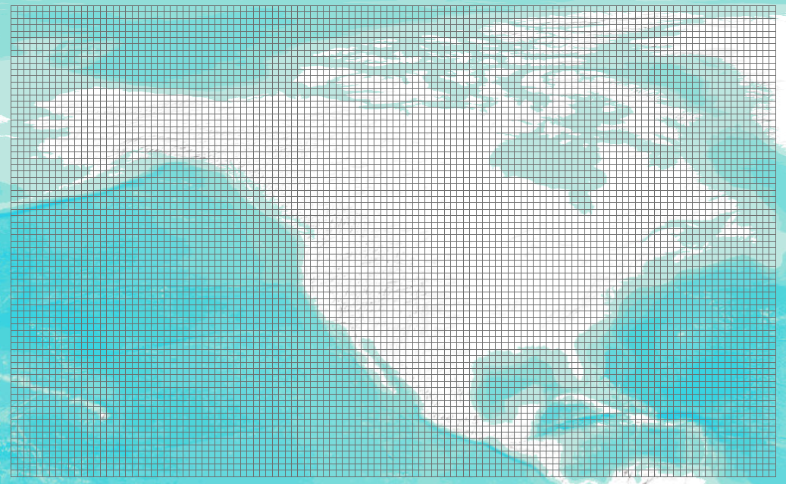
Spatial Example (2)
Where do my data represent?
  Regular gridded data: all grid cells have consistent size (e.g. NACP regional TBM output)
    Define your SRS
      Sphere-based GCS (radius of the earth: 6370997m)
    Provide X/Y spatial resolution: size of a grid cell
      X: 1-degree, Y: 1-degree
    Provide spatial extent: outer boundary of all cells
      West: -170, South: 10, East: -50, North: 84

Slide 8
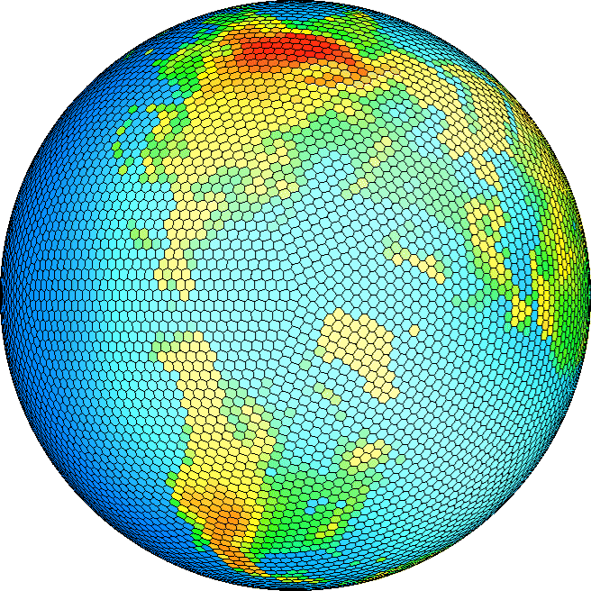
Spatial Example (2) Con’t
Where do my data represent?
  Irregular gridded data (e.g. 10242 Spherical Geodesic Grid)
    Define your SRS
    Provide coordinates for each vertex of each polygon
    Provide coordinates for the center of each polygon

Slide 9
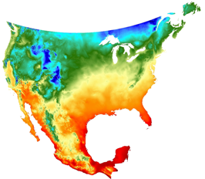
Spatial Example (3)
SRS for Daymet data
  1-km daily surface weather and climatological data
  Projection: Lambert Conformal Conic
    projection units: meters
    datum (spheroid): WGS_84
    1st standard parallel: 25 deg N
    2nd standard parallel: 60 deg N
    Central meridian: -100 deg (W)
    Latitude of origin: 42.5 deg N
    false easting: 0
    false northing: 0
Minimum Temperature

Slide 10
Temporal Example (1)
What calendar does a model use?
  julian: one leap year in every 4 years
  gregorian: leap year if either (i) it is divisible by 4 but not by 100 or (ii) it is divisible by 400
  proleptic_gregorian: gregorian calendar extended to dates before 1582-10-15
  365_day: no leap year, Feb. always has 28 days
  360_day: 30 days for each month
  366_day: all leap years
  gregorian is the internationally used civil calendar
  MsTMIP project chose proleptic_gregorian calendar

Slide 11
Temporal Example (2)
Specify the time a measurement was made
  “the measurement was made at 6 in the afternoon on March 22, 2010 and it took 1 hour 20 minutes and 30 seconds” - BAD
ISO 8601: representation of dates and times
  Time point: YYYY-MM-DDThh:mm:ss.sTZD (2010-03-22T18:00:00.00-06:00)
  Duration: P[n]Y[n]M[n]DT[n]H[n]M[n]S (PT1H20M30S)

Slide 12
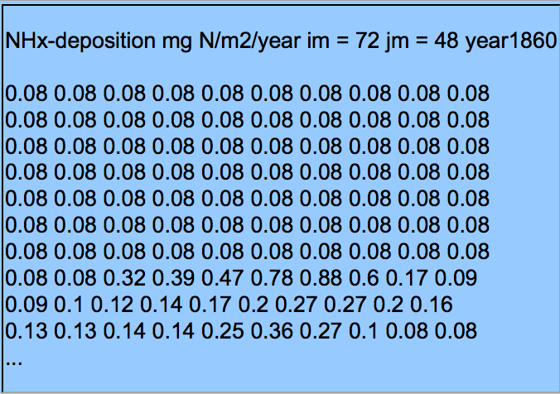
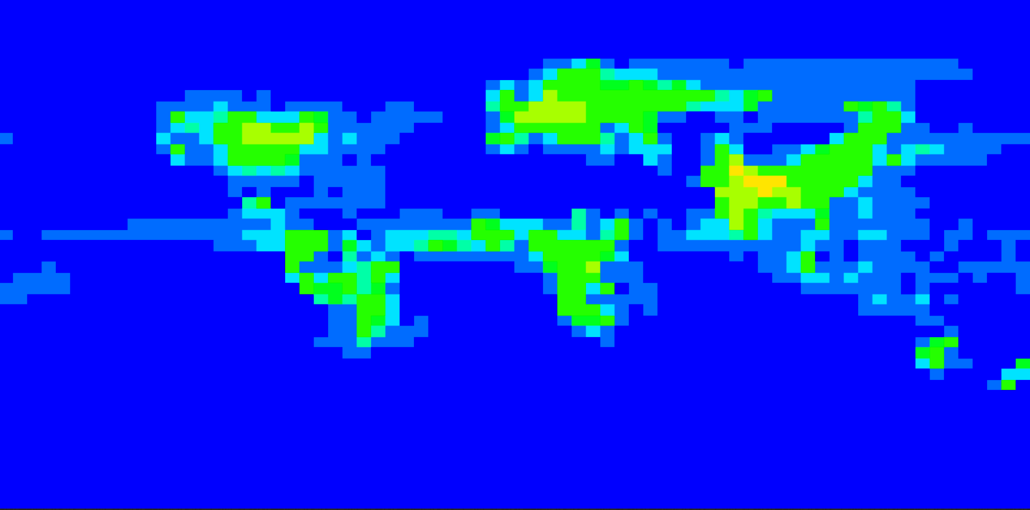
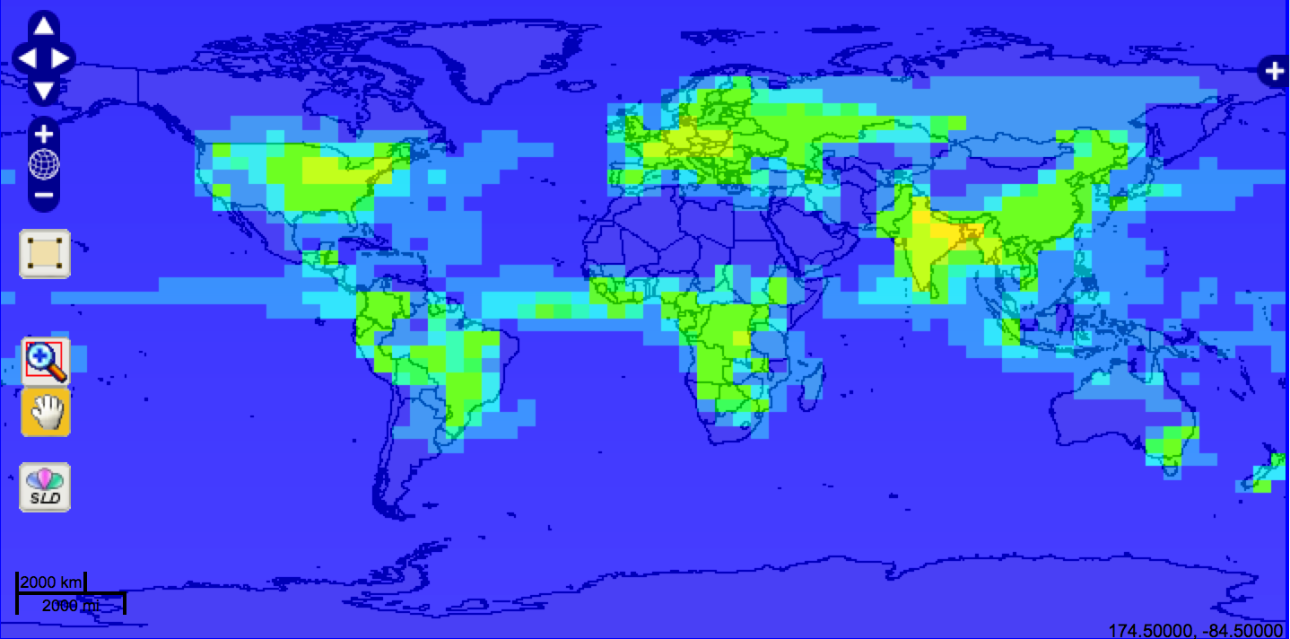
Bad Practice (1)
Global Maps Of Atmospheric Nitrogen Deposition, 1860, 1993, and 2050

Slide 13
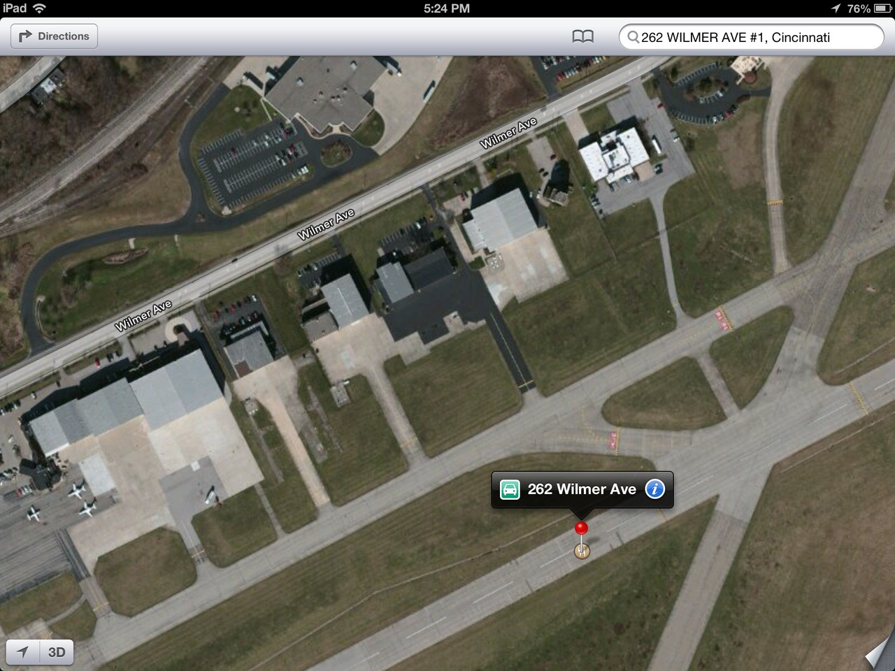
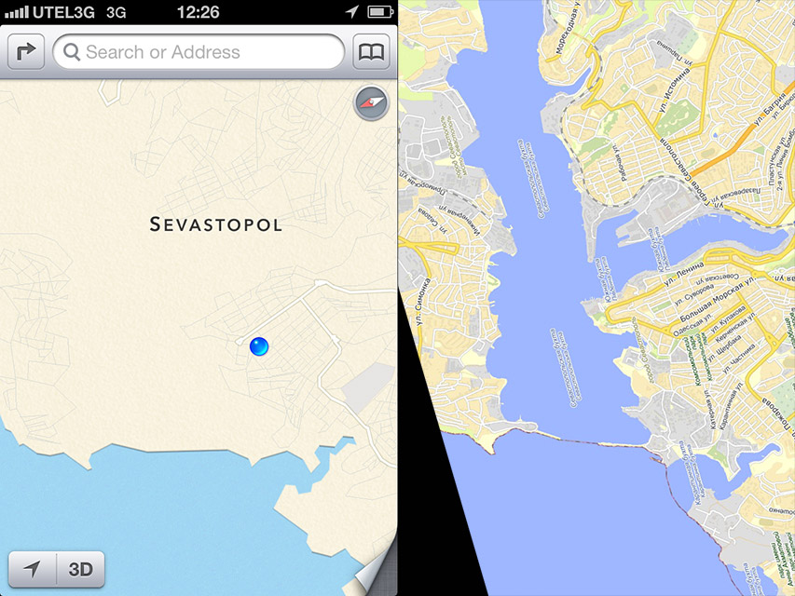
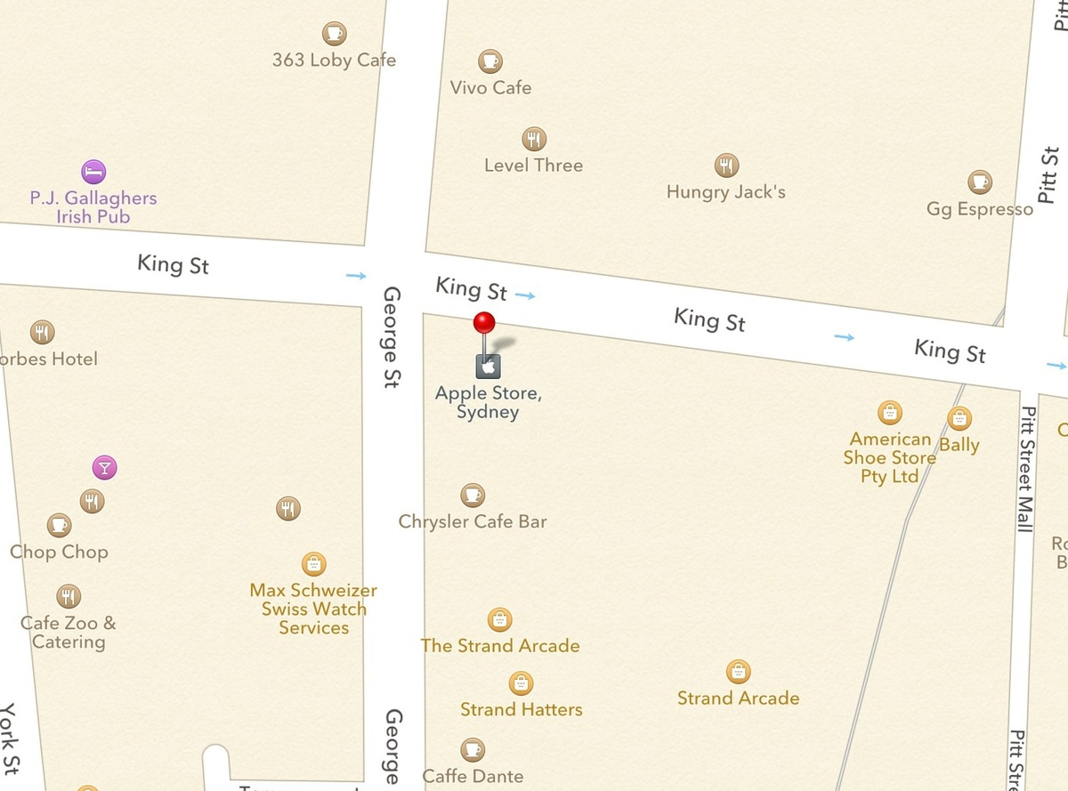
Bad Practice (2)
Precision
Spatial Reference
Norfolk - UK
More than 200 people - nearly all of them adults - live in each house and apartment in the southernmost corner of the city's West Ghent neighborhood.
At least that's according to the latest census figures, which show an astonishing population growth rate of 8,300 percent within the handful of blocks south of Redgate Avenue.

Slide 14
Bad Practice (3)
Time in Daymet
  Time information was messed up in the alpha release of Daymet data
  Daymet has data for 365 days in every year, so we thought it used the “365_day” calendar
  No! It has leap years. It removed December 31st instead of Feb 29th in leap years. We reset its calendar to “gregorian”

Slide 15
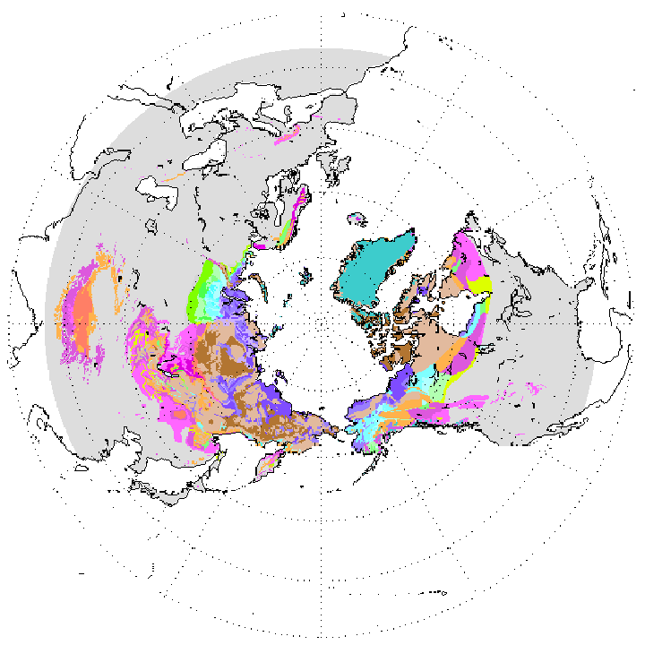
A Not-so-Good Practice
Circum-Arctic Map of Permafrost and Ground Ice Conditions
  It provides a 25km by 25km gridded map in BINARY format along with a header file and SRS definition in readme
Header:
nrows 721
ncols 721
nbits 8
byteorder I
ulxmap -9024309
ulymap 9024309
xdim 25067.525
ydim 25067.525
SRS Definition:
Projection: Lambert Azimuthal
Units: meters
Spheroid: defined
Major Axis: 6371228.00000
Minor Axis: 6371228.000
longitude of center of projection: 0
latitude of center of projection: 90
false easting (meters): 0.00000
false northing (meters): 0.00000

Slide 16
Make a Step Forward
Choose “GOOD” formats to store your spatial data and provide spatial/temporal information in STANDARD ways

Slide 17
“Good” Formats
Open and non-proprietary
Simple and commonly used
More importantly, self-descriptive
  Interpretative metadata is included inside data
Feature Data Formats
  Shapefile
  KML
  GML
  ESRI Geodatabase
Coverage Data Formats
  GeoTIFF
  netCDF v3/v4
  HDF-EOS

Slide 18
Standard Ways for Interpretative Metadata
Climate and Forecast (CF) Metadata Convention
  CF Standard Names
  CF Convention
    Spatial/temporal coordinates
    Cell boundaries/shape/methods
    Missing data
    Data units
    …..
    Many more, just google “cf metadata”

Slide 19
NetCDF + CF Convention
NetCDF + CF: perfect combination for climate change and earth system model data
  The NetCDF classic model provides a clean way to organize multi-dimensional data
  The NetCDF enhanced model is suitable for more complex data
  NetCDF v4 supports internal compression
  NetCDF is supported by many tools: Matlab, IDL, Ferret, Python, NCO, Panoply, …
  CF makes data analysis can be automated

Slide 20
Specify Spatial Info in NetCDF (1)
Define SRS
short lambert_conformal_conic;
:grid_mapping_name = "lambert_conformal_conic";
:longitude_of_central_meridian = -100.0; // double
:latitude_of_projection_origin = 42.5; // double
:false_easting = 0.0; // double
:false_northing = 0.0; // double
:standard_parallel = 25.0, 60.0; // double

Slide 21
Specify Spatial Info in NetCDF (2)
Provide cell center coordinates in Geographic Lat/Lon SRS and native SRS (if different)
double x(x=162);
:units = "m";
:long_name = "x coordinate of grid cell";
:standard_name = "projection_x_coordinate";
double y(y=227);
:units = "m";
:long_name = "y coordinate of grid cell";
:standard_name = "projection_y_coordinate”;
double lat(y=227, x=162);
:units = "degrees_north";
:long_name = "latitude coordinate";
:standard_name = "latitude";
double lon(y=227, x=162);
:units = "degrees_east";
:long_name = "longitude coordinate";
:standard_name = "longitude”;

Slide 22
Specify Spatial Info in NetCDF (3)
Specify cell boundaries
  Left-right boundary
  Bottom-top boundary
double lat_bnds(lat=360, nv=2);
:units = "degrees_north";
double lon_bnds(lon=720, nv=2);
:units = "degrees_east";
double lat(lat=360);
:bounds = "lat_bnds";
:units = "degrees_north";
double lon(lon=720);
:bounds = "lon_bnds";
:units = "degrees_east";

Slide 23
Specify Temporal Info in NetCDF
Specify calendar and time coordinate
Specify time step boundaries
2008 Daymet Daily Average Vapor Pressure
Calendar: gregorian
Time coordinate units: days since 1980-01-01T00:00:00Z
Time coordinate values: 10227.5, 10228.5, 10229.5, 10230.5, 10231.5, …, 10590.5, 10591.5 (Dec 30th noon)
Time step boundaries: 10227,10228; 10228,10229; …; 10590,10591; 10591,10592 (start,end of Dec 30th)

Slide 24
Cell Methods
To describe the characteristic of a variable that is represented by grid cell values
  NARR dswrf: 3-hourly average, average across a 32km by 32km region
  NARR precip: 3-hourly accumulated, average across a 32km by 32km region
cell_methods
  “time: mean area: mean”
  “time: sum area: mean”
point
Sum
maximum
median
mid_range
minimum
mean
mode
standard_deviation
variance

Slide 25
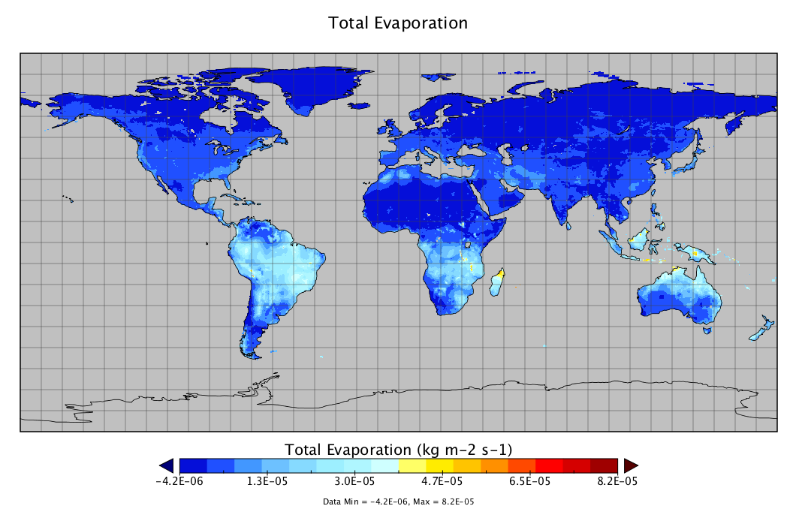
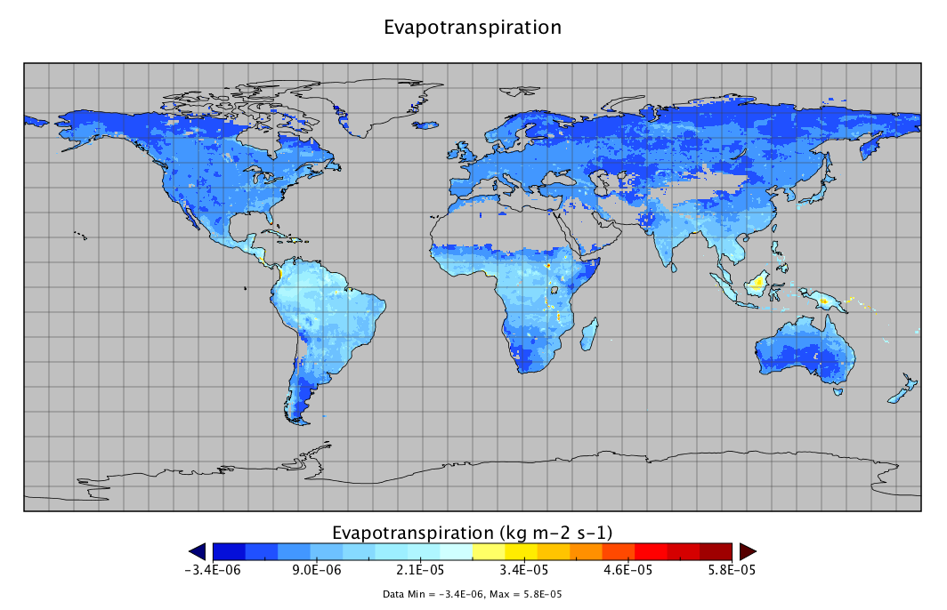

Missing Data
Use _FillValue, missing_value, valid_min, valid_max, and valid_range to indicate what values in a variable are considered to be valid or what values shall be ignored.
  float nbp(time=20, lat=74, lon=120);
  :_FillValue = -99999.0f; // float

Slide 26
Data Units
UDUNITS
  Support conversion of unit specifications
  Support arithmetic manipulation of units
  conversion of values between compatible scales of measurement
Follow the rules and computers can then do a lot of work for you and others.
Units for Gross Primary Productivity (GPP)
kg m-2 s-1
Kg/m2/month
kgC m-2 s-1

Slide 27
Summary
Provide spatial and temporal information completely and accurately
Choose good formats to organize the data content and make them self-descriptive
Provide interpretative metadata in standard ways
You will be returned a lot by doing this
  Your data will be easily understood by not only users but also computers
  A lot of data visualization and analysis can be automated
  Your data can be ingested into many existing Web services to provide on-demand data distribution to users
  Value of your data can be preserved longer into the future

