Slide 1



Standards and Tools to Access and Visualize Data
Yaxing Wei, Alison Boyer, and Debjani Deb
ORNL Distributed Active Archive Center (ORNL DAAC)
Environmental Sciences Division
Oak Ridge National Laboratory
Oak Ridge, TN
March 26, 2017

Slide 2
Outline
Data/Metadata Standards and Tools
Tabular Data and Google Fusion Table
NetCDF and Climate & Forecast Convention
Data Access/Visualization Standards and Tools
OPeNDAP
NetCDF Subset Service (NCSS)
OGC Web Services
Demonstration

Slide 3
Outline
Data/Metadata Standards and Tools
Tabular Data and Google Fusion Table
NetCDF and Climate & Forecast Convention
Data Access/Visualization Standards and Tools
OPeNDAP
NetCDF Subset Service (NCSS)
OGC Web Services
Demonstration

Slide 4
Tabular Data
Tabular data
  ASCII Format
  Comma/Tab/Space/…-Separated Values
  Excel spreadsheets
Good tabular data can be easily understood, analyzed, and visualized

Slide 5
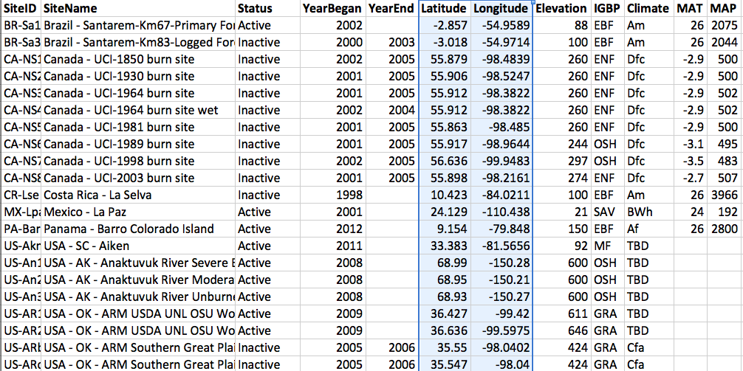
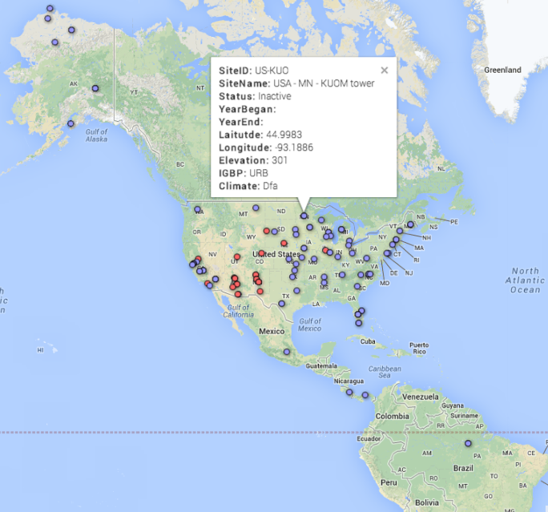

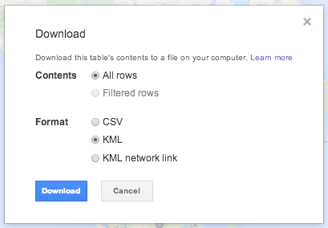

Google Fusion Table
An experimental data visualization web application to gather, visualize, and share data tables. FREE.
  Fusion Table

Slide 6
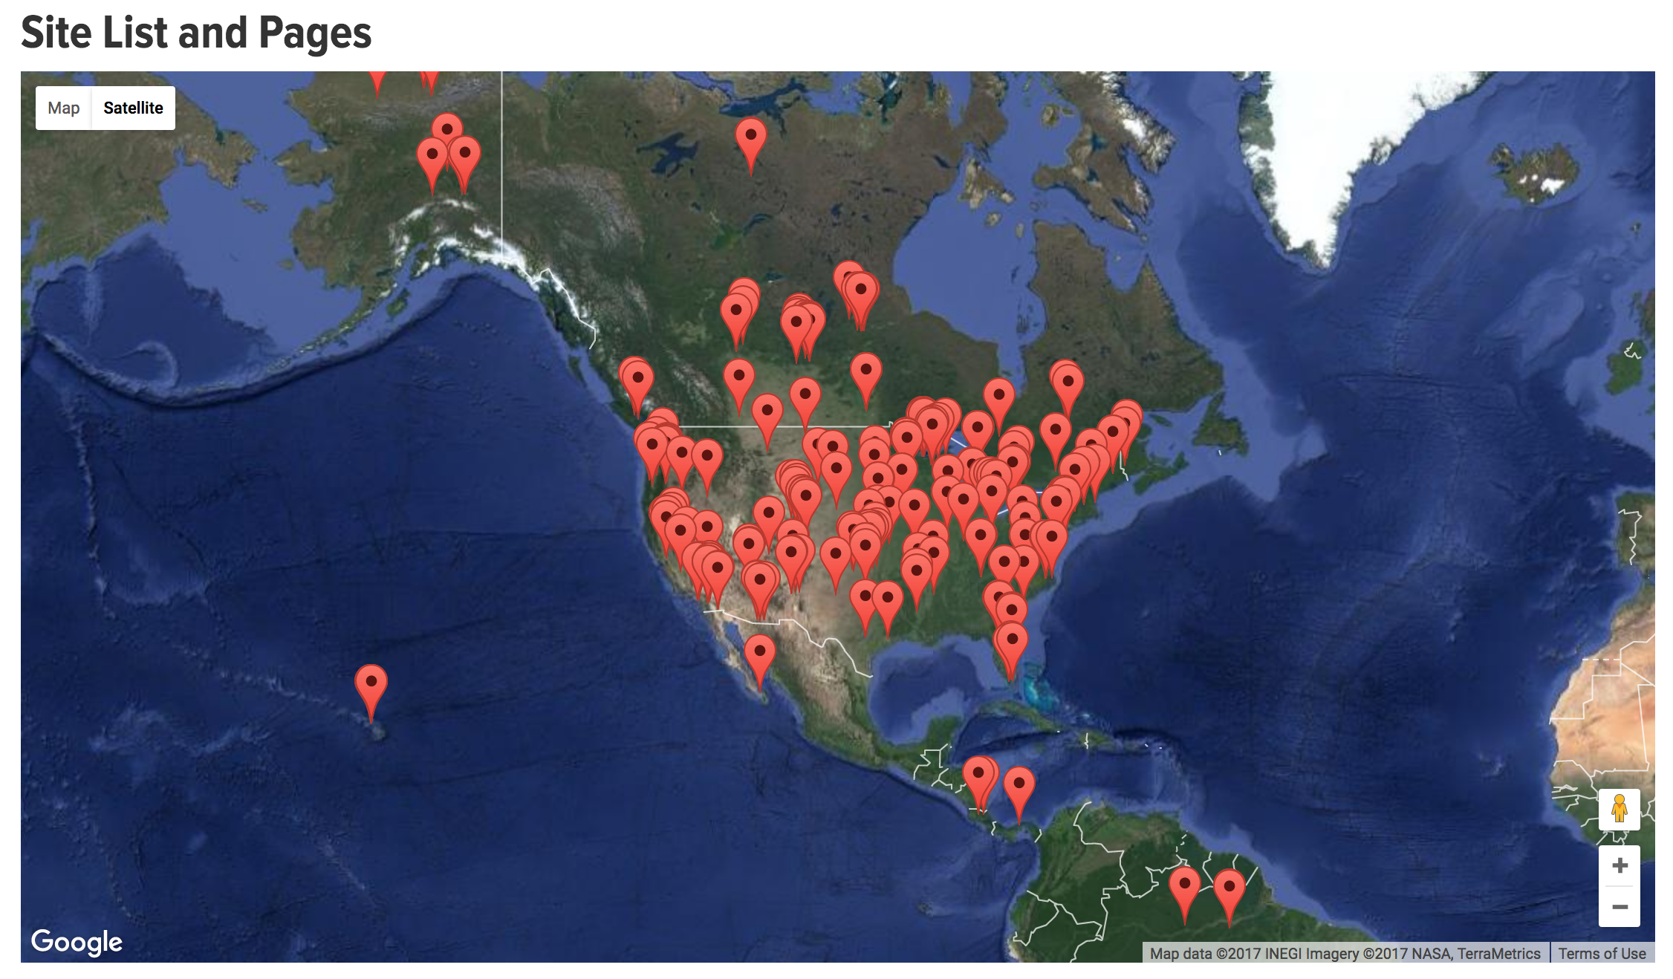
Demo
Visualize AmeriFlux Sites
Source: http://ameriflux.lbl.gov/sites/site-list-and-pages/

Slide 7
Outline
Data/Metadata Standards and Tools
Tabular Data and Google Fusion Table
NetCDF and Climate & Forecast Convention
Data Access/Visualization Standards and Tools
OPeNDAP
NetCDF Subset Service (NCSS)
OGC Web Services
Demonstration

Slide 8
NetCDF
Network Common Data Form (NetCDF)
NetCDF4 v.s. NetCDF3
  Internal compression
  Chunking
  Classic & advanced data models
    Extended primitive types
    User-defined types
    Groups
A NetCDF4 file is actually an HDF5 file

Slide 9
Structure of a Classic-model NetCDF file
dimensions:
lat = 360 ;
lon = 720;
time = UNLIMITED ; // (365 currently)
variables:
double lat(lat) ……;
double lon(lon) ……;
double time(time) ……;
double var1(time, lat, lon) ;
var1:standard_name = “some_variable_standard_name”;
double var2(time, lat, lon) ;
var2:standard_name = “some_variable_standard_name”;
// global attributes: ….
data:
lat = -89.75, -89.25, -88.75, -88.25, -87.75, ……
lon = -179.75, -179.25, -178.75, -178.25, -177.75, ……
time = ……
var1 = ……
var2 = ……
NetCDF Files in Advanced Data Model
CARVE: L2 Atmospheric CO2, CO and CH4 Concentrations, Harvard CRDS, Alaska, 2012-2014

Slide 10
Climate and Forecast (CF) Conventions
http://cfconventions.org
Interoperability
  Self-descriptive
  Human- and machine-readable
  Widely-used
  NASA ESDIS-adopted standard
  IPCC Assessment Report numerical model outputs
Notes:
Intergovernmental Panel on Climate Change

Slide 11
Components of CF Conventions
CF Standard Names
CF metadata conventions
  Spatial/temporal coordinates
  Cell boundaries/shape/methods
  Missing data/valid range
  Data units
  Data quality
  History
  Other attributes

Slide 12
Define Standard Variable Names
CF Standard Name Table (v41)
  Contain 2799 of (name, description, units) + 386 aliases in 9 categories: Atmospheric Chemistry, Atmosphere Dynamics, Carbon Cycle, Cloud, Hydrology, Ocean Dynamics, Radiation, Sea Ice, and Surface.
What if there is no CF standard name that describes your variable?
  Make your own: leaf_carbon_content -> leaf_nitrogen_content
  Make it a CF standard name

Slide 13
Specify Spatial Info in CF Conventions (1)
Provide cell center coordinates in Geographic Lat/Lon SRS and native SRS (if different)
variables:
double lat(lat) ;
lat:standard_name = "latitude" ;
lat:long_name = "latitude coordinate" ;
lat:units = "degrees_north" ;
double lon(lon) ;
lon:standard_name = "longitude" ;
lon:long_name = "longitude coordinate" ;
lon:units = "degrees_east" ;
data:
lat = -89.75, -89.25, -88.75, -88.25, -87.75, …
lon = -179.75, -179.25, -178.75, -178.25, -177.75, …

Slide 14
Specify Spatial Info in CF Conventions (2)
Specify cell boundaries
  Left-right boundary
  Bottom-top boundary
double lat_bnds(lat=360, nv=2);
:units = "degrees_north";
double lon_bnds(lon=720, nv=2);
:units = "degrees_east";
double lat(lat=360);
:bounds = "lat_bnds";
:units = "degrees_north";
double lon(lon=720);
:bounds = "lon_bnds";
:units = "degrees_east";

Slide 15
Specify Temporal Info in CF Conventions (1)
Specify calendar and time coordinates
dimensions:
time = UNLIMITED ; // (365 currently)
variables:
float time(time) ;
time:standard_name = "time" ;
time:calendar = "standard" ;
time:units = "days since 1980-01-01 00:00:00 UTC" ;
time:bounds = "time_bnds" ;
data:
time = 7305.5, 7306.5, 7307.5, …, 7668.5, 7669.5 ;
// time = "2000-01-01 12", "2000-01-02 12", "2000-01-03 12”, …, "2000-12-29 12”, "2000-12-30 12” ;
Calendar and time coordinates for Daymet data in 2000

Slide 16
Specify Temporal Info in CF Conventions (2)
Specify time boundaries
1980
2010
start
middle
end

Slide 17
Specify Temporal Info in CF Conventions (3)
Specify time boundaries
dimensions:
time = UNLIMITED ; // (365 currently)
nv = 2 ;
variables:
float time_bnds(time, nv) ;
time:long_name = "time boundaries" ;
time:calendar = "standard" ;
time:units = "days since 1980-01-01 00:00:00 UTC" ;
data:
time_bnds = {7305, 7306; 7306, 7307; …; 7669, 7670; }
// time_bnds = {"2000-01-01 00:00:00", "2000-01-02 00:00:00”; "2000-01-02 00:00:00", "2000-01-03 00:00:00”; …; "2000-12-30 00:00:00", "2000-12-31 00:00:00”; }
Time boundaries for Daymet data in 2000

Slide 18
Cell Methods
To describe the characteristic of a variable that is represented by grid cell values
  NARR dswrf: 3-hourly average, average across a 32km by 32km region
  NARR precip: 3-hourly accumulated, average across a 32km by 32km region
cell_methods
  “time: mean area: mean”
  “time: sum area: mean”
point
sum
maximum
median
mid_range
minimum
mean
mode
standard_deviation
variance

Slide 19
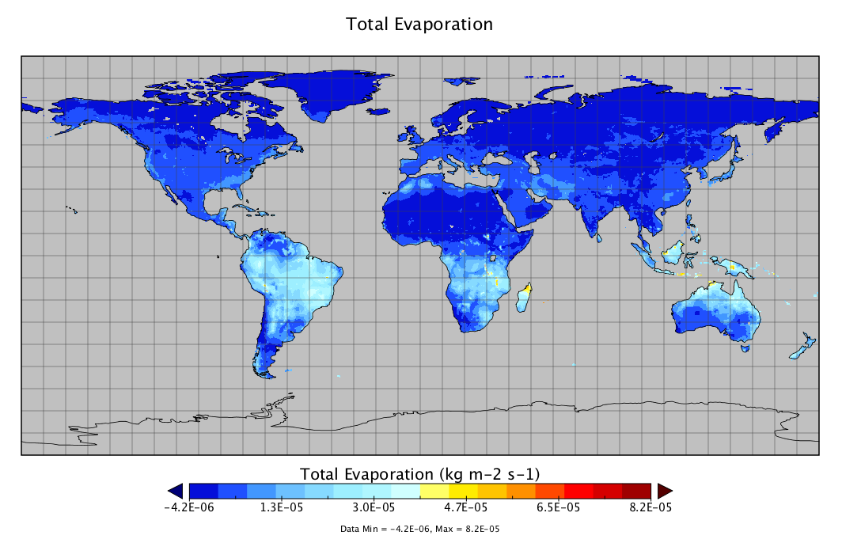
Missing Data
Use _FillValue, valid_min, valid_max, and valid_range to indicate what values in a variable are considered to be valid or what values shall be ignored.
  float nbp(time=20, lat=74, lon=120);
  :_FillValue = -9999.0f; // float

Slide 20
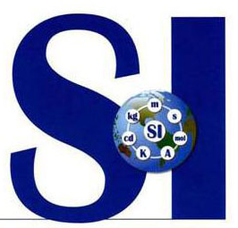
Data Units
UDUNITS
  Based on International System of Units
  Support conversion of unit specifications
  Support arithmetic manipulation of units
  conversion of values between compatible scales of measurement
Follow the rules and computers can then do a lot of work for you and others.
kg m-2 s-1
Kg/m2/month
kgC m-2 s-1
Units for Gross Primary Productivity (GPP)

Slide 21
Data Quality (1)
Ancillary Data
  one data variable provides metadata about the individual values of another data variable
float q(time) ;
q:standard_name = "specific_humidity" ;
q:units = "g/g" ;
q:ancillary_variables = "q_error_limit q_detection_limit" ;
float q_error_limit(time)
q_error_limit:standard_name = "specific_humidity standard_error" ;
q_error_limit:units = "g/g" ;
float q_detection_limit(time)
q_detection_limit:standard_name = "specific_humidity detection_minimum" ;
q_detection_limit:units = "g/g" ;
Source: Example 3.2. of CF Conventions Document

Slide 22
Data Quality (2)
Flags
  The attributes flag_values, flag_masks and flag_meanings are intended to make variables that contain flag values self describing.
byte current_speed_qc(time, depth, lat, lon) ;
current_speed_qc:long_name = "Current Speed Quality" ;
current_speed_qc:standard_name = "sea_water_speed status_flag" ;
current_speed_qc:_FillValue = -128b ;
current_speed_qc:valid_range = 0b, 2b ;
current_speed_qc:flag_values = 0b, 1b, 2b ;
current_speed_qc:flag_meanings = "quality_good sensor_nonfunctional outside_valid_range" ;
Source: Example 3.3. of CF Conventions Document

Slide 23
General Attributes
title: description of what is in the dataset
institution: specifies where the data was produced
references: references that describe the data
source: the method of production of the original data
history: provenance of the data
comment: miscellaneous information
// global attributes:
:title = "CLM4 monthly GPP for MsTMIP RG1 global simulation" ;
:source = "CLM-CN v4.0" ;
:institution = "Oak Ridge National Laboratory" ;
:references = "Oleson K. W. et al., 2010, Technical description of version 4.0 of the Community Land Model (CLM) NCAR Tech. Note NCAR/TN-478+STR (Boulder, CO: National Center for Atmospheric Research)" ;
Attributes for Global Monthly GPP Output from CLM4 Model

Slide 24
CF Conventions for Discrete Data
Point Data
Time Series Data
Profile Data
Trajectory Data
Time Series of Profiles
Trajectory of Profiles

Slide 25
CF-compliance Checker
Check if a netCDF file complies with the CF comformance requirements and recommendations.
http://cfconventions.org/compliance-checker.html

Slide 26
CF Conventions for HDF
CF Conventions were originally tied to NetCDF
The HDF Group and NASA are working together to make HDF work with CF
  NASA ESDSWG Data Interoperability WG
  Consider converting/augmenting HDF/HDF-EOS to netCDF
    HDF4/HDF-EOS2 to CF Conversion Toolkit
    HDF-EOS5 augmentation tool
  Example from The HDF Group: Adding CF Attributes to an HDF file

Slide 27
Outline
Data/Metadata Standards and Tools
Tabular Data and Google Fusion Table
NetCDF and Climate & Forecast Convention
Data Access/Visualization Standards and Tools
OPeNDAP
NetCDF Subset Service (NCSS)
OGC Web Services
Demonstration

Slide 28

Open-source Project for a Data Access Protocol
  On-the-fly remote data access: provides users simple, remote access to large collections of data sets via the internet through HTTP
  Subset data along any dimension(s)
  Get data in ASCII (ascii), DAP (dods), and netCDF formats (nc/nc4)
OPeNDAP Data Request Syntax
http://HOSTNAME/PATH/TO/DATA.format?VAR1[start:stride:end], VAR2[start1:stride1:end1][start2:stride2:end2][start3:stride3:end3]
An OPeNDAP Quick Start Guide

Slide 29
OPeNDAP Servers and Clients
Servers
  THREDDS Data Server
  Hyrax
  ERDDAP
  PyDAP
  GrADS Data Server (GDS)
  …
Clients
  NCL
  CDAT
  Ferret
  GrADS
  Panoply
  ArcGIS Desktop
  ArcGIS Pro
  R
  IDV
  Matlab
  Python
  …

Slide 30
Outline
Data/Metadata Standards and Tools
Tabular Data and Google Fusion Table
NetCDF and Climate & Forecast Convention
Data Access/Visualization Standards and Tools
OPeNDAP
NetCDF Subset Service (NCSS)
OGC Web Services
Demonstration

Slide 31
NCSS – NetCDF Subset Service
Similar to OPeNDAP
Subset based on real coordinates and time ranges instead of matrix indices
Get data in netCDF format
NCSS Data Request Syntax
http://HOSTNAME/PATH/TO/DATA?var=VAR1&var=VAR2 &north=70&west=10&east=50&south=20&horizStride=1
&time_start=1988-01-01T12:00:00Z&time_end=1988-12-30T12:00:00Z
&timeStride=1 &accept=format
Spatial and Temporal Subsets of Daymet Data Using the THREDDS NetCDF Subset Service (NCSS) for Grids

Slide 32
Outline
Data/Metadata Standards and Tools
Tabular Data and Google Fusion Table
NetCDF and Climate & Forecast Convention
Data Access/Visualization Standards and Tools
OPeNDAP
NetCDF Subset Service (NCSS)
OGC Web Services
Demonstration

Slide 33
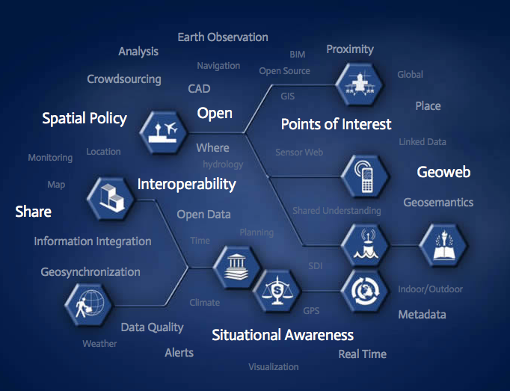
OGC
OGC – Open Geospatial Consortium
“The Open Geospatial Consortium, Inc.® (OGC) is a non-profit, international, voluntary consensus standards organization that is leading the development of standards for geospatial and location based services”
http://www.opengeospatial.org/

Slide 34
OGC Standards
OGC Web Coverage Service (WCS)
  Web service for geospatial raster data access
OGC Web Feature Service (WFS)
  Web service for geospatial vector data access
OGC Web Map Service (WMS)
  Web service for geospatial data (raster or vector) visualization
Many others …
WCS Data Request Syntax
http://HOSTNAME/PATH/TO/WCS? service=WCS&version=1.0.0&request=GetCoverage &coverage=data_name&crs=EPSG:4326&bbox=west,south,east,north&resx=0.2&resy=0.2&format=GeoTIFF&time=1972-01&interpolation=AVERAGE

Slide 35
Data Available Through These Web Services
Most NASA data centers set up OPeNDAP/NCSS/OGC services to distribute their data holdings
  Daymet, NACP, ABoVE, …
  Land surfaces
  Atmosphere
  Ocean
Coupled Model Intercomparison Project (CMIP5) model outputs

Slide 36
Outline
Data/Metadata Standards and Tools
Tabular Data and Google Fusion Table
NetCDF and Climate & Forecast Convention
Data Access/Visualization Standards and Tools
OPeNDAP
NetCDF Subset Service (NCSS)
OGC Web Services
Demonstration

Slide 37
Demo
Explore the ORNL DAAC THREDDS Data Server to visualize and find data of your interest
  Get the remote data URL
  Get familiar with the OPeNDAP/NCSS protocols
Access and use remote data from OPeNDAP services in your workspace (e.g. Python)
ORNL DAAC THREDDS Data Server
Notes:
Thematic Real-time Environmental Distributed Data Services (THREDDS)

Slide 38
Spatial Data Access Tool
Spatial Data Access Tool (SDAT)
  A family of Web-based services and applications for
    Visualization and exploration
    Subset, reformat, reprojection, and download
    Spatial query
  Built on top of OGC standards
    Web Coverage Service (WCS)
    Web Map Service (WMS)
    Web Feature Service (WFS)
    Keyhole Markup Language (KML)
    Well-known Text (WKT)
    Styled Layer Descriptor (SLD)
Notes:
Underlined items are standards approved by the ESDIS Standards Office (ESO). Dashed-underlined items means discussions have been held and lessons-learned document has been provided.

Slide 39
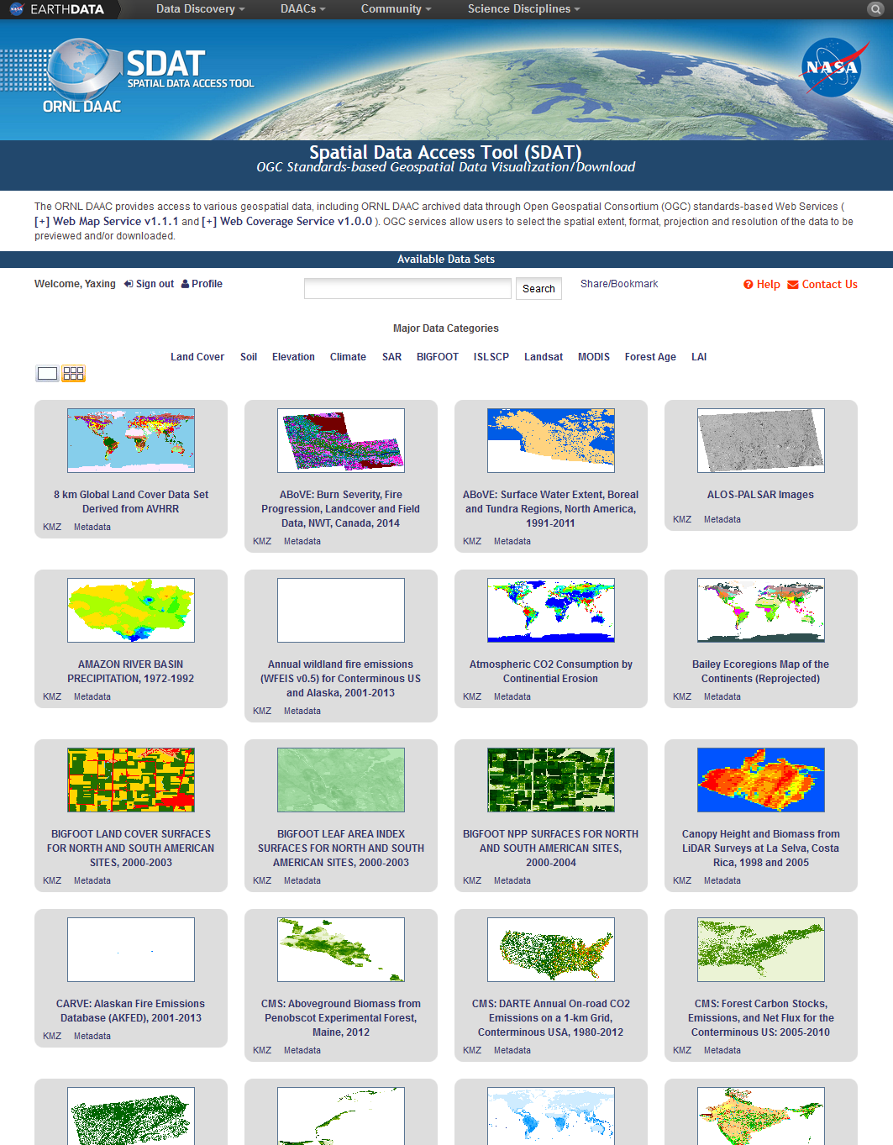
SDAT Web
User Interface (1)
Browse Data
Web-based application
- No software installation needed
Browse and search data
- Grid/Map view
- Keywords-based search
Bring OGC features to users
- Data visualization
- Data download
https://webmap.ornl.gov/ogcdown
C-23 Sherpa

Slide 40
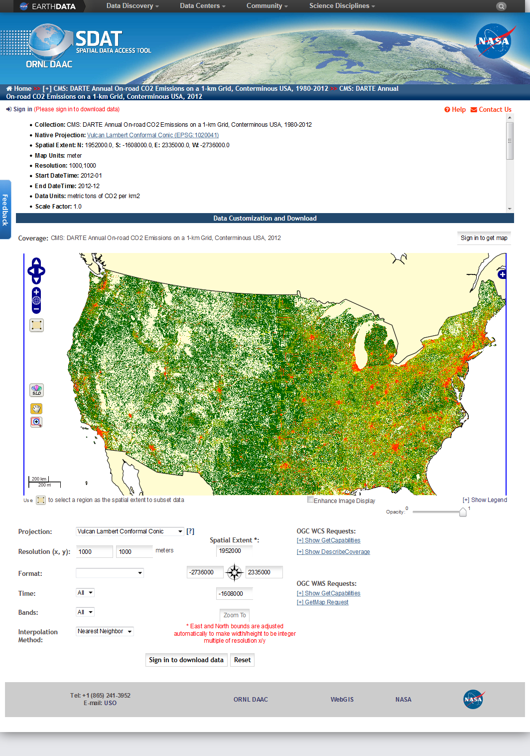
SDAT Web
User Interface (2)
Visualize/Download Data
Download data in standard formats (e.g. netCDF, geoTIFF, and KML)
Reproject, Resample, and Subset
Download in various file formats
Detailed granule level metadata
Open Geospatial Consortium (OGC)–based
Export to Google Maps or Earth
Detailed Metadata
OGC WMS map
C-23 Sherpa
OGC WCS Download
Download Options

Slide 41
SDAT Demo
Fire Disturbance Caused by
Cedar Fire in 2003

Slide 42
Demo
This forest disturbance demo shows how SDAT Web user interface can help you download different data in the same form (projection, extent, resolution, format, etc.) so you can integrate them directly in your analysis …

Slide 43
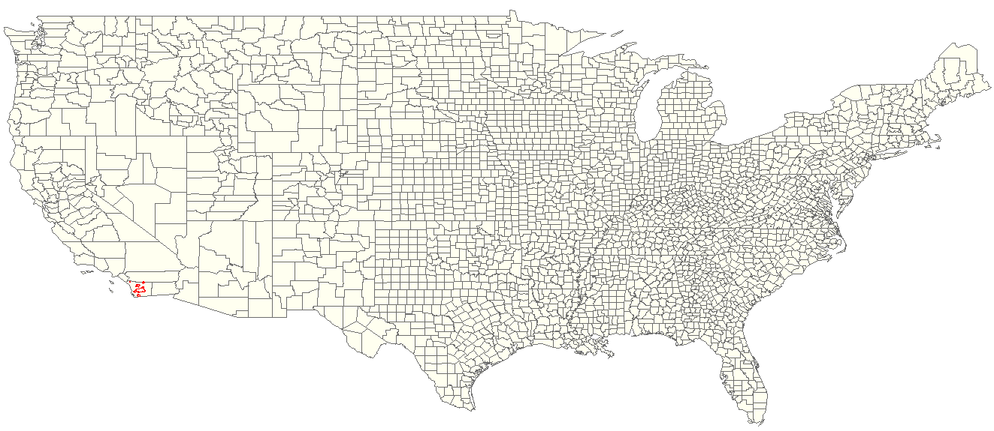
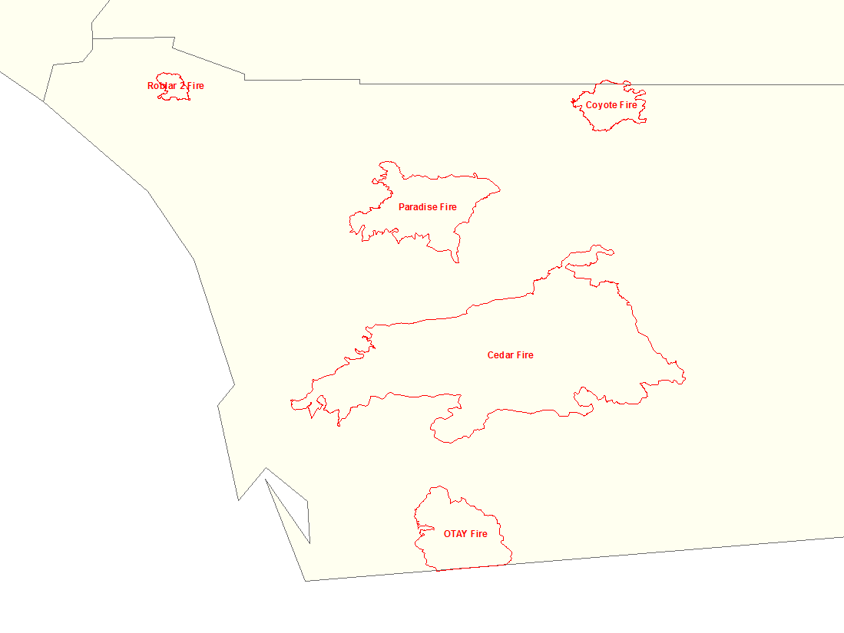
San Diego Fire Boundaries in 2003
It says the Cedar Fire was the largest wildfire in recorded California history, with the possible exception of the Santiago Canyon Fire of 1889.
Spatial Extent of Interest
West: -117.674°, South: 32.441°, East: -116.162°, North: 33.576°

Slide 44
Data of Interest
Forest Disturbance
Forest Age
Land Cover

Slide 45
Find Data
Go to SDAT Web user interface: https://webmap.ornl.gov/ogcdown

Slide 46
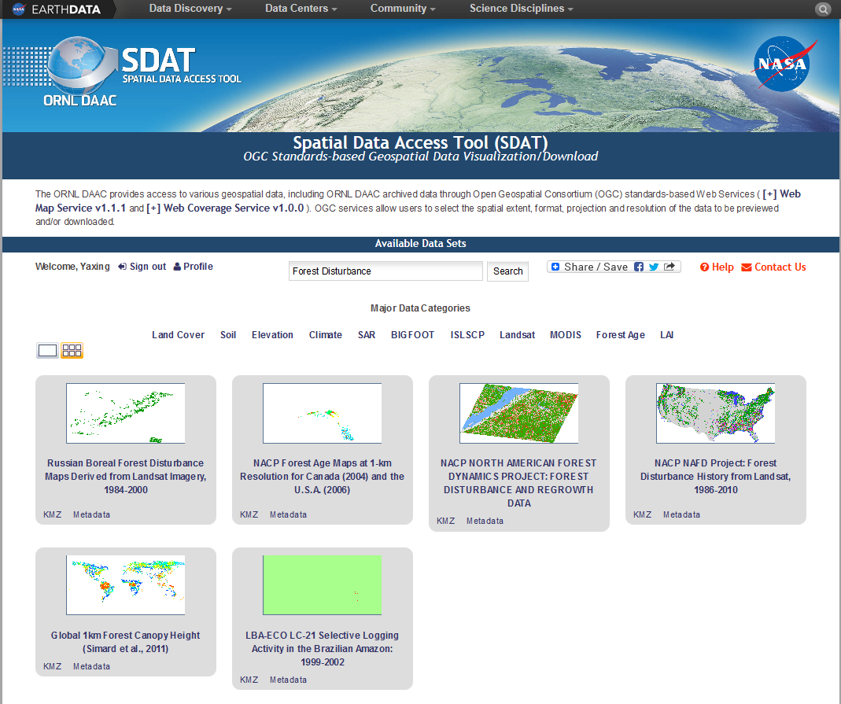
Forest Disturbance
NACP NAFD Project: Forest Disturbance History from Landsat, 1986-2010
Search “Forest Disturbance” in SDAT

Slide 47
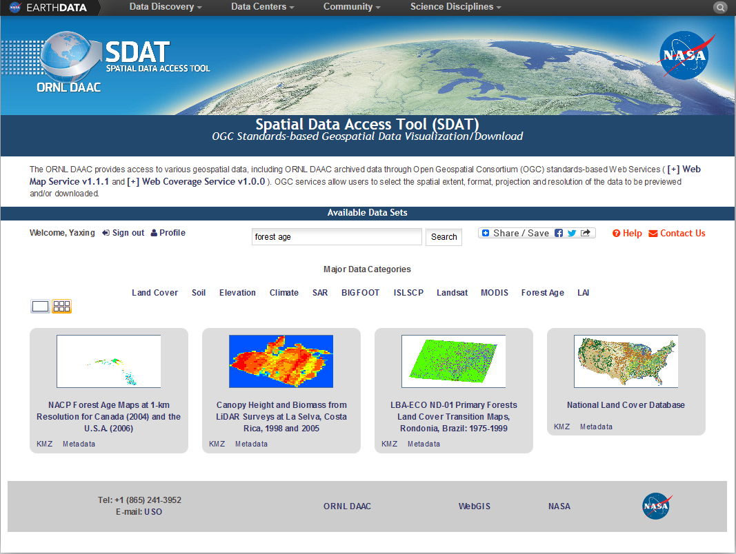
Forest Age
NACP Forest Age Maps at 1-km Resolution for Canada (2004) and the U.S.A. (2006)
Search “Forest Age” in SDAT

Slide 48
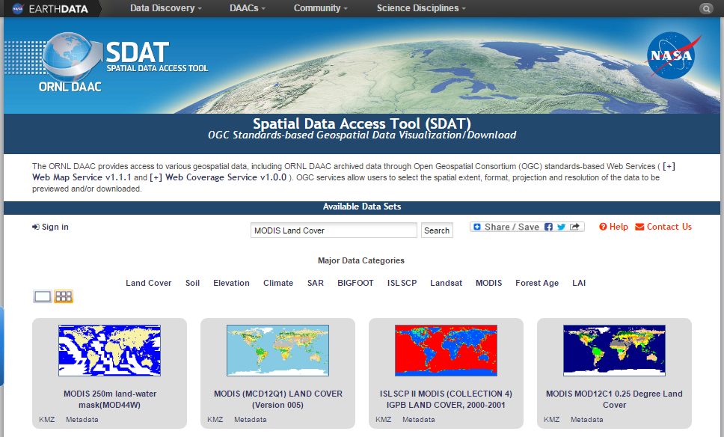
Land Cover
MODIS Land Cover
Search “MODIS Land Cover” (or other relevant words) in SDAT

Slide 49
Get Data
SDAT Web user interface allows you to subset data in your preferred spatial extent/resolution

Slide 50
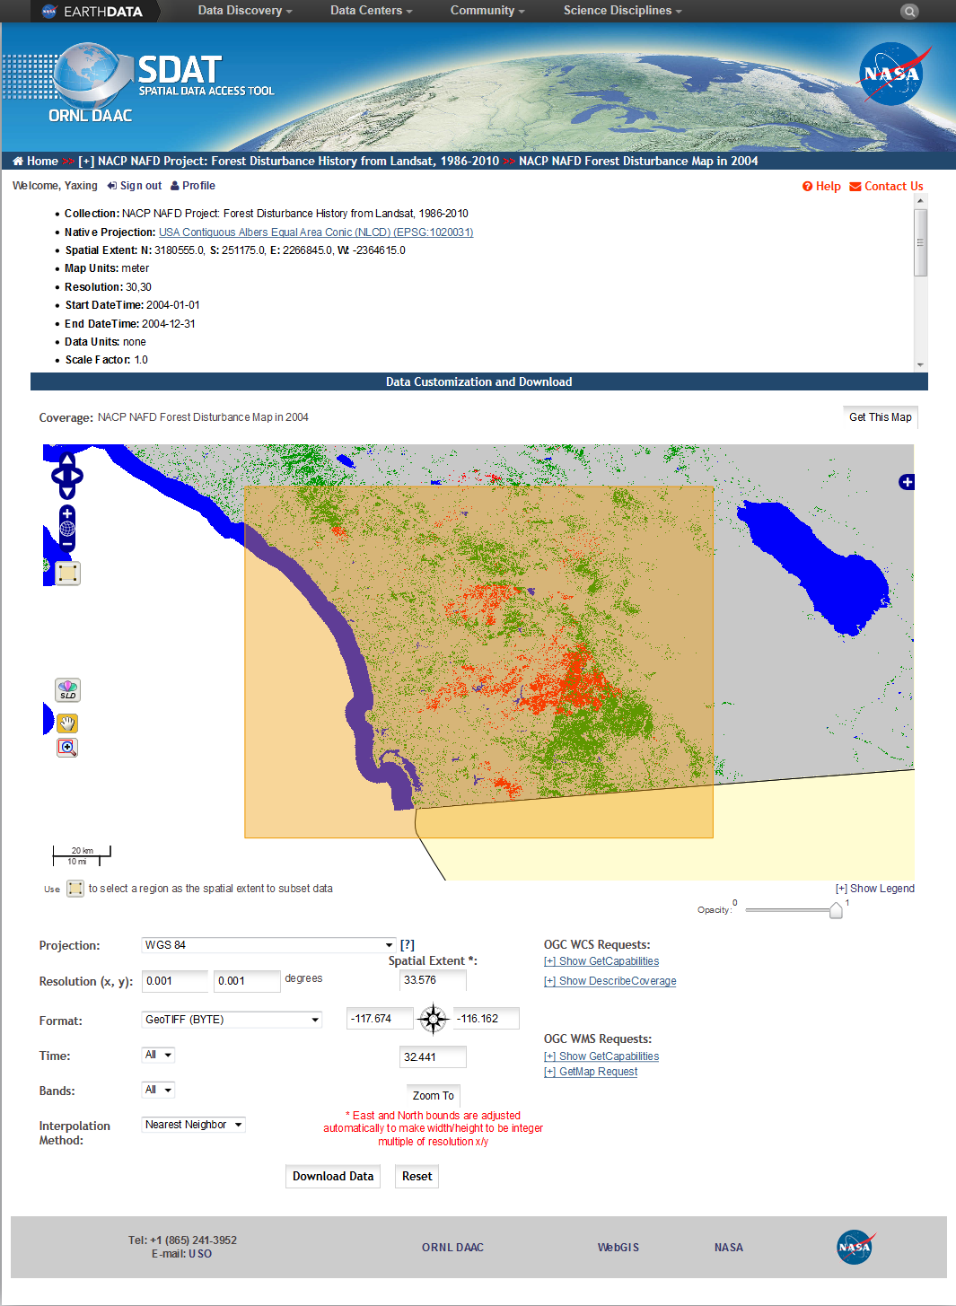
Subset 2004 Forest Disturbance Data in San Diego
Original projection is Albers
Original extent is CONUS
Original resolution is 30 meters
You want data in Geographic Lat/Lon
You want a resolution of 0.001 degree
You want data in geotiff format
This is the spatial extent you want to subset
Click “Download Data” button to get data

Slide 51
Subset “Forest Age Distribution in the Continental United States (2006)” data in the same way
Subset “Land Cover Type 1 (2006): IGBP global vegetation classification ” in the same way

Slide 52
Explore and Analyze Downloaded Data in Your Own Workspace
Since all data have been transformed into the same form by SDAT, you can directly do further data exploration and analysis directly in your own workspace

Slide 53
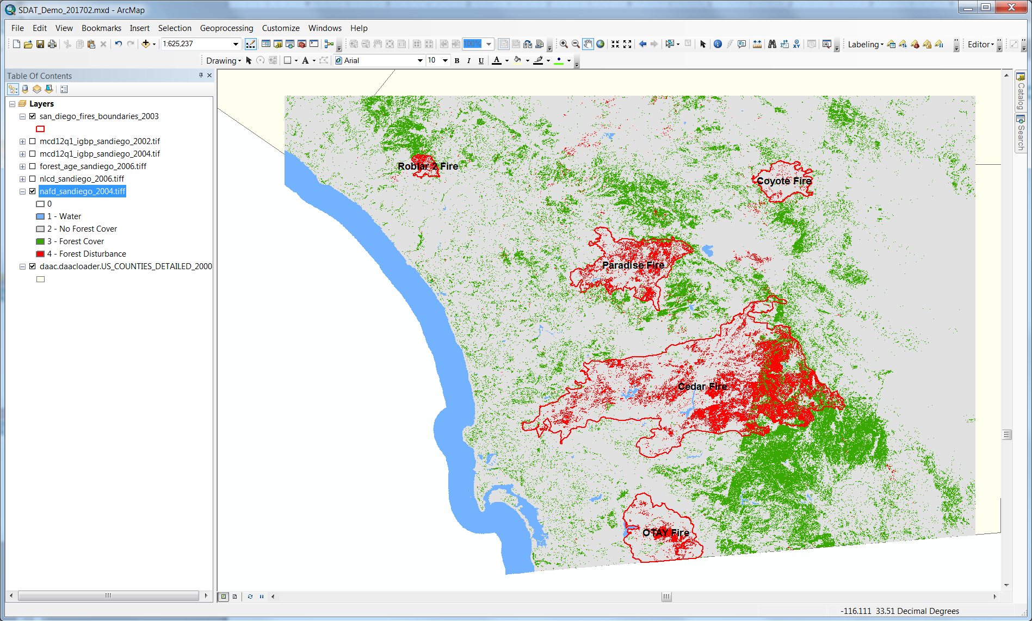
View 2004 Forest Disturbance Map in ArcMap

Slide 54
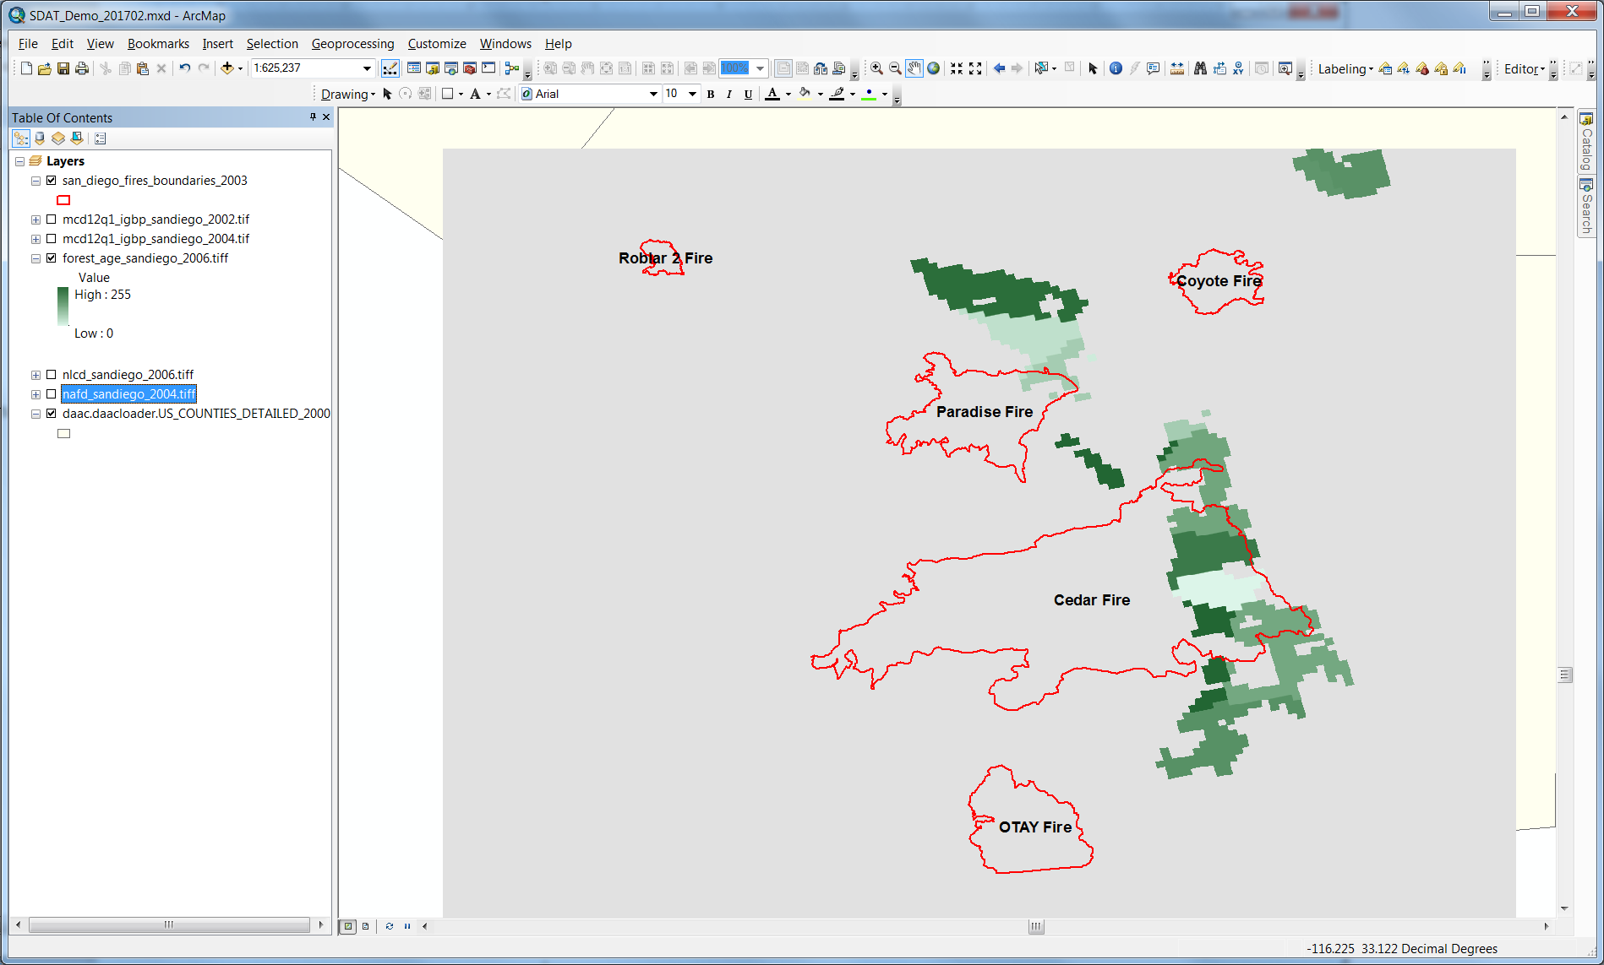
View Forest Age (2006) Map in ArcMap

Slide 55
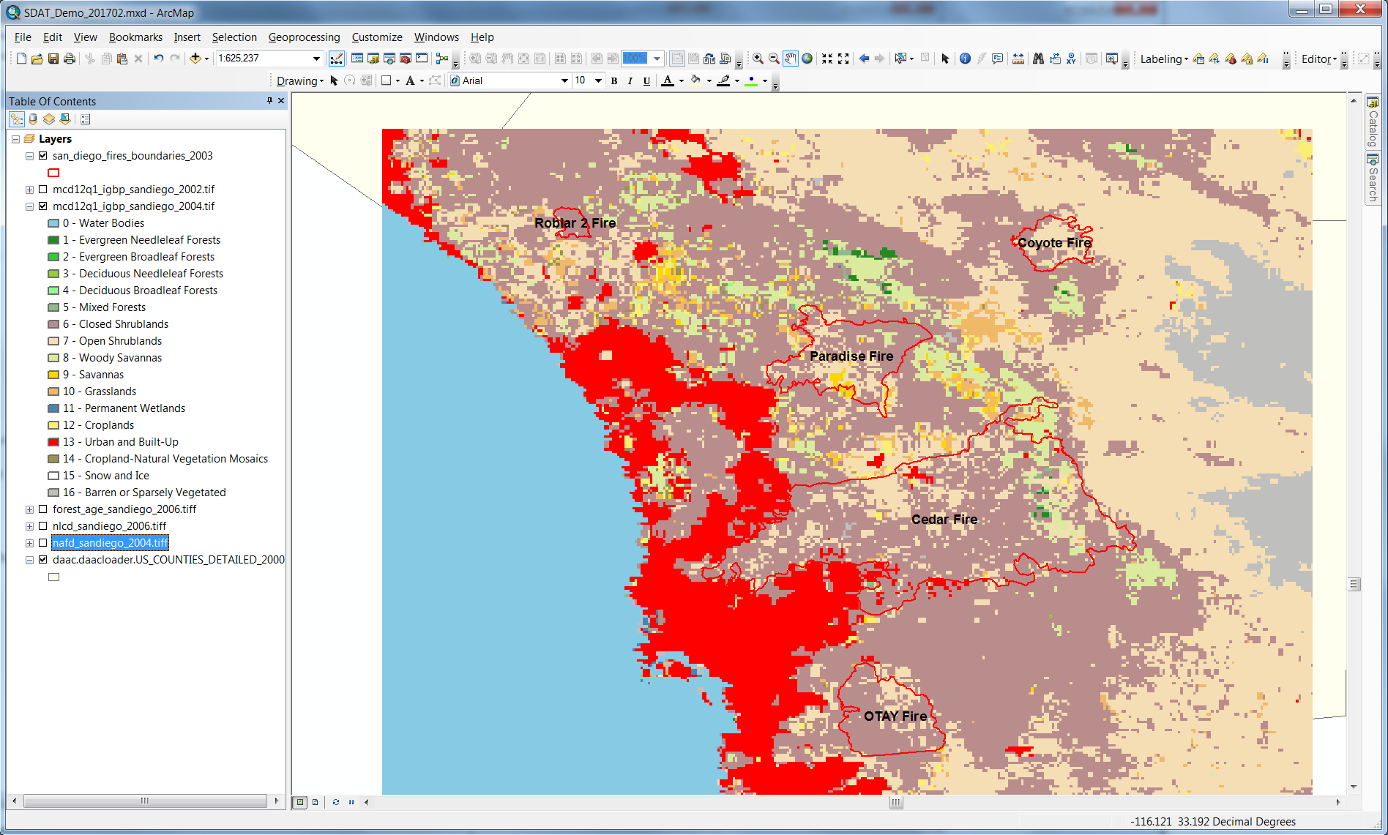
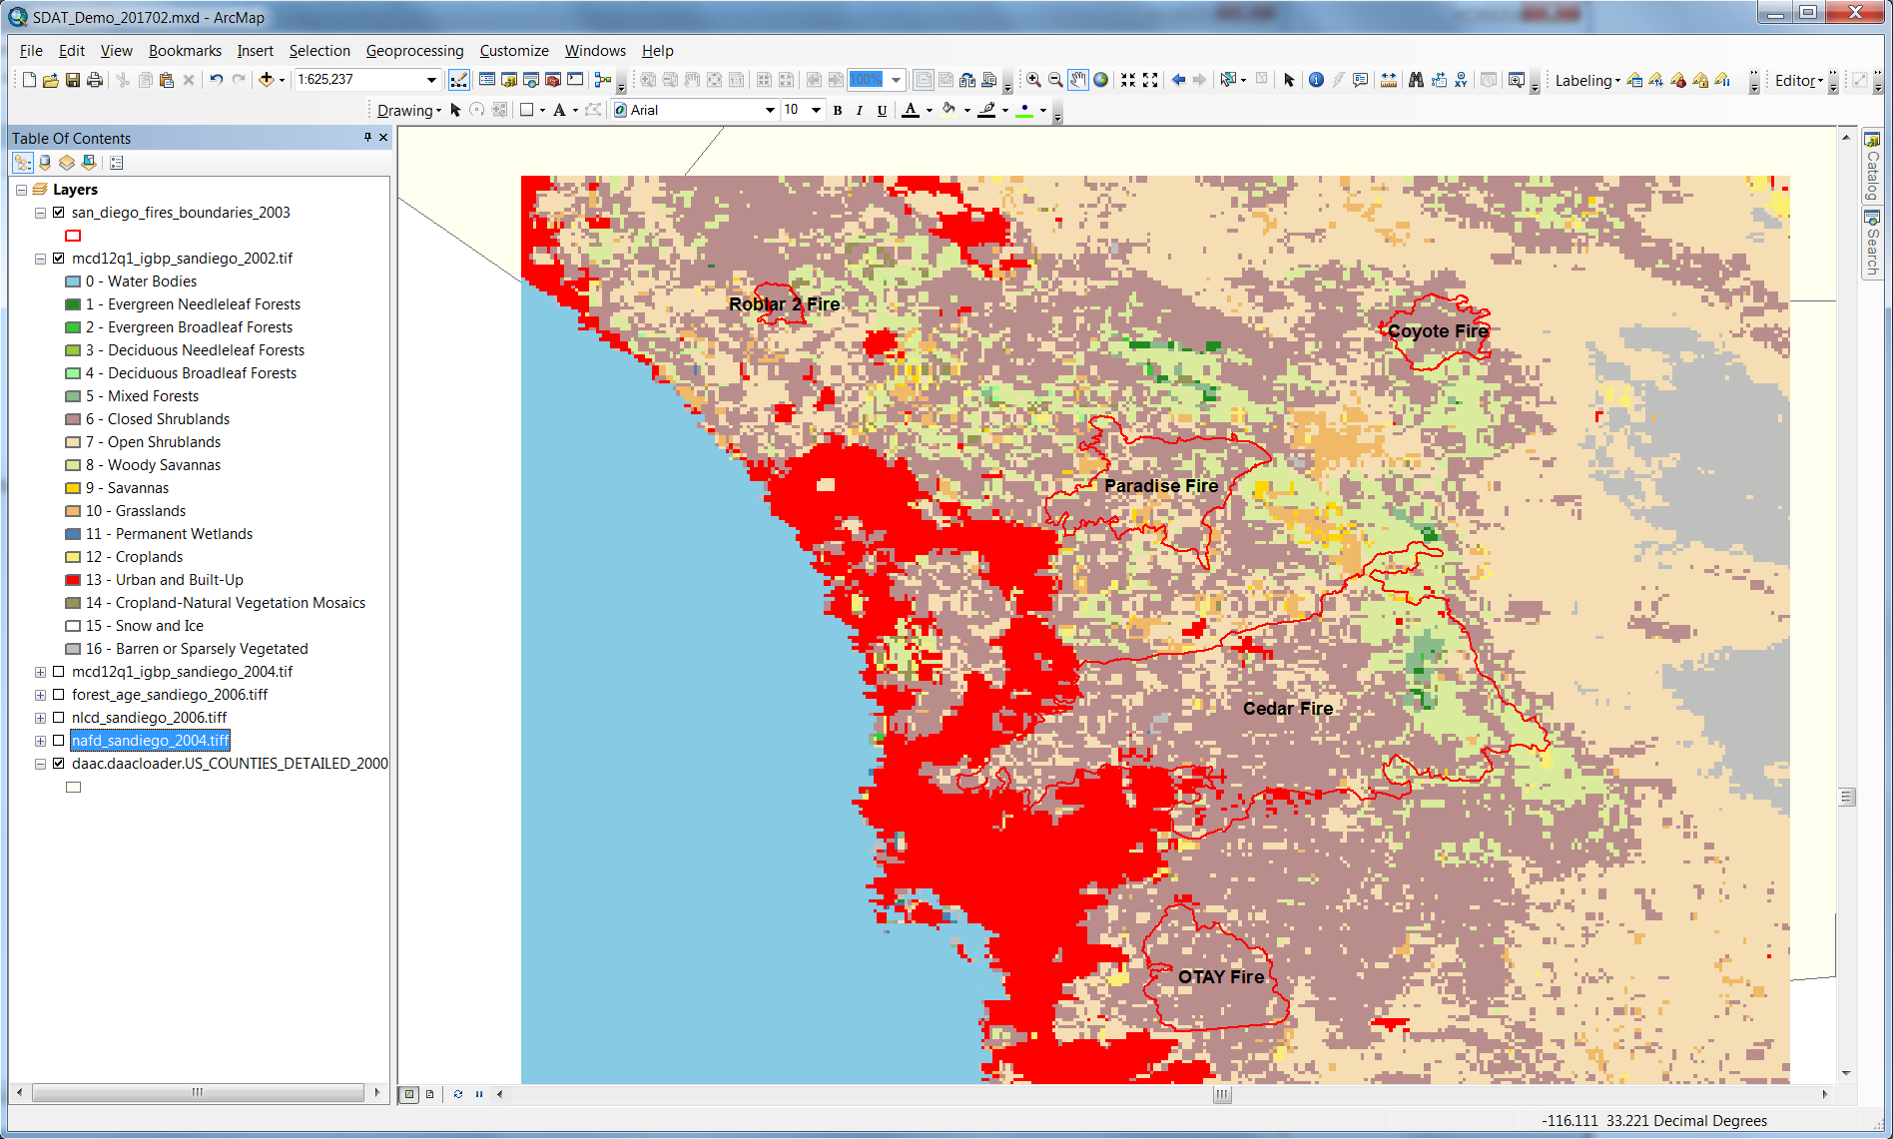
Compare 2002&2004 MODIS Land Cover

Slide 56
Contact us
ORNL DAAC: https://daac.ornl.gov
Yaxing Wei: weiy@ornl.gov
Alison G. Boyer: boyerag@ornl.gov
Debjani Deb: debd@ornl.gov

