Slide 1



Data Management Best Practices
Alison Boyer, Debjani Deb, and Yaxing Wei
ORNL Distributed Active Archive Center
Environmental Sciences Division
Oak Ridge National Laboratory
Oak Ridge, TN
March 26, 2017

Slide 2
WiFi
Network name:
MARRIOTT_CONFERENCE
Password:
NACP2017

Slide 3
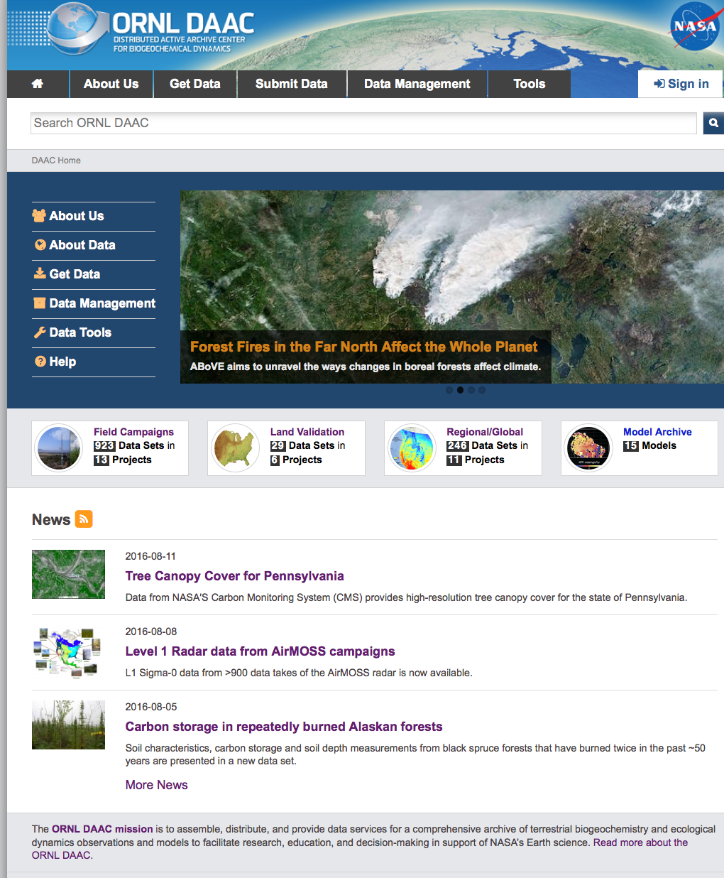
About ORNL DAAC
The Oak Ridge National Laboratory Distributed Active Archive Center (ORNL DAAC) archives data produced by NASA’s Terrestrial Ecology Program in support of NASA’s Carbon Cycle and Ecosystems Focus Area.
ORNL DAAC
Model Code
Land Validation
Regional and Global
Field Campaign
http://daac.ornl.gov

Slide 4
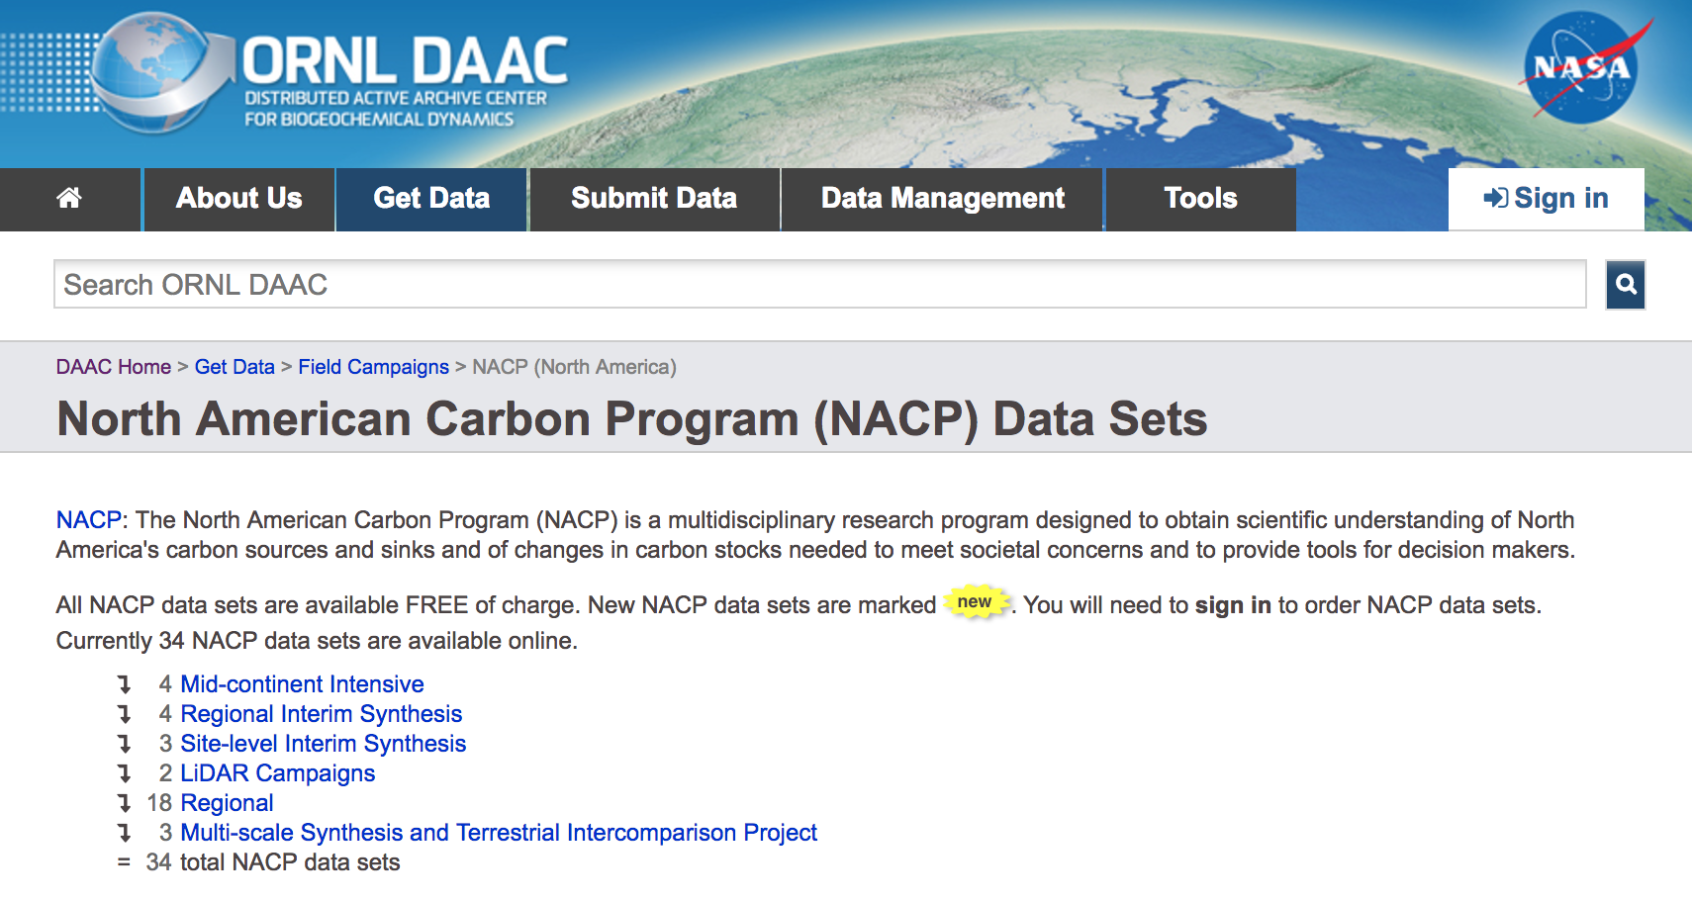
NACP and FLUXNET data at ORNL DAAC
34 NACP data sets
4 FLUXNET data sets

Slide 5
Workshop Goals
Provide data management practices that investigators can use to
improve the usability of their data
encourage open science and reproducible research

Slide 6
Workshop Agenda
Introduction | Alison Boyer | 1:00
Ten principles of data management | Alison Boyer | 1:15
How to write a data management plan | Debjani Deb | 2:00
Break | -- | 2:30 – 2:45
Standards and tools to access and visualize data | Yaxing Wei | 2:45
Archiving data with ORNL DAAC | Debjani Deb | 3:30
Writing a readme file / Open Q&A | Workshop team | 4:00
Closing | Alison Boyer | 4:45

Slide 7
Benefits of Good Data Management Practices
Short-term
Spend less time on data “munging” and more time doing research
Collaborators can readily understand and use data files
Long-term (data archival)
Scientists outside your project can find, understand, and use your data
You get credit for archived data products and their use in other papers
Funding agencies protect their investment
Notes:
Easier to prepare and use data for yourself

Slide 8
Ten principles of data management
Define the contents of your data files
Define the variables
Use consistent data organization
Use stable file formats
Assign descriptive file names
Preserve processing information
Perform basic quality assurance
Provide documentation
Protect your data
Preserve your data
Notes:
These are basic habits that will help improve the information content of your data and make it easier to share with others

Slide 9
1. Define the contents of your data files
Content flows from science plan (hypotheses) and is informed from requirements of final archive.
Keep a set of similar measurements together in one file
    same investigator,
    methods,
    time basis
    instrument
  No hard and fast rules about contents of each file
Notes:
Yaxing begin here

Slide 10



2. Define the variables
Choose the units and format for each variable
Explain the format in the metadata
Use that format consistently throughout the file
Use commonly accepted variable names and units
Example Variable
  Temperature (degrees C)
  Use a value/code (e.g., -9999) for missing values
International System of Units
UDUNITS
CF Standard Name
Unit database and conversion between units
Climate Forecast (CF)
standards promote sharing
Representation of dates and times

Slide 11
2. Define the variables
Variable Names
Use unambiguous and “interoperable” variable names
  Build a table that defines the “short name”→“full name” pairs for variables in your project
  Global Change Master Directory
tmax → land_surface_air__daily_time_max_of__temperature
srad → atmosphere_radiation~incoming~shortwave__transmitted_energy_flux

Slide 12
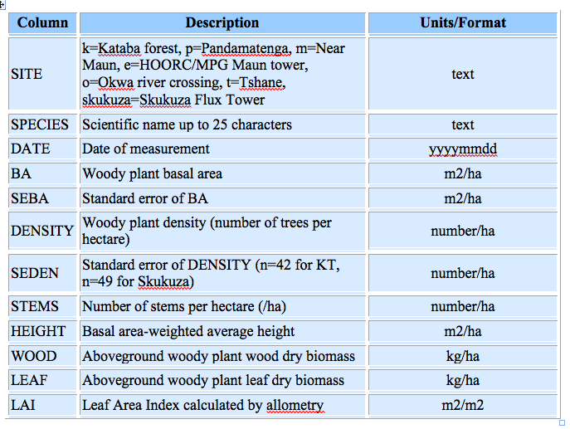
2. Define the variables
Variable Table or “Data Dictionary”
Be consistent
Explicitly state units
Use ISO formats
Scholes (2005)

Slide 13
Site Table
2. Define the variables
site_name | site_code | latitude | longitude | elevation | date
Kataba (Mongu) | k | -15.43892 | 23.25298 | 1195 | 2000-02-21
Pandamatenga | p | -18.65651 | 25.49955 | 1138 | 2000-03-07
Skukuza Flux Tower | skukuza | -31.49688 | 25.01973 | 365 | 2000-06-15
……
Scholes, R. J. 2005. SAFARI 2000 Woody Vegetation Characteristics of Kalahari and Skukuza Sites. ORNL DAAC, Oak Ridge, Tennessee, U.S.A. http://doi.org/10.3334/ORNLDAAC/777

Slide 14
3. Use consistent data organization
Wide format
Long format
Station | Date | Temp | Precip
Units | YYYYMMDD | C | mm
HOGI | 19961001 | 12 | 0
HOGI | 19961002 | 14 | 3
HOGI | 19961003 | 19 | -9999
Station | Date | Variable | Value | Unit
HOGI | 19961001 | Temp | 12 | C
HOGI | 19961002 | Temp | 14 | C
HOGI | 19961003 | Temp | 19 | C
HOGI | 19961001 | Precip | 0 | mm
HOGI | 19961002 | Precip | 3 | mm
HOGI | 19961003 | Precip | -9999 | mm
Note: -9999 is a missing value code for the data set
Notes:
Choose one way to organize your data and stick to that way throughout the file
Make month or site a variable and have all the data in one large file.
There is an upper limit to the size of files, though.
Wide format: Each row in a file represents a complete record, and the columns represent all the variables that make up the record.
Long format: Variable name, value, and units are placed in individual rows. Similar to a database.

Slide 15
Example of poor data organization
Problems with spreadsheets
Multiple tables
Embedded figures
No headings / units
Poor file names
Courtesy of Stefanie Hampton, NCEAS
Notes:
Problems with spreadsheets
Many tables (not a consistent format)
Embedded figures
No headings
Poor filenames

Slide 16
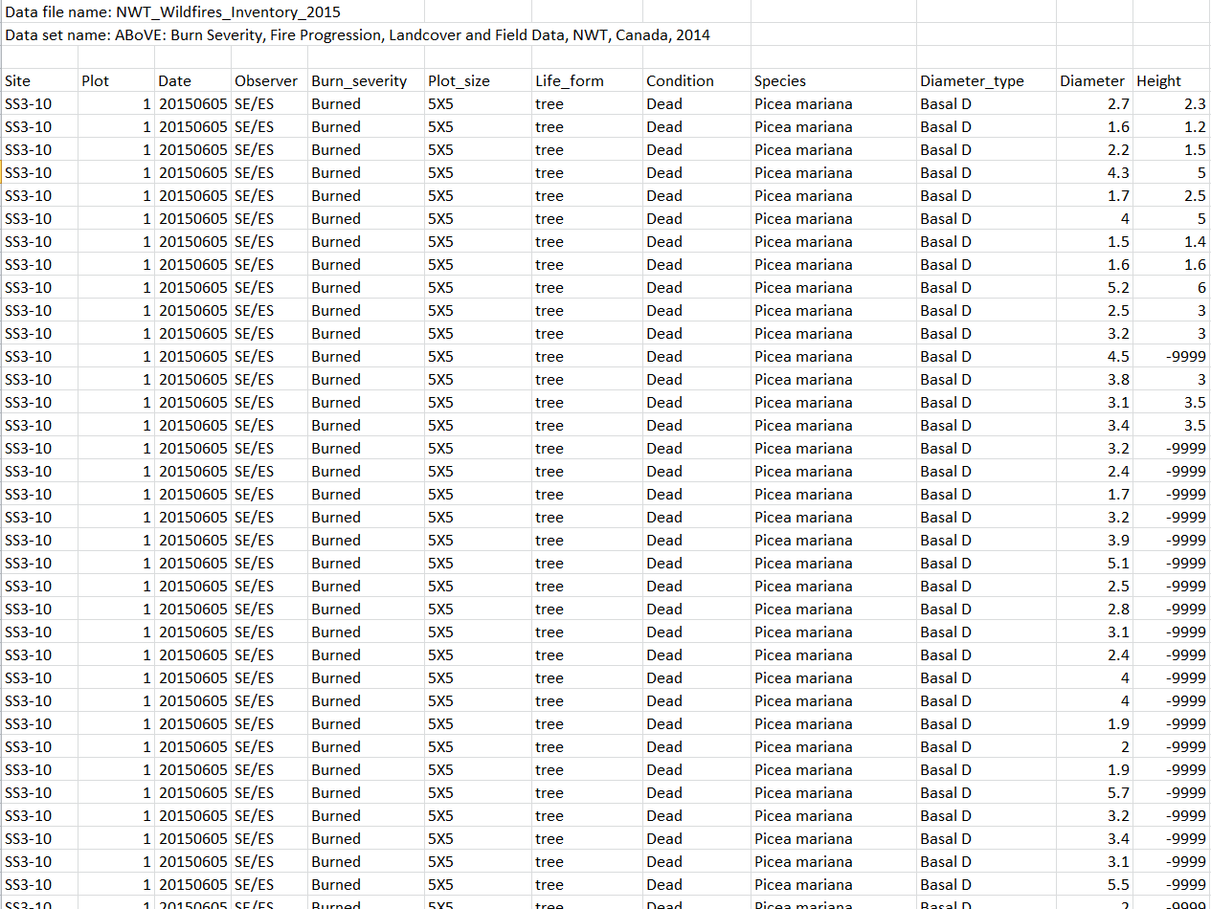
Boreal Burn Severity Data at ORNL: tabular csv format
Bourgeau-Chavez, et al., 2016. http://doi.org/10.3334/ORNLDAAC/1307

Slide 17
Boreal Burn Severity Data at ORNL: tabular csv format
Bourgeau-Chavez, et al., 2016. http://doi.org/10.3334/ORNLDAAC/1307
csv guidelines:
One header line with variable names
No spaces in variable names
Don’t mix types in the same column
Keep summary info separate
Specify the no-data value

Slide 18
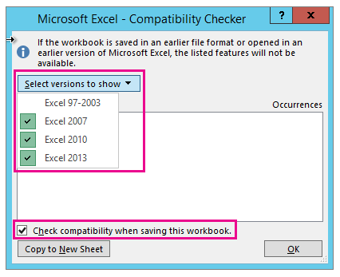
4. Use stable file formats
Avoid proprietary formats; they may not be readable in the future
Recommended formats for
tabular or site-based data:
csv
netCDF
http://news.bbc.co.uk/2/hi/6265976.stm
18

Slide 19
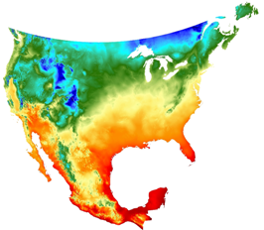
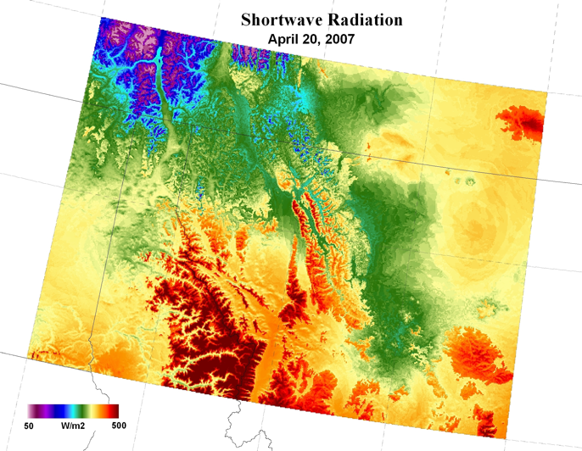
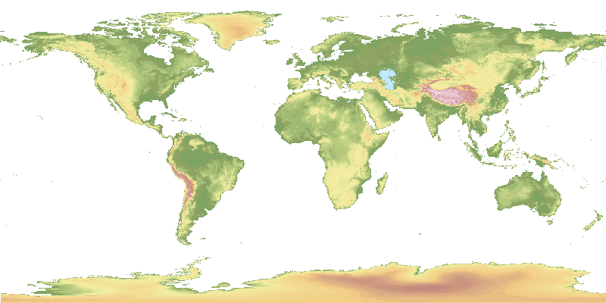
4. Use stable file formats (cont)
Suggested Geospatial File Formats
Raster formats
Geotiff
netCDF
  with CF convention preferred
HDF
ASCII
  plain text file gridded format with external projection information
Vector
Shapefile
ASCII
Minimum Temperature
GTOPO30 Elevation
19

Slide 20
5. Assign descriptive file names
Use descriptive file names
Unique
Reflect contents
ASCII characters only
Avoid spaces
Bad: Mydata.xls
2001_data.csv
best version.txt
Better: bigfoot_agro_2000_gpp.tiff
Project Name
File Format
Year
Site name
What was measured
20

Slide 21
5. Assign descriptive file names
Descriptive file names for model outputs
  Model name
  Simulation code
  Version number
  Variable name
  Spatial info (e.g. place name and/or resolution)
  Time info (e.g. range and/or resolution)
Example good filenames:
BIOME-BGC_BG1_Monthly_GPP_V2.nc4
rlds_Amon_CESM1-CAM5_historical_r1i1p1_185001-200512.nc
daymet_v3_srad_2012_na.nc4
Notes:
Use descriptive file names, which shall include components like model name, simulation code, version number, variable name, space info, and time info. Here we have some example filenames from a few different model research projects, including NACP, CMIP5, and Daymet.

Slide 22

5. Assign descriptive file names Organize files logically
Make sure your file system is logical and efficient
Biodiversity
Lake
Biodiv_H20_heatExp_2005_2008.csv
Experiments
Biodiv_H20_predatorExp_2001_2003.csv
…
Biodiv_H20_planktonCount_start2001_active.csv
Field work
Biodiv_H20_chla_profiles_2003.csv
…
Grassland
Notes:
As a corollary, need to make sure that your well-named files are organized in a logical directory structure

Slide 23
6. Preserve processing information
Raw Data File
Processing Code
Giles_zoopCount_Diel_2001_2003.csv
TAX COUNT TEMPC
C 3.97887358 12.3
F 0.97261354 12.7
M 0.53051648 12.1
F 0 11.9
C 10.8823893 12.8
F 43.5295571 13.1
M 21.7647785 14.2
N 61.6668725 12.9
### Giles_zoop_temp_regress_4jun08.r
### Load data
Giles<-read.csv("Giles_zoopCount_Diel_2001_2003.csv")
### Look at the data
Giles
plot(COUNT~ TEMPC, data=Giles)
### Log Transform the independent variable (x+1)
Giles$Lcount<-log(Giles$COUNT+1)
### Plot the log-transformed y against x
plot(Lcount ~ TEMPC, data=Giles)
Keep raw data raw:
Do not include transformations, interpolations, etc. in data file
Make your raw data “read only” to ensure no changes
Keep your processing code (e.g., R, SAS, MATLAB)
  Code is a record of the processing done and it can be revised & rerun
  Use version control (Git)
  Try a Jupyter notebook or R Studio Markdown
Notes:
To preserve your data and its integrity, save a "read-only" copy of your raw data files with no transformations, interpolation, or analyses. Use a scripted language such as “R”, “SAS” or “MATLAB” to process data in a separate file, located in a separate directory. The scripts you have written are an excellent record of data processing, they can also easily and quickly be revised and rerun in the event of data loss or requests for edits, and have the added benefit of allowing a future worker to follow-up or reproduce your processing. Keep in mind that while GUI-based programs are easy on the front end, they do not keep a record of changes to your data and make reproducing results difficult.
In this example, an “R” to call is made on the data set to plots the data and perform a log transform – this way, changes are not retained in the original, raw data file.

Slide 24
7. Perform basic quality assurance
Ensure that data are delimited and line up in proper columns
Check that there no missing values (blank cells) for key variables
Scan for impossible and anomalous values
Perform and review statistical summaries
Map location data (lat/long) and assess errors
There is no better QA than to analyze data

Slide 25
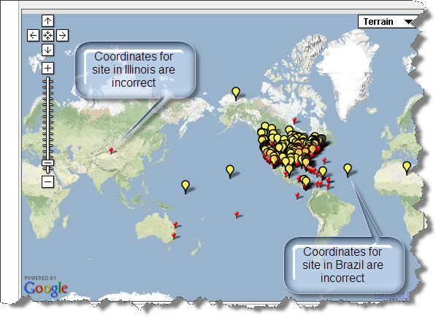
7. Perform basic quality assurance
Place geographic data on a map to ensure that geographic coordinates are correct.
Notes:
Place geographic data on a map to ensure that geographic coordinates are correct. Example is from OBFS Web site.
Illinois site (longitude has the wrong sign, should be negative)
Brazil Site (latitude is positive, but should be negative (should be south of the equator).

Slide 26
8. Provide Documentation / Metadata
What does the data set describe?
Why was the data set created?
Who produced the data set and Who prepared the metadata?
When and how frequently were the data collected?
Where were the data collected and with what spatial resolution? (include coordinate reference system)
How was each variable measured?
How reliable are the data? What is the uncertainty, measurement accuracy? What problems remain in the data set?
What assumptions were used to create the data set?
What is the use and distribution policy of the data set? How can someone get a copy of the data set?
Provide any references to use of data in publication(s)
Notes:
Alison Begin here

Slide 27
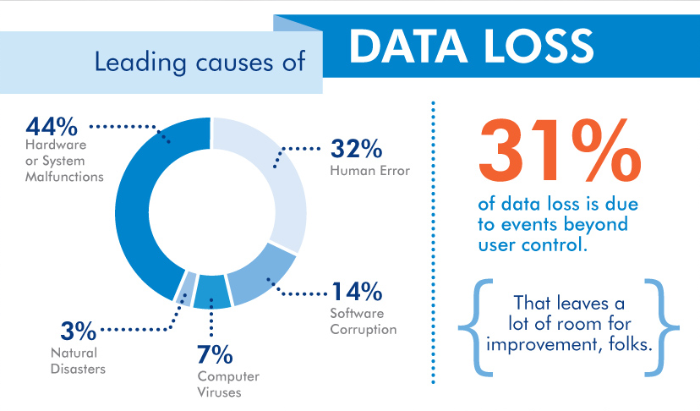
9. Protect data
Create back-up copies and update them often
  original, one on-site (external), and one off-site
Periodically test your back ups
Courtesy of LaCie
Notes:
Remember that disaster may strike not just your computer, but also your building or city. Public repositories provide mirroring of your data at multiple, managed sites.

Slide 28
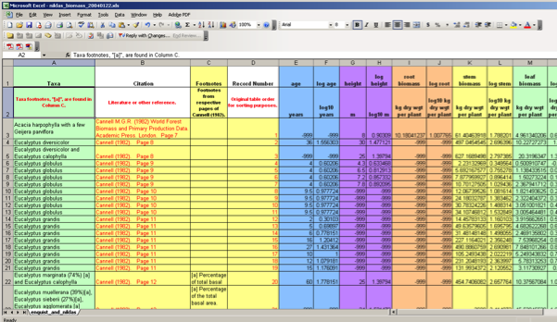
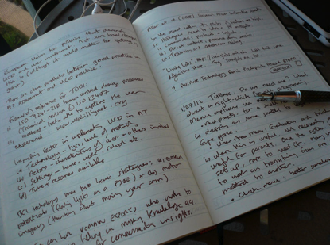
10. Preserve Your Data
What to preserve from the research project?
Well-structured data files, with variables, units, and values defined
Documentation and metadata record describing the data
Additional information (provides context)
  Materials from project wiki/websites
  Files describing the project, protocols, or field sites (including photos)
  Publication(s)
Notes:
You may wonder what should you be preserving from your research project. Generally you should preserve your well-structured data files, with variables, units, and values well-defined. Additionally, preserve your standardized metadata record that describes the data, and, finally, any additional information that provides context such as materials from project wikis or websites, files describing the project, protocols, or field sites, including photos, and any publications using the data.

Slide 29
10. Preserve Your Data (cont)
Where should the data be archived?
Part of project planning
Contact archive / data center early to find out their requirements
  What additional data management steps would they like you to do?
http://daac.ornl.gov
http://ameriflux.lbl.gov/
http://www.fluxdata.org/default.aspx

Slide 30
More resources
Data management information: https://daac.ornl.gov/PI/pi_info.shtml
Workshop presentations will be placed online: https://daac.ornl.gov/workshops/workshops.shtml
Contact me at boyerag@ornl.gov
Follow us on Twitter @ORNLDAAC

