Slide 1
Preparing Spatial Data to Archive
Yaxing Wei
Environmental Sciences Division
Oak Ridge National Laboratory
weiy@ornl.gov
5th NACP Principal Investigator’s Meeting
Washington, DC
January 25, 2015

Slide 2

Presenter: Yaxing Wei
Geospatial Information Scientist at Oak Ridge National Laboratory Distributed Active Archive Center (ORNL DAAC)
Spatial data management, Web-based spatial data distribution and visualization, data quality assurance and quality check (QAWC), …

Slide 3
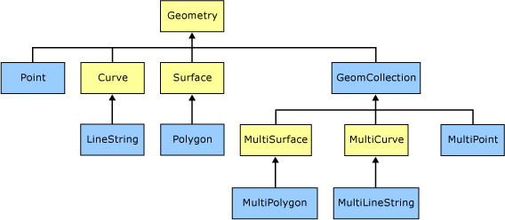
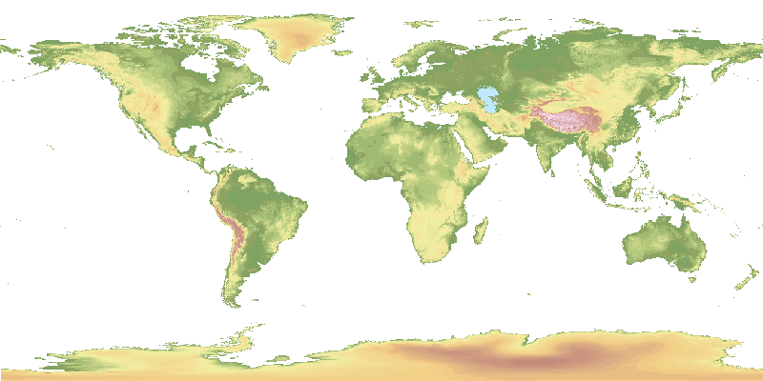
Spatial Data
Any data with location information
  Feature (vector) data: “object” with location and other properties
    AmeriFlux sites/instruments, river lines, ecoregion boundaries, etc.
  Coverage (raster) data: “phenomenon” spanning spatial extent / temporal period
    AmeriFlux site GPP time series (1-D)
    one scene of MODIS LAI (2-D)
    global 1°monthly model output NEE (3-D)
    ….
Source: Microsoft
GTOPO30 Elevation

Slide 4
Fundamental Things for Spatial Data
Where: spatial information
  Spatial Reference System: datum and projection
  Spatial extent/boundary/resolution/scale
When: temporal information
  Calendar
  Time units & extent/resolution/boundary
What: data content
  Data format: structure & organization
  Variables, units, scale, missing value, valid range, …

Slide 5
“Good” Spatial Data
Fundamental things have to be PROVIDED and CORRECT, even if they are provided in human-understandable ways!
One step forward: choose “Good” formats to store your spatial data and provide fundamental information in STANDARD ways.
“Good” spatial data shall be easy to understand and use by yourself and other researchers.

Slide 6
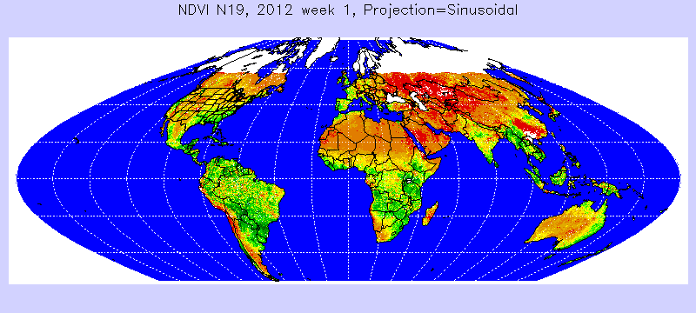
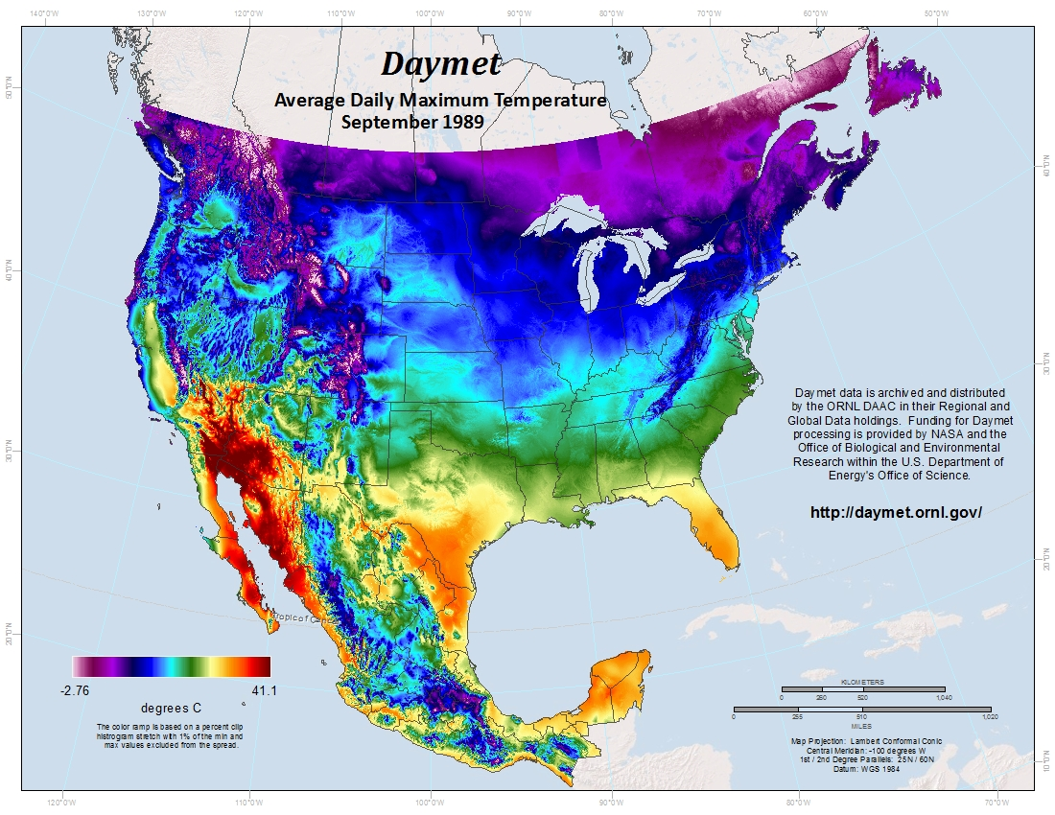
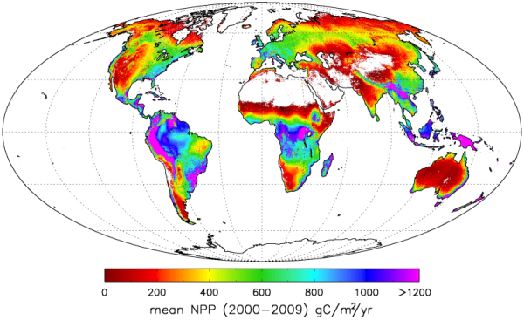
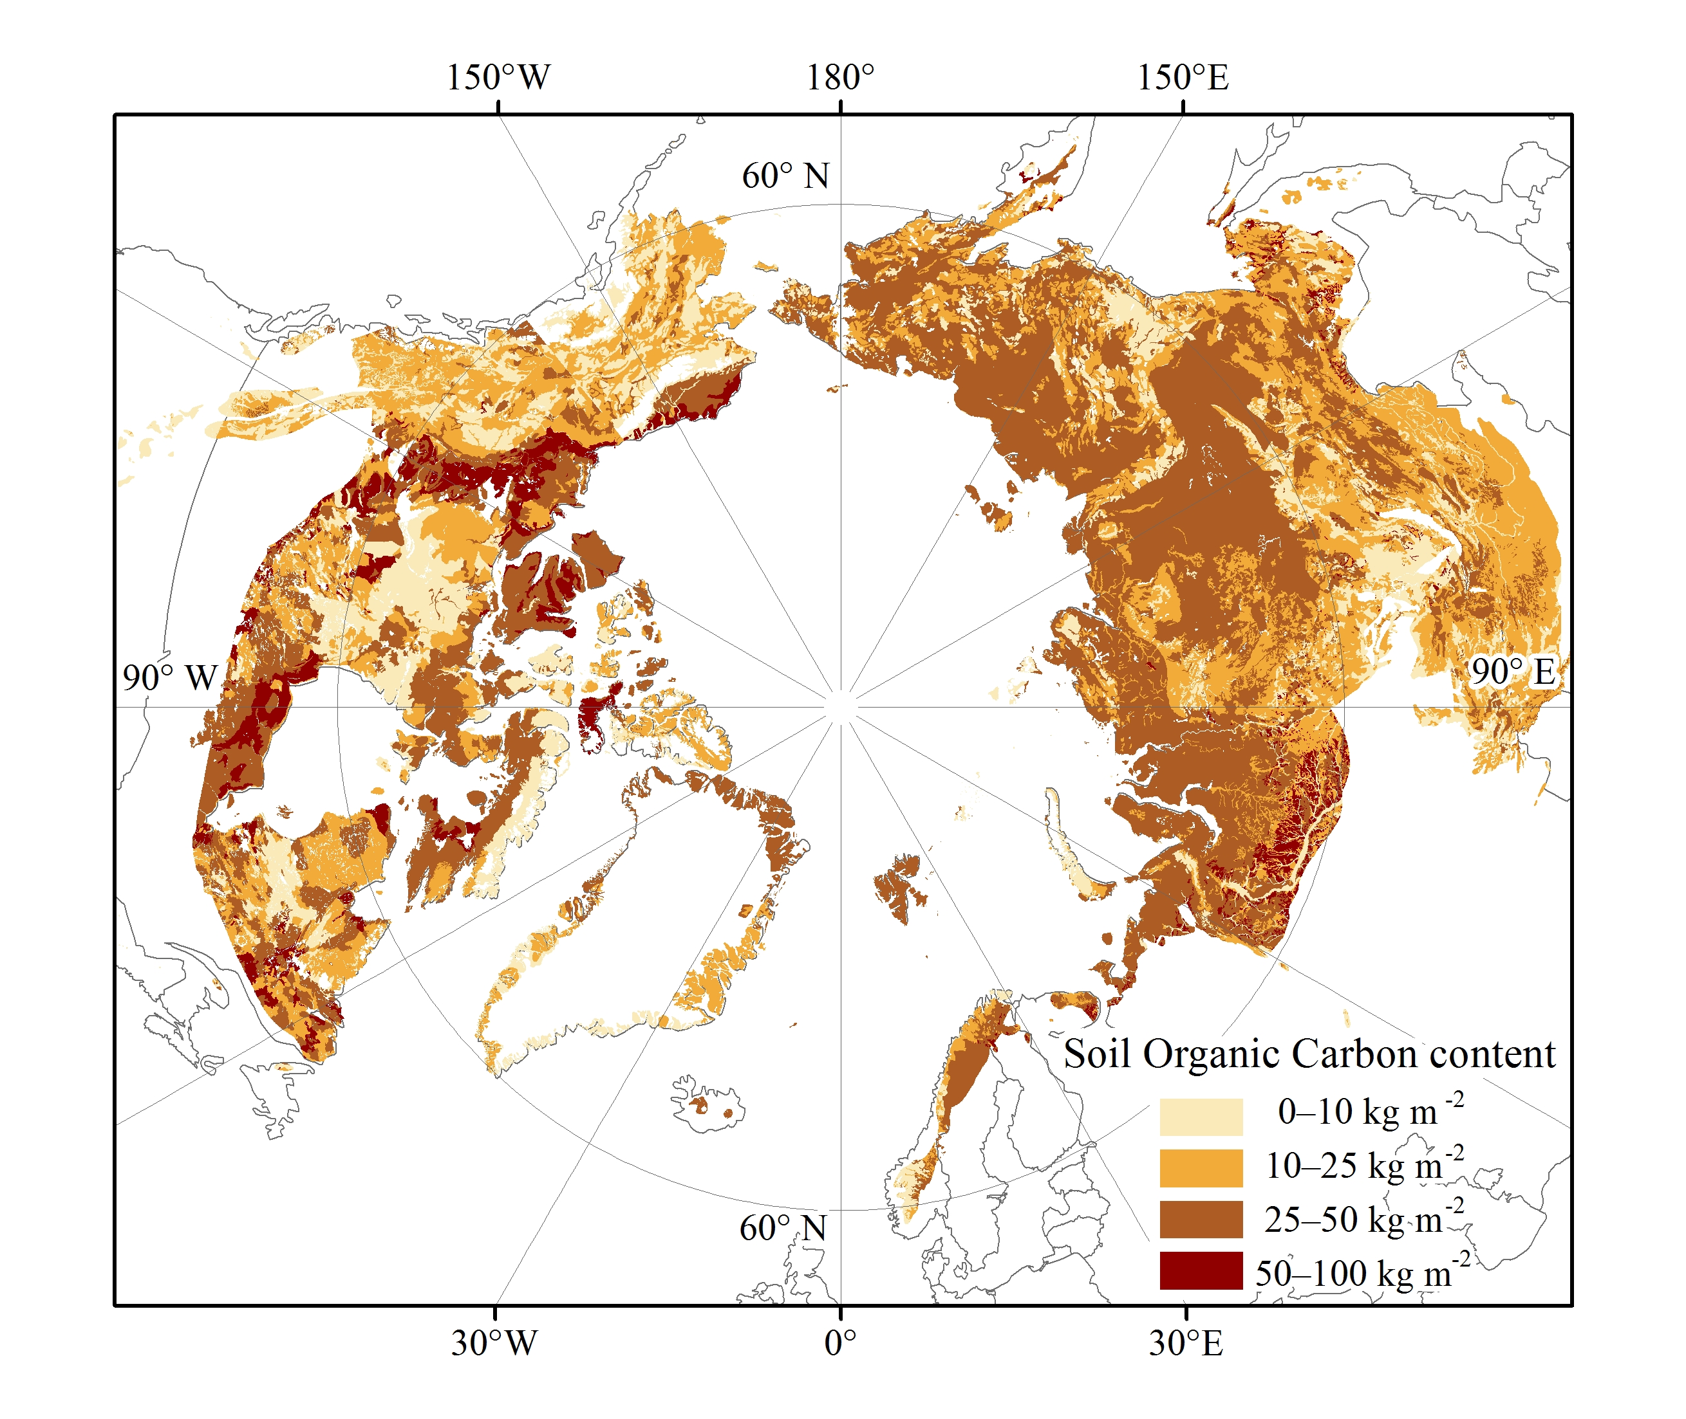
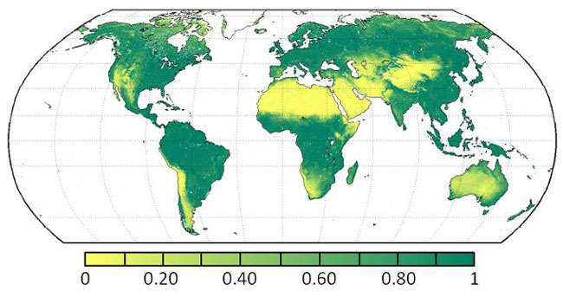
Spatial Data with Different “Shapes”

Slide 7
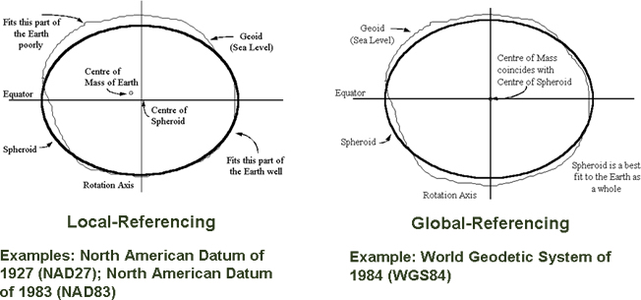
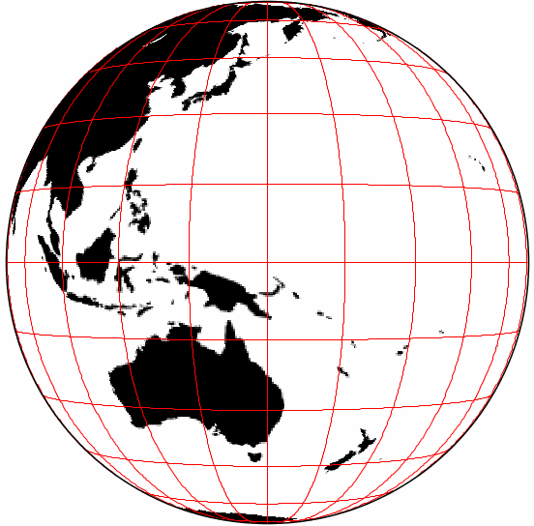
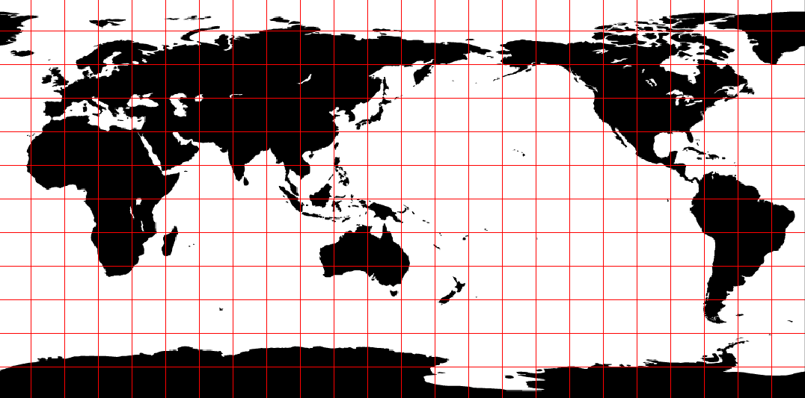
Spatial Reference System (SRS)
Datum: a system which allows the location of latitudes and longitudes (and heights) to be identified onto the surface of the Earth
  Sphere / Spheroid
Projection: define a way to flatten the Earth surface
SRID: code representing pre-defined popular SRS, e.g. EPSG:4326
  http://spatialreference.org

Slide 8
Spatial Example (1)
Where is an AmeriFlux site located?
  Valles Caldera Mixed Conifer / US-Vcm
  Latitude: 35.8884
  Longitude: -106.5321
  Elevation: 3003m
Precision: on the order of 10 meters
Datum: shape and center of the earth
  NAD83 (e.g. USGS NHD) or WGS84 (e.g. GPS)
  Do I care? Not if 1-2 meters difference doesn’t matter
  Vertical datum

Slide 9
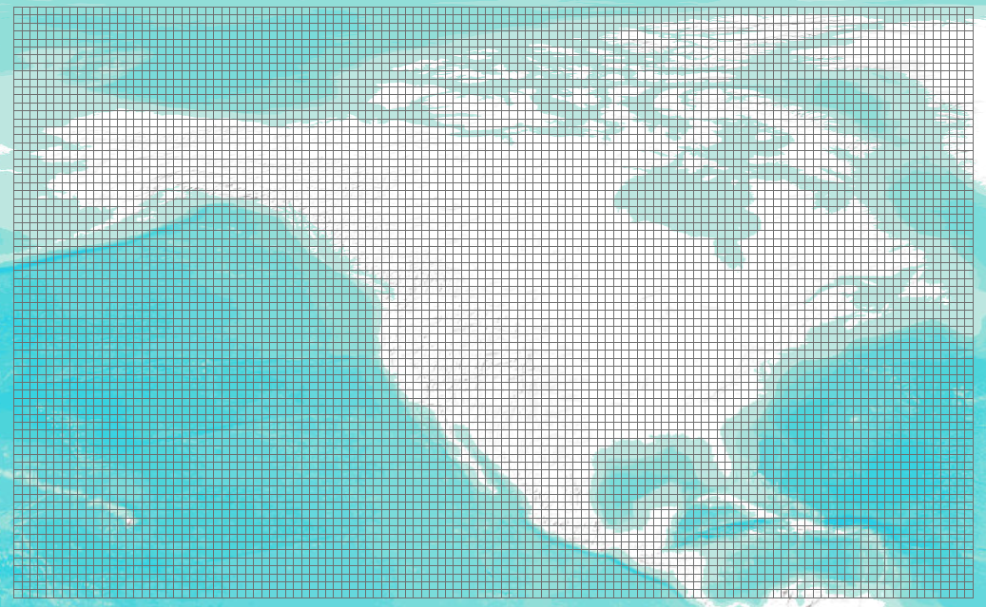
Spatial Example (2)
Where do my data represent?
  Regular gridded data: all grid cells have consistent size (e.g. NACP regional TBM output)
    Define your SRS
      Sphere-based GCS (radius of the earth: 6370997m)
    Provide X/Y spatial resolution: size of a grid cell
      X: 1-degree, Y: 1-degree
    Provide spatial extent: outer boundary of all cells
      West: -170, South: 10, East: -50, North: 84

Slide 10
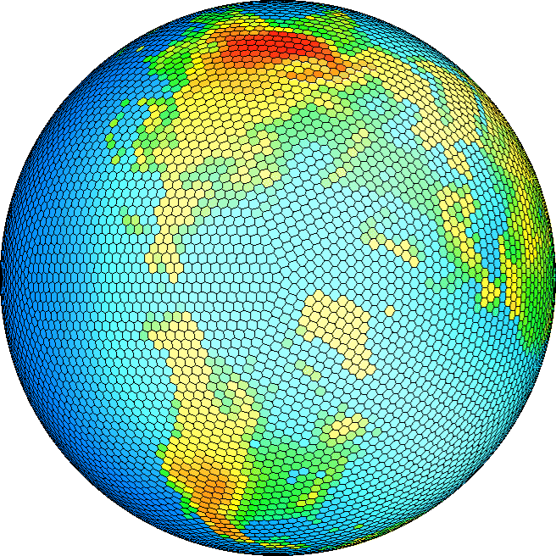
Spatial Example (2) Cont’d
Where do my data represent?
  Irregular gridded data (e.g. 10242 Spherical Geodesic Grid)
    Define your SRS
    Provide coordinates for each vertex of each polygon
    Provide coordinates for the center of each polygon

Slide 11
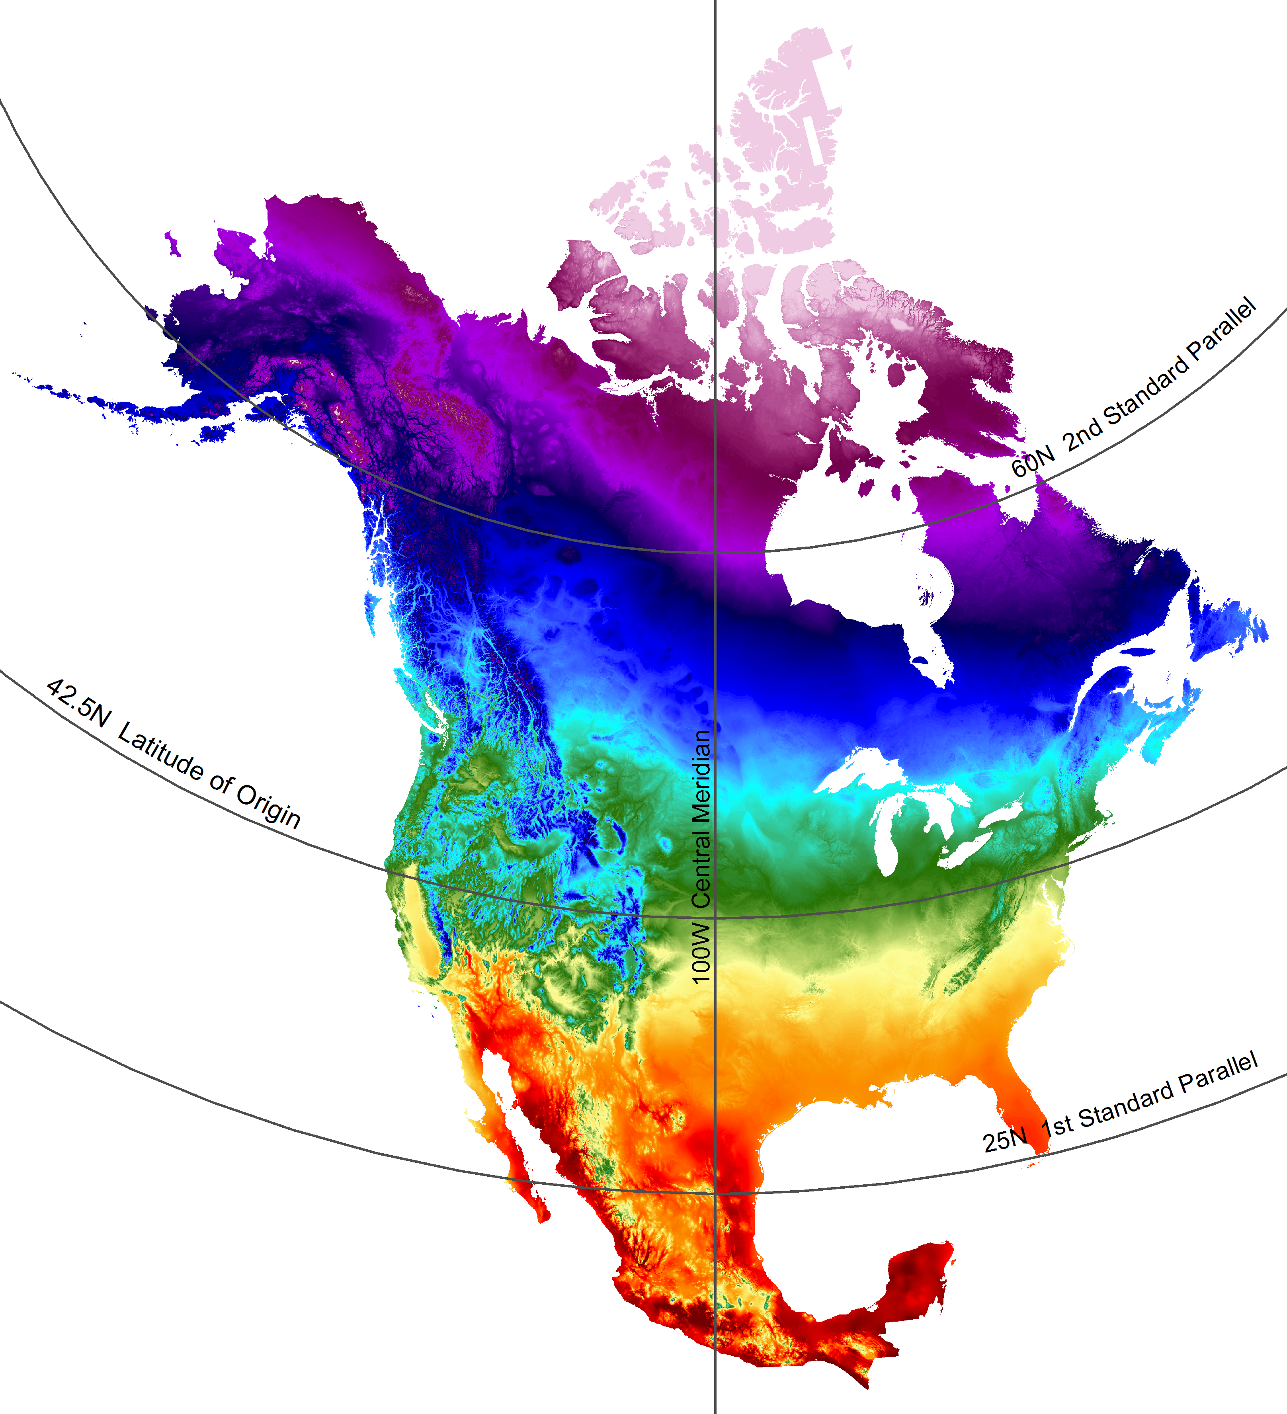
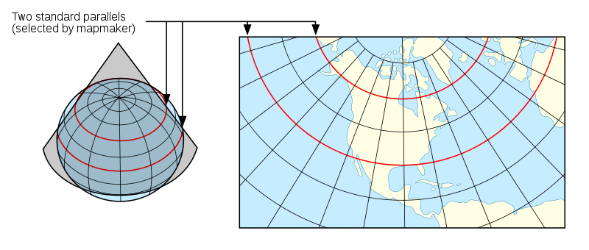
Spatial Example (3)
SRS for Daymet data
  1-km daily surface weather data over NA
  Projection: Lambert Conformal Conic
    projection units: meters
    datum (spheroid): WGS_84
    1st standard parallel: 25 deg N
    2nd standard parallel: 60 deg N
    Central meridian: -100 deg (W)
    Latitude of origin: 42.5 deg N
    false easting: 0
    false northing: 0
Source: wikimedia
Notes:
Key principles of this chart are:
Distance distortion is limited. As the cone 'sticks' closely to the sphere, distance is pretty uniform on the entire chart
Straight lines most closely represent an arc of a great circle.
Lines of latitude (horizontal), curves concave towards the poles
Lines of longitude (vertical), converge towards an imaginary point over the poles.

Slide 12
Temporal Information
Need to correctly and precisely specify:
Overall start and end temporal representation of a data variable
Time point/period that each data value represents
Temporal frequency of a data variable

Slide 13
Temporal Example (1)
Calendar
  julian: one leap year in every 4 years
  gregorian: leap year if either (i) it is divisible by 4 but not by 100 or (ii) it is divisible by 400
  proleptic_gregorian: gregorian calendar extended to dates before 1582-10-15
  365_day: no leap year, Feb. always has 28 days
  360_day: 30 days for each month
  366_day: all leap years
  gregorian is the internationally used civil calendar
  MsTMIP project chose proleptic_gregorian calendar

Slide 14
Temporal Example (2)
Specify the time a measurement was made
  “the measurement was made at 6 in the afternoon on March 22, 2010 and it took 1 hour 20 minutes and 30 seconds” - BAD
ISO 8601: representation of dates and times
  Time point: YYYY-MM-DDThh:mm:ss.sTZD
  (2010-03-22T18:00:00.00-06:00)
  Duration: P[n]Y[n]M[n]DT[n]H[n]M[n]S (PT1H20M30S)

Slide 15
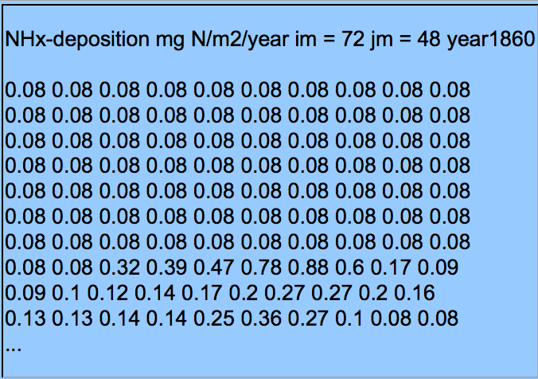
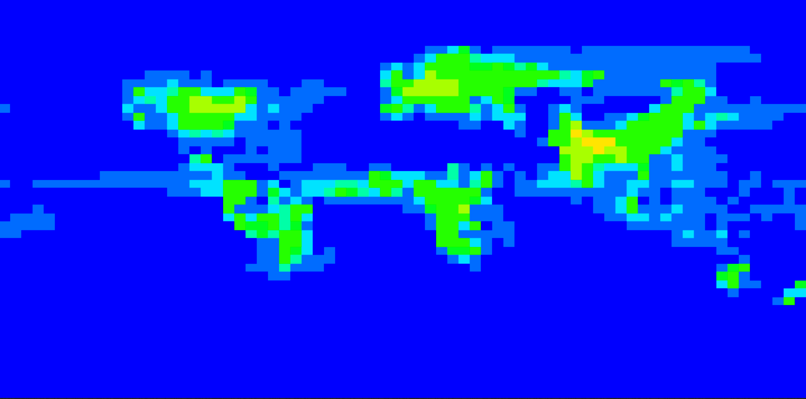
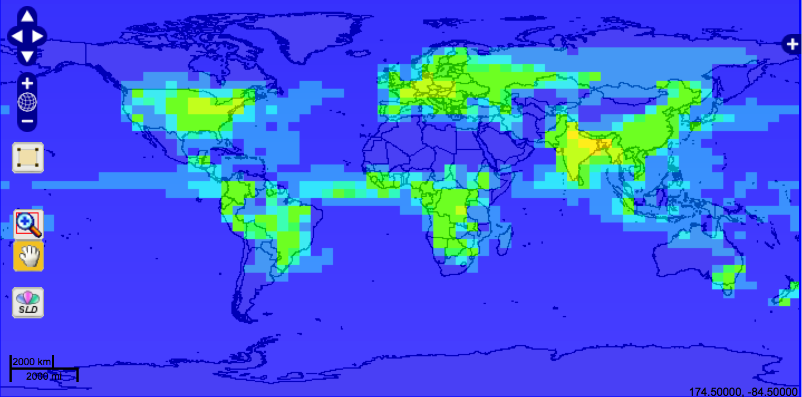
Bad Practice (1)
Global Maps Of Atmospheric Nitrogen Deposition, 1860, 1993, and 2050

Slide 16
Bad Practice (2)
Time in Daymet
  Time information was messed up in the alpha release of Daymet data
  Daymet has data for 365 days in every year, so we thought it used the “365_day” calendar
  No! It has leap years. It removed December 31st instead of Feb 29th in leap years. We reset its calendar to “gregorian”

Slide 17
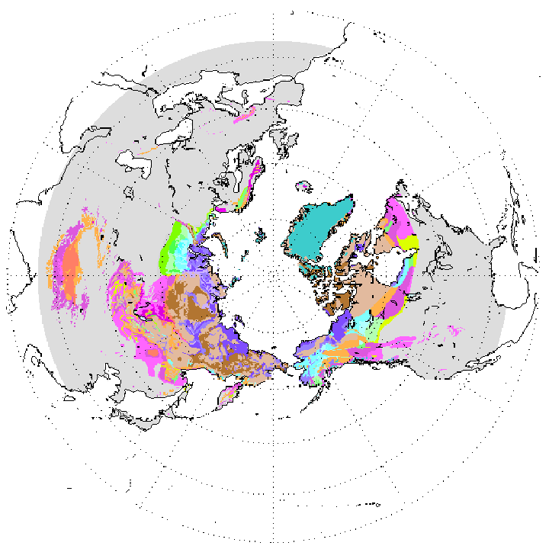
A Not-so-Good Practice
Circum-Arctic Map of Permafrost and Ground Ice Conditions
  It provides a 25km by 25km gridded map in BINARY format along with a header file and SRS definition in readme
Header:
nrows 721
ncols 721
nbits 8
byteorder I
ulxmap -9024309
ulymap 9024309
xdim 25067.525
ydim 25067.525
SRS Definition:
Projection: Lambert Azimuthal
Units: meters
Spheroid: defined
Major Axis: 6371228.00000
Minor Axis: 6371228.000
longitude of center of projection: 0
latitude of center of projection: 90
false easting (meters): 0.00000
false northing (meters): 0.00000

Slide 18
“Good” Data Formats
Open and non-proprietary
Easy to use, simple, and widely-supported
More importantly, self-descriptive
  Interpretative metadata is included inside data
Feature Data Formats
  Tabular
  Shapefile
  KML/GML
  ESRI Geodatabase
Coverage Data Formats
  GeoTIFF
  CF-netCDF
  HDF/HDF-EOS

Slide 19
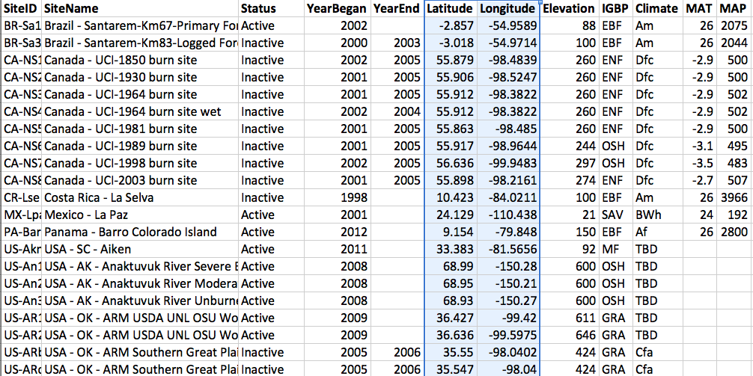
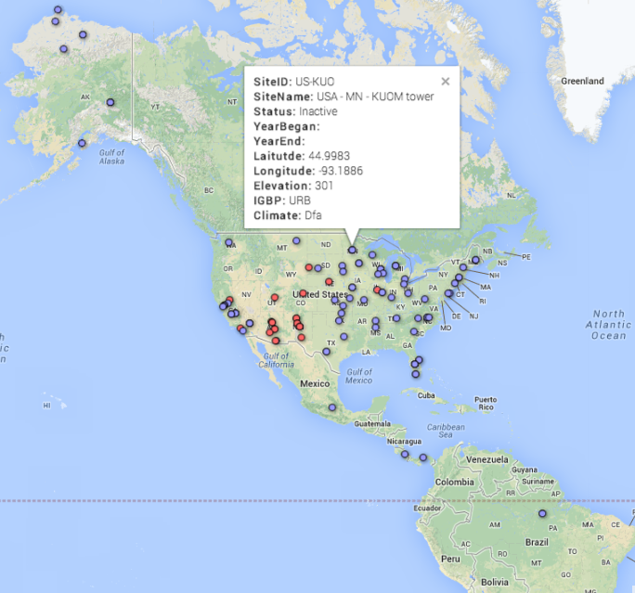

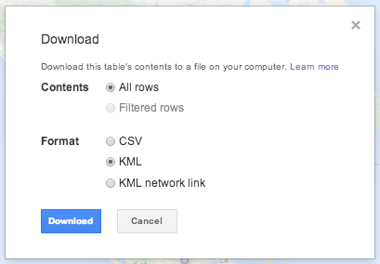

Tabular
Tabular data can be “spatial”
Good tabular spatial data can be easily understood, analyzed, and visualized
  Fusion Table

Slide 20
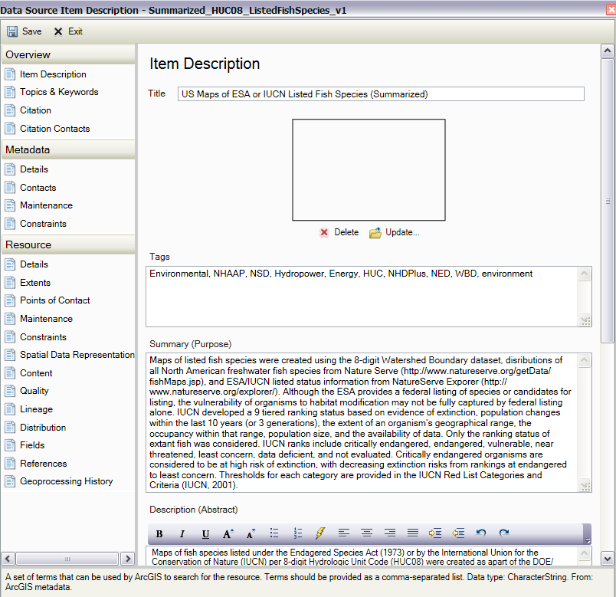
Shapefile
Ideal for feature data
  point, line, and polygon
SRS can be embedded inside files (*.prj)
Metadata can be embedded inside files (*.xml)

Slide 21
Standard Ways for Interpretative Metadata
Climate and Forecast (CF) Metadata Convention
  CF Standard Names
  CF Convention
    Spatial/temporal coordinates
    Cell boundaries/shape/methods
    Missing data/valid range
    Data units
    …..
    Many more, just google “cf metadata”

Slide 22
NetCDF + CF Convention
NetCDF + CF: perfect combination for climate change and earth system model data
  The NetCDF classic model provides a clean way to organize multi-dimensional data
  The NetCDF enhanced model is suitable for more complex data
  NetCDF v4 supports internal compression
  NetCDF is supported by many tools: Matlab, IDL, Ferret, Python, NCO, Panoply, …
  CF makes data analysis can be automated

Slide 23
Specify Spatial Info in NetCDF (1)
Define SRS
short lambert_conformal_conic;
:grid_mapping_name = "lambert_conformal_conic";
:longitude_of_central_meridian = -100.0; // double
:latitude_of_projection_origin = 42.5; // double
:false_easting = 0.0; // double
:false_northing = 0.0; // double
:standard_parallel = 25.0, 60.0; // double

Slide 24
Specify Spatial Info in NetCDF (2)
Provide cell center coordinates in Geographic Lat/Lon SRS and native SRS (if different)
double x(x=162);
:units = "m";
:long_name = "x coordinate of grid cell";
:standard_name = "projection_x_coordinate";
double y(y=227);
:units = "m";
:long_name = "y coordinate of grid cell";
:standard_name = "projection_y_coordinate”;
double lat(y=227, x=162);
:units = "degrees_north";
:long_name = "latitude coordinate";
:standard_name = "latitude";
double lon(y=227, x=162);
:units = "degrees_east";
:long_name = "longitude coordinate";
:standard_name = "longitude”;

Slide 25
Specify Spatial Info in NetCDF (3)
Specify cell boundaries
  Left-right boundary
  Bottom-top boundary
double lat_bnds(lat=360, nv=2);
:units = "degrees_north";
double lon_bnds(lon=720, nv=2);
:units = "degrees_east";
double lat(lat=360);
:bounds = "lat_bnds";
:units = "degrees_north";
double lon(lon=720);
:bounds = "lon_bnds";
:units = "degrees_east";

Slide 26
Specify Temporal Info in NetCDF
Specify calendar and time coordinate
Specify time step boundaries
2008 Daymet Daily Average Vapor Pressure
Calendar: gregorian
Time coordinate units: days since 1980-01-01T00:00:00Z
Time coordinate values: 10227.5, 10228.5, 10229.5, 10230.5, 10231.5, …, 10590.5, 10591.5 (Dec 30th noon)
Time step boundaries: 10227,10228; 10228,10229; …; 10590,10591; 10591,10592 (start,end of Dec 30th)

Slide 27
Cell Methods
To describe the characteristic of a variable that is represented by grid cell values
  NARR dswrf: 3-hourly average, average across a 32km by 32km region
  NARR precip: 3-hourly accumulated, average across a 32km by 32km region
cell_methods
  “time: mean area: mean”
  “time: sum area: mean”
point
Sum
maximum
median
mid_range
minimum
mean
mode
standard_deviation
variance

Slide 28
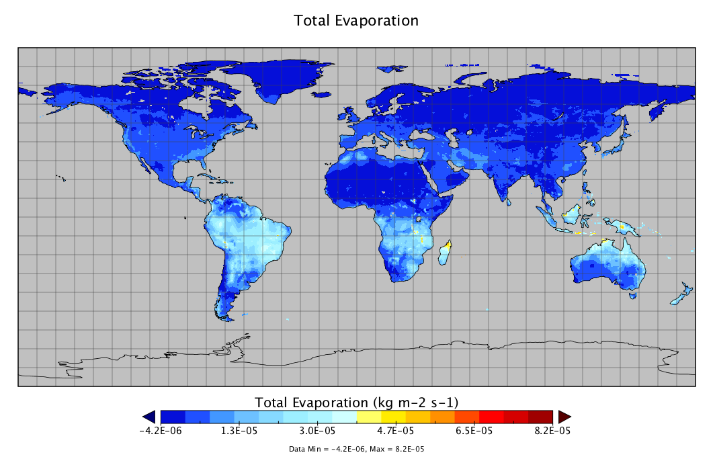
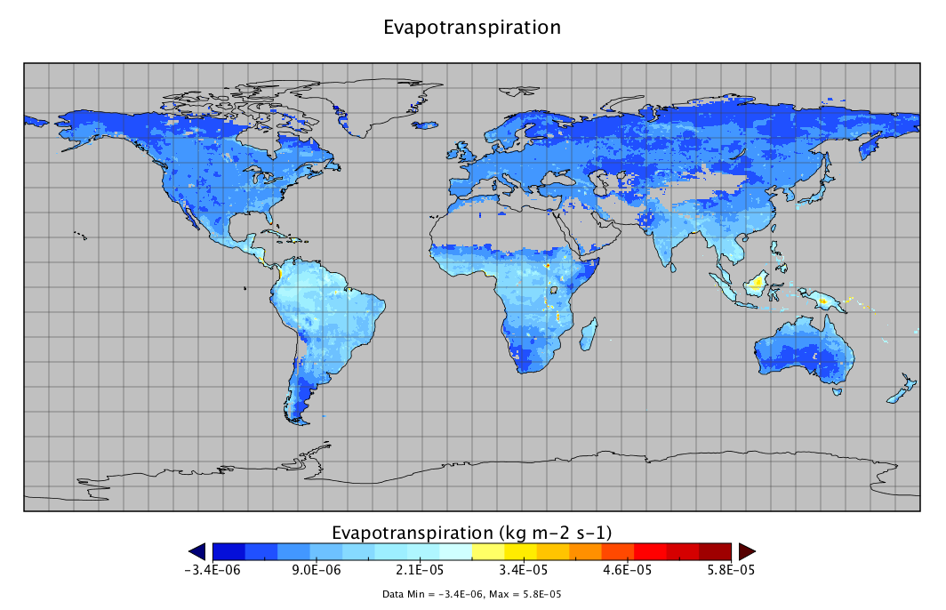

Missing Data
Use _FillValue, missing_value, valid_min, valid_max, and valid_range to indicate what values in a variable are considered to be valid or what values shall be ignored.
  float nbp(time=20, lat=74, lon=120);
  :_FillValue = -99999.0f; // float

Slide 29

Data Units
UDUNITS
  Based on International System of Units
  Support conversion of unit specifications
  Support arithmetic manipulation of units
  conversion of values between compatible scales of measurement
Follow the rules and computers can then do a lot of work for you and others.
Units for Gross Primary Productivity (GPP)
kg m-2 s-1
Kg/m2/month
kgC m-2 s-1

Slide 30
Exercise: A Real Data Archival Example
NDVI Growing Season Trends
  It’s a data product derived from 8-km bi-monthly GIMMS3g NDVI, whose growing season (JJA) was first averaged for each year.
  Data to be archived include:
    yearly growing season (JJA) mean NDVI in 1982-2012
    3 trend-related variables
      GIMMS3g GS-NDVI trends
      significance of the trend
      land cover data used in the study (to remove certain types of areas).

Slide 31
Exercise: Cont’d
What we received
  A GeoTIFF file with 3 bands: Band 1, Band 2, Band 3. All bands have data type of Float64.
  A netCDF file with:
    dimensions:
    longitude = 4320 ;
    latitude = 2160 ;
    value = UNLIMITED ; // (3 currently)
    variables:
    float variable(value, latitude, longitude) ;
    variable:long_name = "variable" ;
    variable:units = ;
  A GeoTIFF file with 31 bands: Band 1, …, Band 31
  All 3 files have global coverage

Slide 32
Exercise: Cont’d
What we recommend
  Throw away data below 20°N
  Choose the CF-netCDF v4 format with compression
  Create 2 files
    Yearly growing season (JJA) mean NDVI in 1982-2012
      time dimension: mid-point of each time step and boundary (start&end) of each time step
      cell_methods: “area: mean time: mean”
    Trend-related variables
      Create 3 variables instead of 1: “trends”, “significance”, “land_cover”
      Use different data type for each variable (e.g. Byte for “land_cover”)

Slide 33
Exercise: Cont’d
gimms3g_gs_mean_ndvi_1982_2012_yearly.nc
dimensions:
lon = 4320 ;
lat = 840 ;
time = UNLIMITED ; // (31 currently)
nv = 2 ;
variables:
double lon(lon) ;
lon:standard_name = "longitude" ;
lon:long_name = "longitude coordinate" ;
lon:units = "degrees_east" ;
double lat(lat) ;
lat:standard_name = "latitude" ;
lat:long_name = "latitude coordinate" ;
lat:units = "degrees_north" ;
double time(time) ;
time:standard_name = "time" ;
time:units = "months since 1982-01-01 00:00:00" ;
time:calendar = "standard" ;
time:bounds = "time_bnds" ;
double time_bnds(time, nv) ;
time:units = "months since 1982-01-01 00:00:00" ;
time:calendar = "standard" ;
double NDVI(time, lat, lon) ;
NDVI:standard_name = "normalized_difference_vegetation_index" ;
NDVI:long_name = “Mean Normalized Difference Vegetation Index in growing season (June, July, and August)" ;
NDVI:cell_methods = "area: mean time: mean" ;
NDVI:_FillValue = -9999. ;
NDVI:missing_value = -9999. ;
// global attributes:
:Conventions = "CF-1.6" ;
:title = "Mean Normalized Difference Vegetation Index in growing season (June, July, and August)" ;
:source = "GIMMGS3g algorithm" ;
:contact = "Name" ;
:institution = "Institution" ;
:email = "Email" ;
:references = "References" ;

Slide 34
Exercise (2): Cont’d
gimms3g_gs_ndvi_trends_analysis_8km_1982_2012.nc
dimensions:
lon = 4320 ;
lat = 840 ;
variables:
double lon(lon) ;
lon:standard_name = "longitude" ;
lon:long_name = "longitude coordinate" ;
lon:units = "degrees_east" ;
double lat(lat) ;
lat:standard_name = "latitude" ;
lat:long_name = "latitude coordinate" ;
lat:units = "degrees_north" ;
double trends(lat, lon) ;
NDVI:long_name = "Northern hemisphere growing season (June, July, and August) trends in 1982-2012" ;
NDVI:source = "Theil-Sen method" ;
NDVI:_FillValue = -9999. ;
NDVI:missing_value = -9999. ;
double significance(lat, lon) ;
NDVI:long_name = "Significance of northern hemisphere growing season (June, July, and August) trends in 1982-2012" ;
NDVI:source = "Mann-Kendall test" ;
NDVI:_FillValue = -9999. ;
NDVI:missing_value = -9999. ;
byte land_cover(lat, lon) ;
NDVI:long_name = "Global Land Cover 2000 map resampled to the GIMMS3g grid" ;
NDVI:valid_min = 0;
NDVI:valid_max = 16;
// global attributes:
:Conventions = "CF-1.6" ;
:title = "Northern hemisphere growing season (June, July, and August) trends, significance, and related variables in 1982-2012 " ;
:contact = "Name" ;
:institution = "Institution" ;
:email = "Email" ;
:references = "References" ;

Slide 35
Summary
Provide spatial and temporal information completely and accurately
Choose good formats to organize the data content and make them self-descriptive
Provide interpretative metadata in standard ways
You will be returned a lot by doing this
  Your data will be easily understood by not only users but also computers
  A lot of data visualization and analysis can be automated
  Your data can be ingested into many existing Web services to provide on-demand data distribution to users
  Value of your data can be preserved longer into the future

