Slide 1
Preparing Metadata
Suresh Vannan
ORNL Distributed Active Archive Center
Oak Ridge National Laboratory, Oak Ridge, TN
santhanavans@ornl.gov
Viv Hutchison
US Geological Survey
Core Science Analytics Synthesis & Libraries
Denver, CO
vhutchison@usgs.gov
CC&E Joint Science Workshop
College Park, MD
April 19, 2015

Slide 2
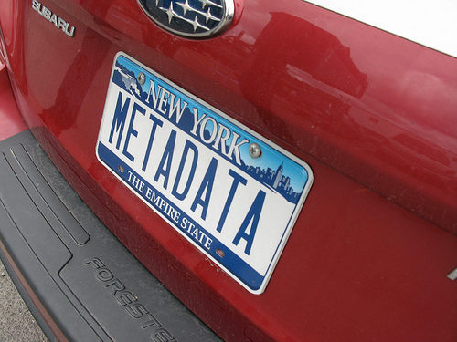
Topics
When to collect Metadata?
How to collect Metadata?
Metadata and Documentation
Metadata standards and how to choose one to use
Tips on how to write quality metadata records

Slide 3
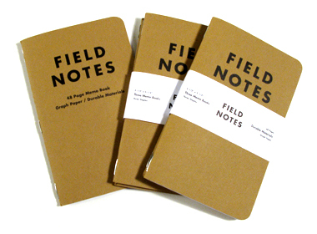
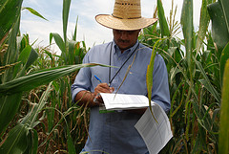
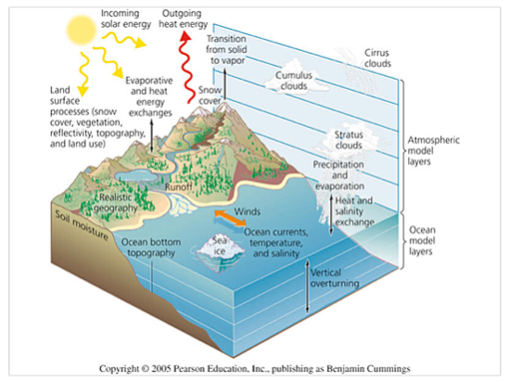
When to collect Metadata?
Field
Start Early
Create a structure for the data to be collected/stored
Establish tags and descriptions for each of the
Use metadata options within the software used for data collection
Model Output
Remote Sensing
Notes:
Data collection in the field is recorded in a wide variety of ways, including field notebooks, streaming data from satellites, data created from models, etc

Slide 4
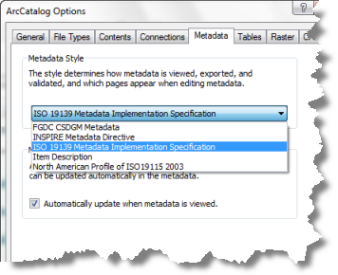
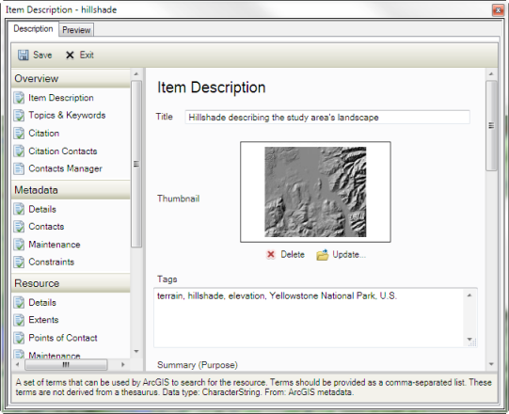
Collecting metadata
ArcGIS

Slide 5
Collecting metadata
Access Database
CSV file
http://www.w3.org/TR/2014/WD-tabular-metadata-20140710/

Slide 6
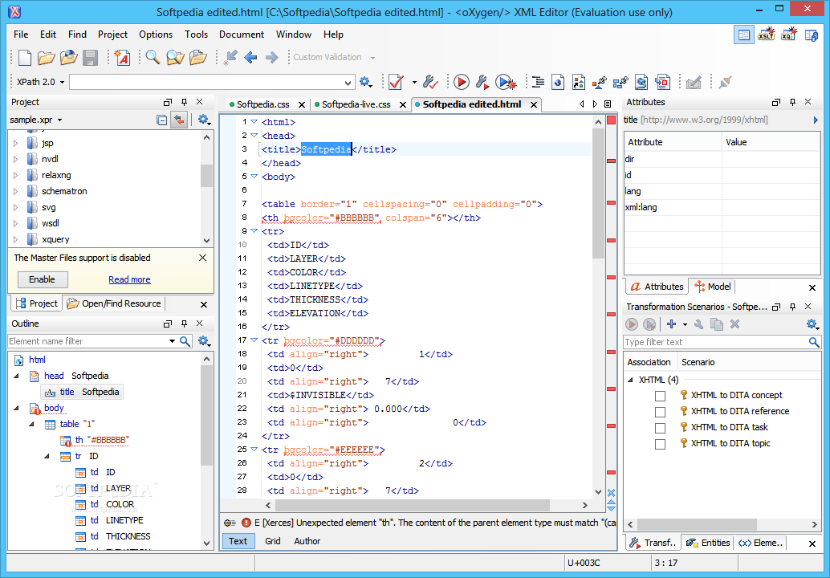
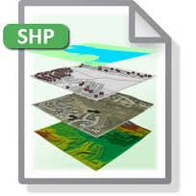
Collecting metadata
XML (Example Oxygen)
File Embedded

Slide 7
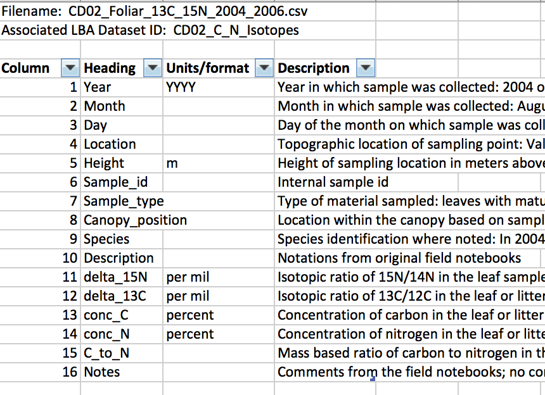
From Notes to Datasets
C and N Isotopes in Leaves and Atmospheric CO2, Brazil
Notes:
After returning from the field, scientists will transfer field notes into spreadsheets and other types of databases in preparation for their data analysis. Displayed here is a partial copy of a data set taken from the website “Frog Watch”. Notice there is no indication of Celsius or Fahrenheit in the “temperature” column. This is a simple example of how it is difficult to understand a dataset without all of the information.

Slide 8
Meta Elements
Discovery or Descriptive metadata
Resources:
https://www.fgdc.gov/metadata/iso-metadata-editor-review
http://resources.arcgis.com/en/help/main/10.1/index.html#//003t00000008000000
https://data.gulfresearchinitiative.org/metadata-editor-start
http://www.usgs.gov/datamanagement/describe/metadata.php

Slide 9
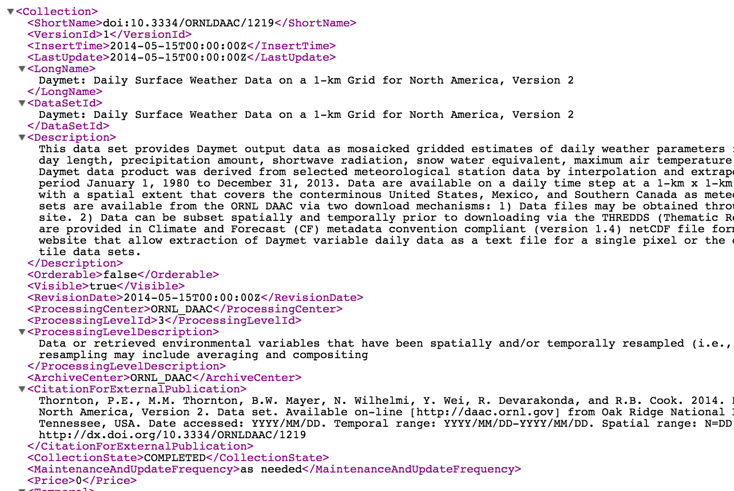
Metadata Example

Slide 10
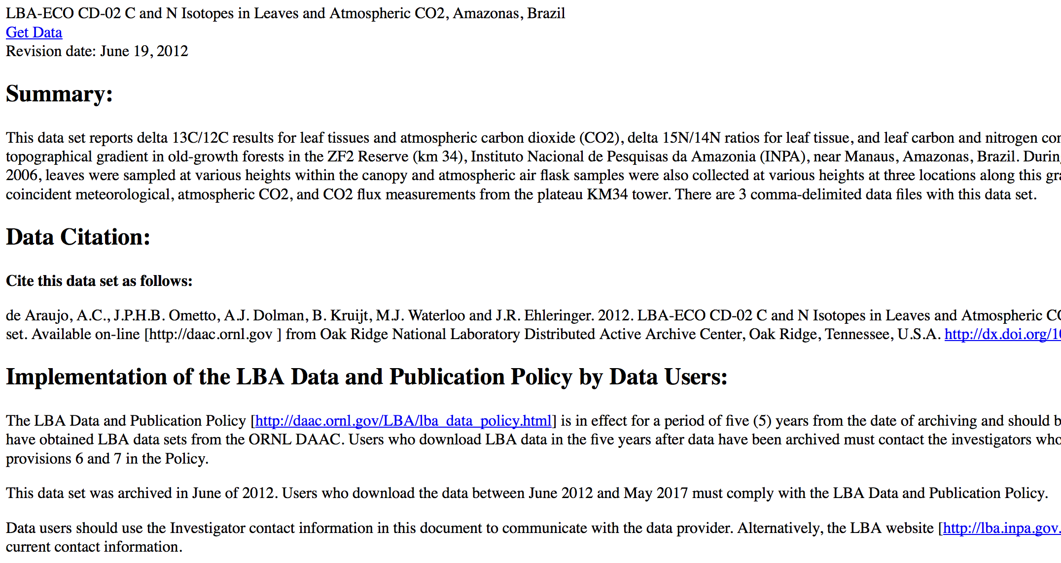
Documentation

Slide 11
Metadata and Documentation
Metadata | Documentation
Structured | Unstructured
Standards compatible | User defined
Machine readable | Human readable
Can supplement documentation | Cannot supplement metadata
XML based | text, doc, pdf
Granule based | Collection based
Can be automated | Manual

Slide 12
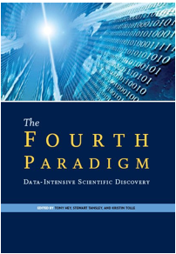
Why Care About Metadata?
Fourth Paradigm: scientific breakthroughs will increasingly be powered by advanced computing capabilities that help researchers manipulate and explore massive datasets.
“Metadata must be preserved when scientific data is generated…” -- Jim Gray, The Fourth Paradigm
Further the time/space distance between data producer and re-use, the more detailed metadata that is required.

Slide 13
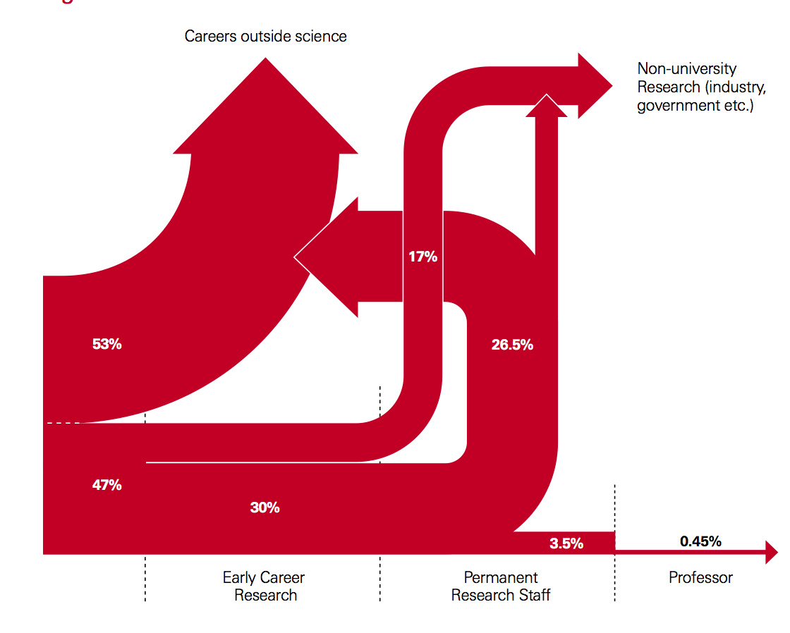
Metadata: Why Care?
Protect research investments
Notes:
https://royalsociety.org/~/media/Royal_Society_Content/policy/publications/2010/4294970126.pdf

Slide 14
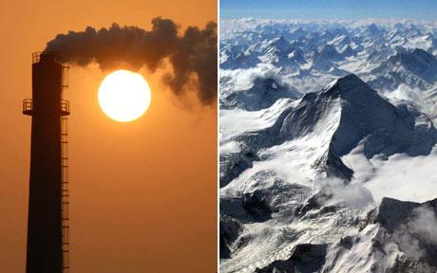
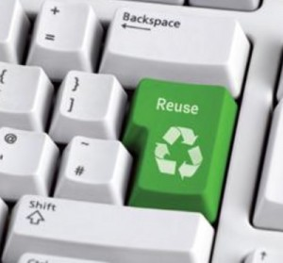
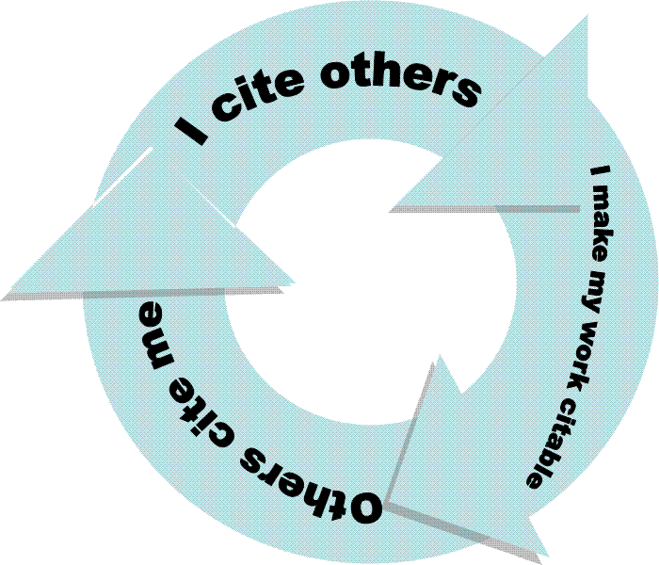
Metadata: Why Care?
Accountability
Reuse of data
Credit
Further Research

Slide 15
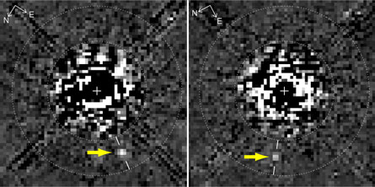
“Planet hidden in Hubble archives” Science News (Feb. 27, 2009)
Metadata: Why Care?
A new image processing technique reveals something not before seen in this Hubble Space Telescope image taken 11 years ago: A faint planet (arrows), the outermost of three discovered with ground-based telescopes last year around the young star HR 8799.D. Lafrenière et al., Astrophysical Journal Letters
“The first thing it tells you is how valuable maintaining long-term archives can be. Here is a major discovery that’s been lurking in the data for about 10 years!” comments Matt Mountain, director of the Space Telescope Science Institute in Baltimore, which operates Hubble.
…Metadata is critical in maintaining data in archives – for understanding data you discover

Slide 16
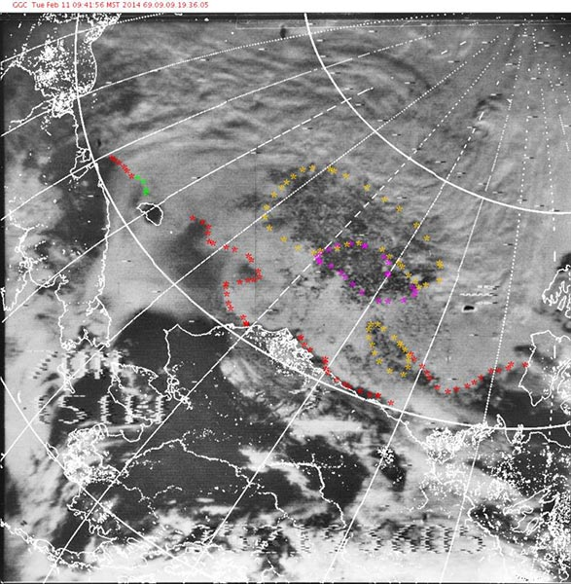
Metadata: Why Care?
Using satellite data from the Nimbus Data Rescue Project, NSIDC scientists have estimated the location of the North and South Pole sea ice edges at various times during the late 1960s.
The researchers manually inspected thousands of recently recovered AVCS and IDCS images from 1964, 1966, and 1969-70 and placed points along visible ice edges to help delineate North and South Pole sea ice extent.
http://nsidc.org/data/nimbus/news.html

Slide 17
What is the Value to Data Users?
Metadata gives a user the ability to:
Search, retrieve, and evaluate data set information from both inside and outside an organization
Find data: Determine what data exists for a geographic location and/or topic
Determine applicability: Decide if a data set meets a particular need
Discover how to acquire the dataset you identified; process and use the dataset
Notes:
Metadata allows the user to search for and access data from a variety of sources. A search for metadata can be constricted to a geographic boundary, thus showing the user what data has been collected in a particular region. Metadata records help users determine whether the data will be applicable for use in a particular study. Finally, metadata records are of value to data users, because they determine how a dataset can be acquired, and if there are any restrictions on how the data can be used.

Slide 18
What is the Value to Organizations?
Metadata helps ensure an organization’s investment in data:
Documentation of data processing steps, quality control, definitions, data uses, and restrictions
Ability to use data after initial intended purpose
Transcends people and time:
Offers data permanence
Creates institutional memory
Advertises an organization’s research:
Creates possible new partnerships and collaborations through data sharing
Notes:
An organization that keeps current metadata can benefit in many ways. Metadata records help ensure the organization’s investment in the data by retaining information about how the data was collected, processed, and quality controlled. This creates a permanent record of the dataset –which is critical institutional memory. When researchers leave or retire, metadata allows the dataset to “live on” for the organization. The data may be reused in another research project in the future, and future researchers in the organization will need to know how the dataset was created. Finally, metadata advertises an organization’s research, creating new potential partnerships and collaboration thru data sharing.

Slide 19
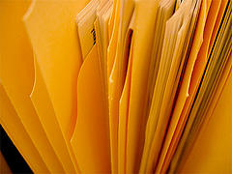
Still…There are Occasional Concerns About Creating Metadata
Even if the value of data documentation is recognized, concerns remain as to the effort required to create metadata that effectively describe the data.
CC image by waterlilysage on Flickr
Notes:
Even if the value of data documentation is recognized, concerns remain as to the effort required to create metadata that effectively describes the data.

Slide 20
Let’s Address these Concerns…
Concern | Solution
workload required to capture accurate robust metadata | incorporate metadata creation into data development process – distribute the effort
time and resources to create, manage, and maintain metadata | include in grant budget and schedule
readability / usability of metadata | use a standardized metadata format
discipline specific information and ontologies | use ‘profile’ standard to require specific information and use specific values
Notes:
Metadata does require time and effort to create. The workload, however, is reduced when metadata creation is incorporated into the data development process and the effort is distributed among data contributors. Metadata creation and management should be treated as a standard data development procedure and resources for staff and time should be included in project and proposal work plans and budgets. The use of a standardized metadata format and the development of discipline specific ‘profiles’ of metadata can enable data users to quickly find needed information and address data developer concerns about metadata use and comprehension.

Slide 21
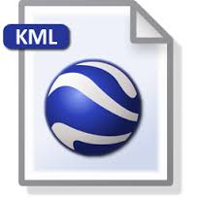
Choosing a Metadata Standard
Many standards collect similar information…factors to consider:
Type | Standard
GIS data? Raster/vector or point data | FGDC Content Standard
Data retrieved from instruments such as monitoring stations or satellites | ISO 19115
Ecological data | Ecological Markup Language

Slide 22
Choosing a Metadata Standard
Organizational Requirements (Example NASA Measures => ECHO/ISO 19115)
Functional Need (Search versus descriptive metadata)
How detailed are the contents (ISO 19115 has quality and provenance specifications too)
Ease of use

Slide 23
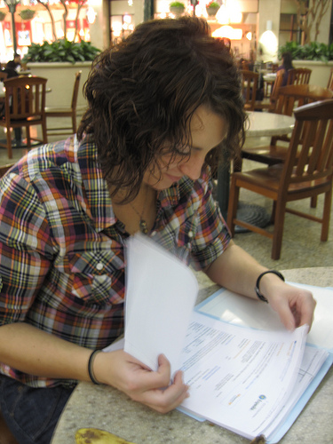
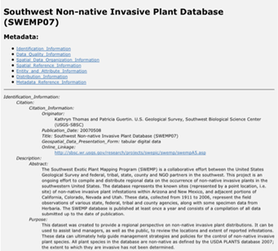
Steps to Create Quality Metadata
Review for accuracy and completeness
Have someone else read your record
Revise the record, based on comments from your reviewer
Review once more before you publish
CC image by Shelly Munkberg on Flickr
CC image by mujalifah on
Flickr
Notes:
Steps in creating quality metadata includes the following:
Organize your information. Before you begin gather your resources, particularly anything you may have already written about the dataset for another purpose. For example, a grant proposal that has a well-written abstract and purpose for the research is a great resource.
Write your metadata.
Review the record for accuracy and completeness.
Ask someone else read your record.
Revise your information based on comments from your reviewer, then review it once more before you publish it.

Slide 24
Tips for Writing Quality Metadata
Do not use jargon -- define technical terms
and acronyms:
CA, LA, GPS, GIS : what do these mean?
Clearly state data limitations
E.g., data set omissions, completeness of data
Express considerations for appropriate re-use of the data
Use “none” or “unknown” meaningfully
None usually means that you knew about data and nothing existed (e.g., a “0” cubic feet per second discharge value)
Unknown means that you don’t know whether that data existed or not (e.g., a null value)
Notes:
Think about the long-term effects of writing good metadata.
Avoid using jargon and take the time to define all technical terms and acronyms.
Clearly state data limitations – this may include any omissions to the data, or how complete the dataset is based on the data collection parameters.
Define the use of none or unknown: None usually means that you knew about data but nothing existed. Unknown means you don’t know whether that data existed or not.

Slide 25
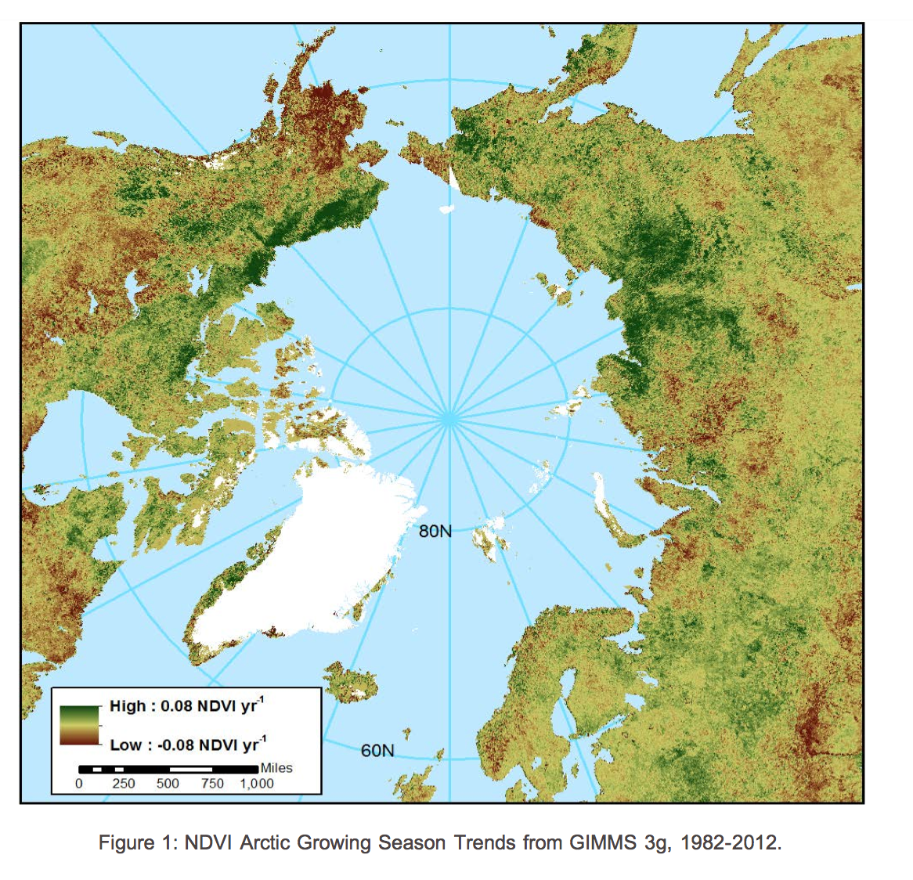
Tips for Writing Quality Metadata
A Clear Choice: Which title is better?
NDVI Trends
OR
Long-Term Arctic Growing Season NDVI Trends from GIMMS 3g, 1982- 2012
Arctic (where)
NDVI(what)
GIMMS 3g(How)
1982- 2012 (when)
Notes:
This example illustrates the importance of descriptive titles in metadata records.
The title “Greater Yellowstone Rivers from 1:126,720 Forest Visitor Maps (1961-1983)”, gives enough detail for a reader to discern whether they might like more information about your data from your metadata record.

Slide 26
Tips for Writing Quality Metadata
Remember: a computer will read your metadata
Do not use symbols that could be misinterpreted: Examples: ! @ # % { } | / \ < > ~
Do not use tabs, indents, or line feeds/carriage returns
When copying and pasting from other sources, use a text editor (e.g., Notepad) to eliminate hidden characters
Notes:
When creating your metadata, keep in mind that a computer will read your metadata record. Therefore, it is important not to use tabs, indents, and special characters because they can be misunderstood by a computer.
If you are copying and pasting content from other sources into your metadata record it is prudent to use a text editor as a middle step to prevent applications from adding in unnecessary characters in the background of your text.

Slide 27
Summary
Metadata is documentation of data
A metadata record captures critical information about the content of a dataset
Metadata allows data to be discovered, accessed, and re-used
A metadata standard provides structure and consistency to data documentation
Standards and tools vary – select according to defined criteria such as data type, organizational guidance, and available resources
Metadata is of critical importance to data developers, data users, and organizations
Writing quality metadata is important because records are expected to last with the data over decades
Metadata completes a dataset.
Creating robust metadata is in your OWN best interest!
Notes:
Metadata is documentation of data
A metadata record captures critical information about the content of a dataset
Metadata allows data to be discovered, accessed, and re-used
A metadata standard provides structure and consistency to data documentation
Standards and tools vary – select according to defined criteria such as data type, organizational guidance, and available resources
Metadata is of critical importance to data developers, data users, and organizations
Writing quality metadata is important because records are expected to last with the data over decades
Metadata completes a dataset.

